Slide 1
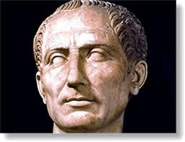
Who is this roman leader?
Julius Caesar

Slide 2
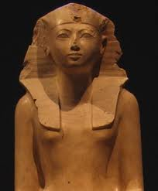
Who is This Pharaoh?
Hatshepsut

Slide 3
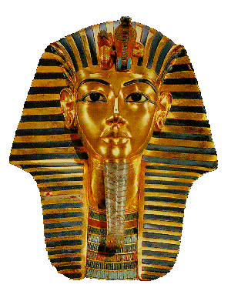
Who is this Pharaoh?
King Tut

Slide 4
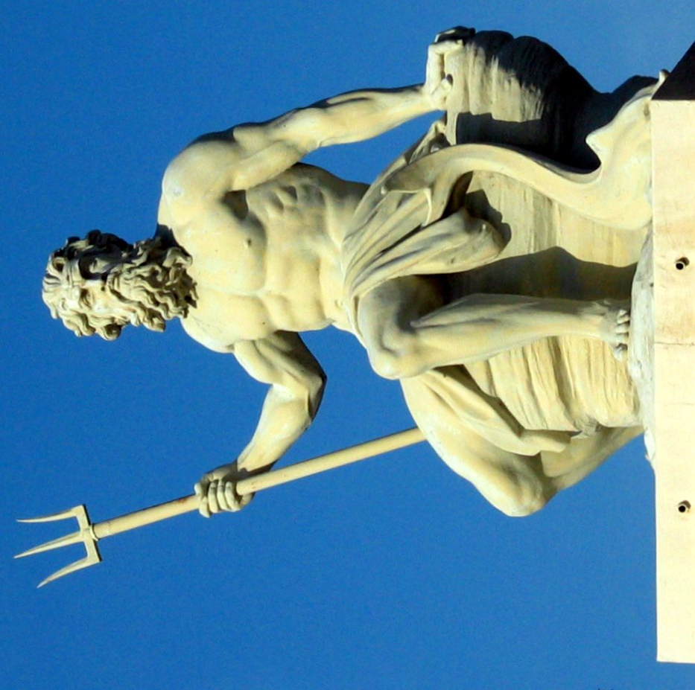
Who is This Ancient God?
Poseidon

Slide 5
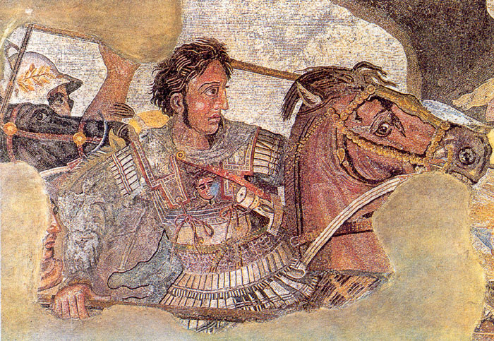
Who is This Greek leader?
Alexander the Great

Slide 6
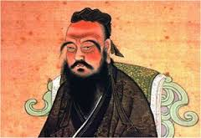
Who is This early thinker?
Confucius

Slide 7
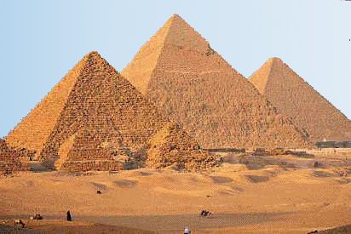
What is this? Where is it from?
Pyramids, Egypt

Slide 8
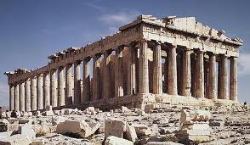
Where is this?
Athens, Greece

Slide 9
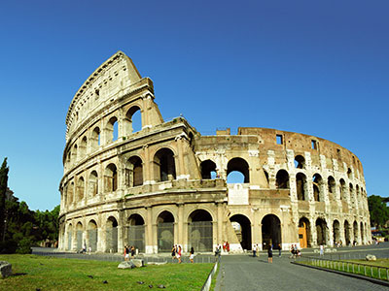
What is this? Where is it from?
Coliseum, Rome

Slide 10
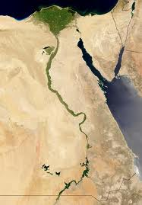
What civilization is this? What is the river?
Egypt, The Nile

Slide 11
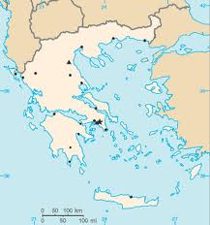
What Ancient civilization is this?
Greece

Slide 12
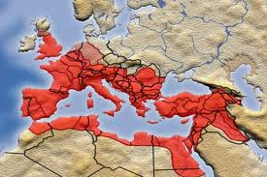
What Ancient civilization is this?
Rome

