Slide 1
China in a Nutshell
© Student Handouts, Inc.

Slide 2
Geography of China
Protected by high mountains, deserts, and wide oceans

Slide 3
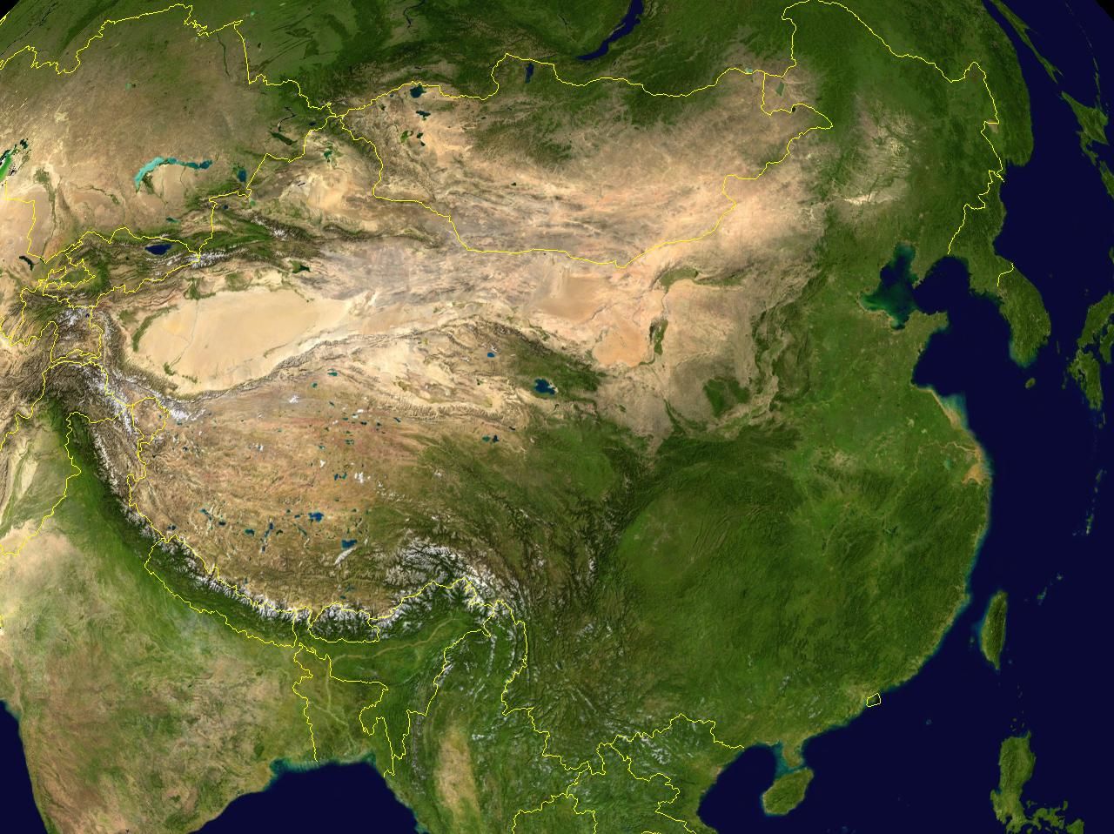

Slide 4
Geography of China
Two important rivers
Huang he (Yellow River)
Chang (Yangtze River)
Flooding of the Yellow River causes fresh soil to be deposited in fields- known as loess
Flooding is not very predictable

Slide 5
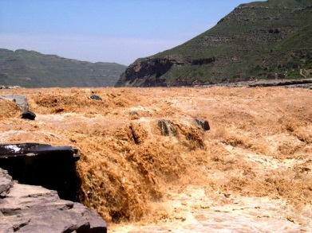
Huang He (Yellow) River

Slide 6
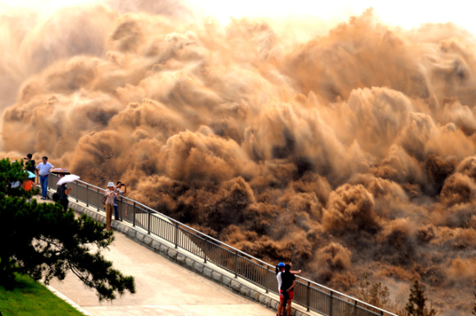
Huang He (Yellow) River

Slide 7
Dynastic Cycle
MANDATE OF HEAVEN –
Belief that the emperor was chosen by heaven to rule
DYNASTIC CYCLE
Emperor comes to power and gains the Mandate of Heaven.
Upward rise (wealth and population increase) to peak.
Downward spiral (natural disasters, corruption, etc.).
Emperor loses the Mandate of Heaven.
Civil war until a new emperor, with the Mandate of Heaven, comes to power.
.

Slide 8
Shang Dynasty
Neolithic farming has developed in Yellow River valley
Capital city (Shang) destroyed by invaders, new capital built (Anyang)
Writing developed

Slide 9
Zhou Dynasty
Loose central government
Feudal power held by strong nobles
Time of prosperity and inventions

Slide 10
Warring States period
No central leader, many different families fighting for control of each other
Confucius and Lao Tzu introduce new philosophies

Slide 11
Qin Dynasty
Emperor Shihuangdi
Conquers neighboring states
Harsh rule
Great Wall (1500 miles)

Slide 12
Han Dynasty
Peasant rebellion overthrows Shihuangdi’s young son
Adopt Qin practices, but less harsh on people
Civil service system

