Slide 1
A Day in the Life of an Ancient Egyptian

Slide 2
Homes
The ancient Egyptians built homes of sun-dried bricks, made of mud and straw.
To make the bricks, the ancient Egyptians invented brick molds. A mix of mud and straw was placed into the molds. Then, the molds were left out in the sun to dry. The desert heat dried the bricks for them. They could make a huge number of bricks easily.
Their homes were huge. Homes had flat roofs. People often sat outside on their roofs in the evening to watch the sunset and catch the evening breeze.

Slide 3
Noble’s Homes
Nobles lived in huge villas along the Nile. Some were front with white limestone, which made the walls sparkle. A few homes were even built with stone. But stone was difficult to cut and use. Most homes were made of sun dried brick.
Each villa had 25-30 rooms. Most rooms had a purpose. They had family rooms, guest rooms, storage rooms, kids rooms, and even bathrooms!
Homes had front and back doors. Each door was built about 4 feet off the ground to reduce the amount of sand and dust. Each door was reached by a ramp. Rather than stairs, ramps led from one level to another inside the house.

Slide 4
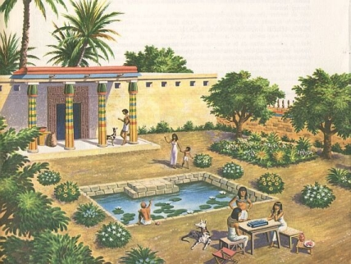

Slide 5
Peasant’s Homes
A peasant's home was tiny by comparison. Still, it was very nice. Each peasant family had their own home. When you opened the door, you entered a courtyard. Inside the courtyard, a ramp led up to the front door of the house. Some homes had two stories, some had three or more. Ramps were used to move from level to level. One ramp led up to the flat roof. People often slept on their roofs. It was cooler, and quite lovely sleeping under the stars.
Some peasants homes were huge, especially in the country. Nobody cared how big you built your home as long as you did it yourself in your own spare time. Since bricks were easy to make, and materials needed to make the bricks were freely found along the shores of the Nile, it was really up to each individual how big of a home they wished to have, especially in the country, where people had more room to build.

Slide 6
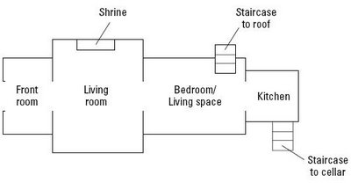
Floor Plan

Slide 7
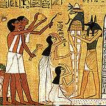
Clothing
Men wore tunics that reached their knees, while women wore tunics that went down to their feet. They were made of white linen, which is a scratchy fabric.

Slide 8
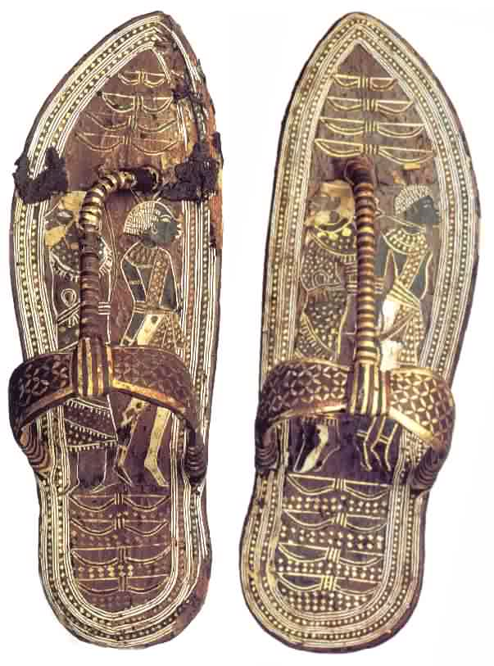
Shoes
They often went barefoot, but sometimes they wore straw or leather sandals.

Slide 9
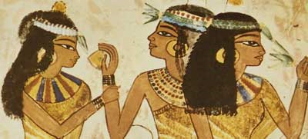
Makeup and Jewelry
Both men and women wore blue and green eye shadow and black kohl eyeliner, when they were dressed up fancy. People also wore kohl around their eyes because it helped to keep the glare of sunlight down (which is why football players do the same thing today)!
Both men and women wore gold jewelry if they could afford to.

Slide 10
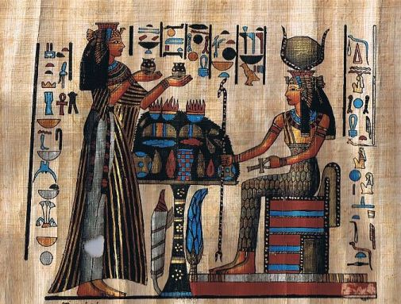
Perfume
Only women wore scented fat on their head like perfume. …YIKES!!

Slide 11
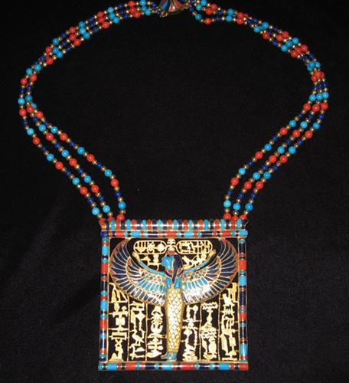
VOCAB WORD
Pectoral- a necklace that covers the chest- made from gold and jewels.

Slide 12
Entertainment in Egypt
See posted pages on song and dance, toys and games, food and drink.

Slide 13
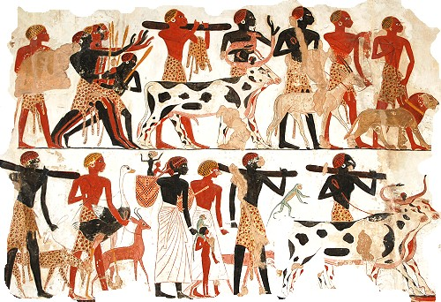
Employment in Egypt
Men could have many job choices in Ancient Egypt. They could be Scribes, Priests, Engineers and Architects, Builders and Artists, Soldiers, Farmers, Fishermen, and many others.

Slide 14
Female Jobs
Females were also able to do many jobs in Ancient Egypt. Some examples are: Hairdresser, Grinding Girl, Supervisor of the Cloth, Supervisor of the Wig Workshop, Treasurer, Steward, Composer, Songstress, Weaver, Dancer, Musician, Mourner, and Priestess.
In pictures, females were often portrayed as having light skin because they supposedly spent so much time indoors. In real life, they worked outside just as much as men.

Slide 15
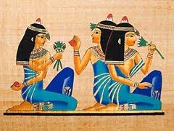

Slide 16
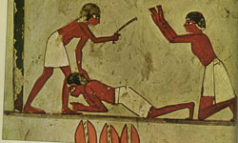
Slaves
Even though slaves were treated pretty awfully in Ancient Egypt, they were taken better care of there than in many other countries at the time.
Slaves had a wide range of jobs in the Egyptian society. Some would be low life laborers and others would be government administrators.

Slide 17
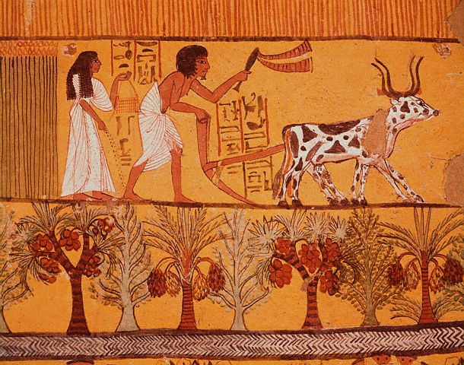
Vocab Word
Fresco- a painting that covers an entire wall.

Slide 18
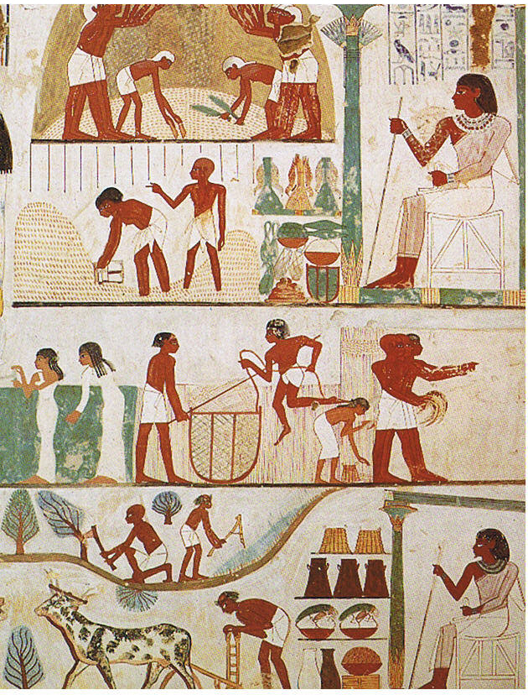
How They Painted
The size of the people in Egyptian art showed their importance: the pharaoh appeared bigger than the official, the master of the tomb
bigger than his servants.

Slide 19
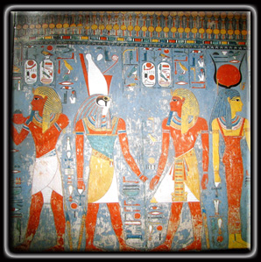
The men were painted with reddish-brown bodies, the females had light-colored or yellow bodies.

Slide 20
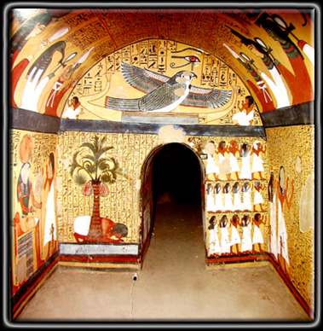
Temple Art
The temple paintings explained the ceremonies that took place there.

