Slide 1
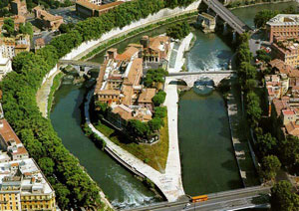
Daily Life in Rome
Rome is located at the first place that people can easily cross the Tiber river, so it is the natural location of the main north-south road in Italy. The reason you can cross the Tiber at Rome is that there is an island in the river there.

Slide 2
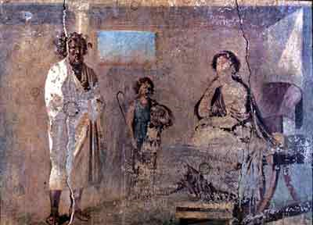
Schools
Most Roman kids did not go to school. Like their parents, they worked in the fields hoeing and weeding and plowing as soon as they were old enough.
Some rich boys, especially
if they lived in cities, did go
to school. Girls mostly did not
go to school.
A Roman
teacher
home-schooling.

Slide 3
The School Room
Roman schools were small, with only one room, and one teacher. The same teacher taught boys of different ages, from about seven to eleven or twelve.
The boys' parents paid the teacher, the way your parents pay for music lessons or karate lessons today.

Slide 4
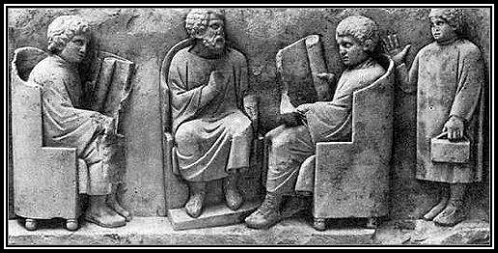
Nobody had a desk. The teacher taught the boys how to read and write, and also how to count and calculate some numbers. Books hadn't been invented yet, and nobody in Europe knew how to make paper, so the boys read from papyrus scrolls.

Slide 5
High School
Only the richest and smartest Roman kids went on from elementary school to high school. Most towns didn't have a high school, so in order to go to high school you had to leave home and go live in a big city, without your family.
The most important subject in high school was rhetoric (REH-torr-ick), or speech-making.

Slide 6
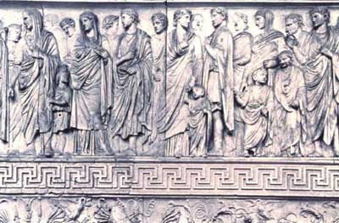
Clothing
They wore a large piece of wool, wrapped around themselves. After they met people from Greece and Egypt, around 200 BC, they began to wear linen tunics (like T-shirts) under their wool robes, which was more comfortable.

Slide 7
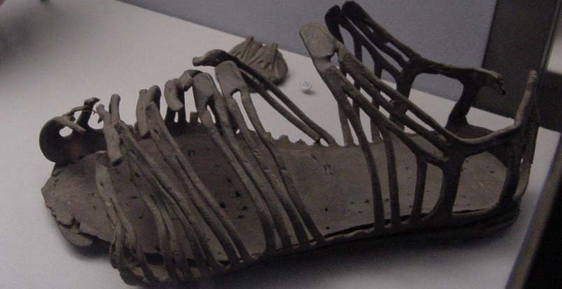
Shoes
On their feet, both men and women wore leather sandals, or leather boots in cold weather.

Slide 8
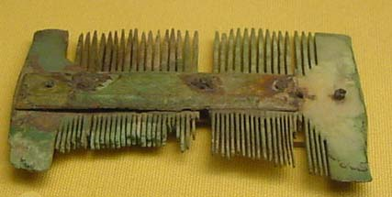
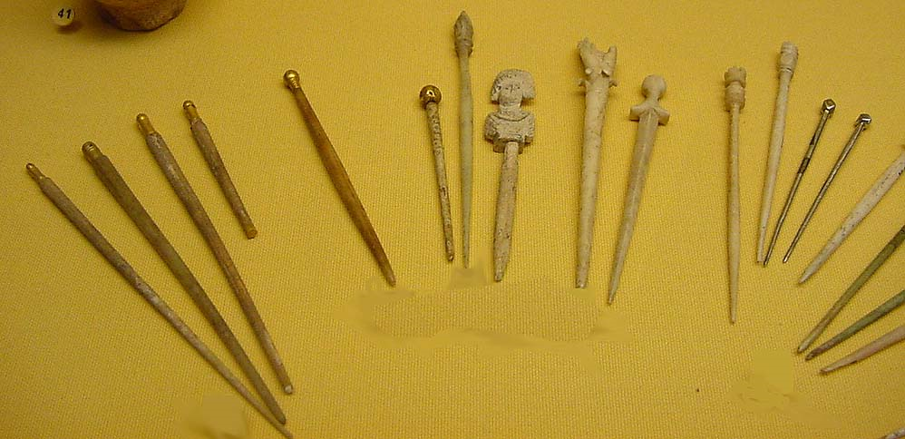
Hair
In their hair, women wore wooden hairsticks or wooden combs, which they could also use to comb their hair.

Slide 9
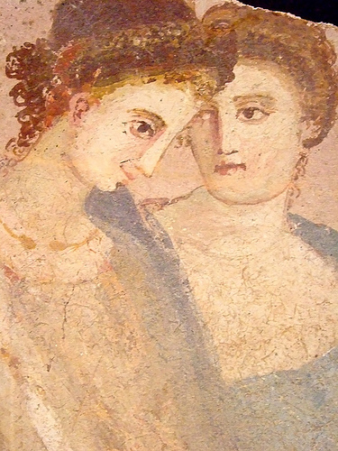
Makeup
Rich women had whiter skin than poor women, because they stayed inside instead of working in the fields as farmers. So women used whitening creams to make themselves look paler, and therefore richer.
One Roman whitening cream from London in the 100s AD was made of cow or sheep fat, starch, and tin oxide. Other whitening creams used lead, even though lead was poisonous.

Slide 10
Homes
Most people living in the Roman Empire lived with their whole family in one room of a sort of apartment house.
Houses for the wealthy were a lot more fancy. Most houses had a front door leading into an atrium (AY-tree-um), or courtyard, and rooms all around the courtyard. Sometimes there was a roof over the courtyard, often with a skylight hole in the center to let in light, and to channel rainwater into a cistern in the middle of the courtyard.

Slide 11
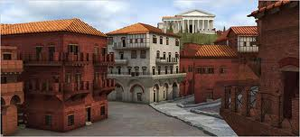

Slide 12
Families
Men could legally beat their wives, like their slaves. (Both men and women could beat their slaves, or their children). Men could also decide whether to raise their baby or let it die, soon after it was born.
But Roman women also had a lot more power than other women of this time. Roman women could own property, and could buy and sell their property, or rent apartments, without their husband's permission. They could (like the men) get a divorce if they wanted to, and if they could afford it.

Slide 13
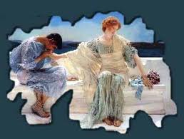
Marriage
Roman people generally seem to have gotten married around the age of twenty (although we are not really sure yet). Some women did marry as young as thirteen. Most people married their first cousins, so that the two branches of the family could combine their grandfather's property again.

Slide 14
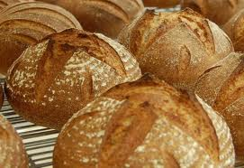
Food
Most people in the Roman empire lived mainly on the usual foods of people living around the Mediterranean Sea- barley, olive oil, and wine, which we call the Mediterranean Triad.

Slide 15
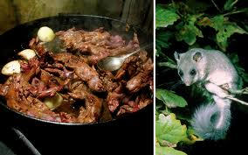
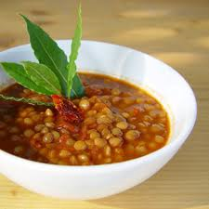
If you were rich, you could also eat beef, pork, lamb, chicken, and fish, dormice, and snails.
If you were poor, you ate mostly just the Mediterranean Triad, with vegetables like lentils and cucumbers and lettuce, fruit like apples and figs, nuts, and sometimes cheese and eggs.

Slide 16
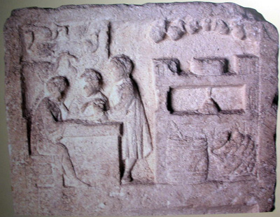
Restaurants
Many people in bigger towns in ancient Rome lived in just one room and didn't have kitchens in their apartments. They ate most of their meals in fast food restaurants like this one in the picture.

Slide 17
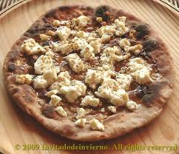
You could order pizza, which didn’t have tomato sauce on it but it had cheese and meat and onions.
There wasn't any drinking age in ancient Rome, but still kids usually drank wine mixed with water so they wouldn't get drunk.

