Slide 1
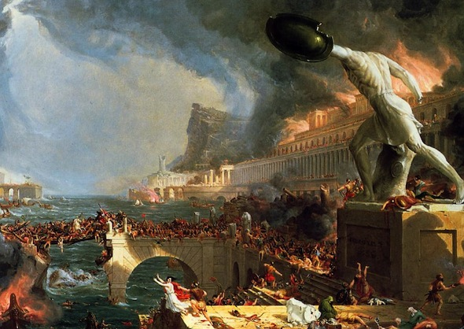
The Decline & Fall of the Roman Empire

Slide 2
Decline of the Roman Empire
The Roman historian Ammianus Marcellinus wrote about the declining Roman Empire:
“Centers of learning are now filled with ridiculous amusements…and the libraries are closed forever like so many graves.”
Of the powerful upper class he wrote, they “fall away into error and vice.”
Of the lower classes, that “some spend the whole night in the wine shops…or else they play at dice.”
And he was alarmed about external threats to the empire, such as the Huns, who he feared could “force their way through all obstacles.”

Slide 3
WEAKENED ARMY
The Pax Romana ends with the death of Marcus Aurelius in AD 180
Men began to enlist simply to gain weapons & spoils
Loyalty once again went to the generals not Rome
From AD 192 to 284, legions installed 28 emperors, only to kill most of them off in rapid succession
Germanic tribes start to take over the borderlands
Eventually Rome hires mercenaries- paid soldiers from the Germanic tribes
To sustain a fighting force, the Roman government had to continually raise soldiers’ wages

Slide 4
SMALLER POPULATION
Warfare, famine, a declining birthrate, & plagues reduced the population
Fewer people meant fewer soldiers for the army, lower tax revenues, & fewer farmers to grow food
Armies were not large enough to defend the empire
Roads & bridges were not repaired which slowed down trade & defense
Less money to buy food for the poor in the cities

Slide 5
OPPRESSIVE GOVERNMENT
Government raised taxes to crippling levels & seized goods from citizens
Many merchants, artisans, & public officials went broke
Artisans forced to stay in their trade & their children to follow their father in the trade
Farmers forced to stay on their farms (chained)
The government forced people to serve the state by repairing roads & bridges without pay

Slide 6
DECLINING FARMS & CITIES
Internal conflicts destroyed areas of farming & killed farmers
Heavy taxes drove many farmers out of business
Farmers left their land to seek their fortune in the army
Harvests declined causing food shortages in the cities
Patricians buy or take abandoned farm lands, building giant private estates
Patricians leave the cities behind, taking their leadership, for the safety of their fortified estates

Slide 7
STAGNANT ECONOMY
Use of slaves left few jobs for landless farmers & the urban poor
People had no money to buy goods, slowing down the economy
Warfare disrupted production, trade, & tax collection
To cope with falling incomes & rising prices, the government minted more coins, sparking severe inflation– a rise in prices corresponding to a decrease in the value of money
The western empire could not rely upon aid from the east & becomes vulnerable to invasion.

Slide 8
ATTEMPTS AT REFORM
Diocletian, Constantine & Theodosius– struggled to halt the empire’s decline.
Empire divided into east & west halves to make it easier to rule
Raised the number of legions & travelled to oversee defense
Froze wages & fixed prices for goods to try to slow down inflation.
Capital of the eastern empire shifted to the city of Byzantium & renamed Constantinople.
Their reforms preserved the government in the eastern part of the empire for more than 1,000 years

Slide 9
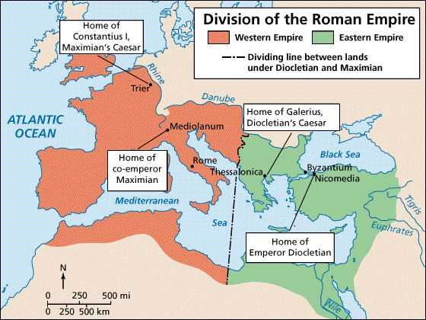
EAST & WEST

Slide 10
LOSS OF CONFIDENCE
With all the problems Rome faced, people’s faith was shaken in the idea of Rome’s superiority
People began thinking only of their own needs & security
People began neglecting their duty to the empire
The people felt that the decaying empire was not worth defending
Different parts of the empire made alliances with barbarians who would eventually conquer them

Slide 11
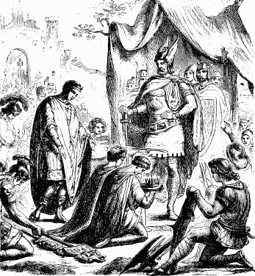
FALL of ROME
In AD 476 the western emperor was overthrown by barbarians in what became the symbolic end of the empire
The western empire crumbles & is replaced by various Germanic kingdoms
The eastern empire became known as the Byzantine Empire & thrives around Constantinople for another thousand years

Slide 12
