Slide 1
Early Greece

Slide 2
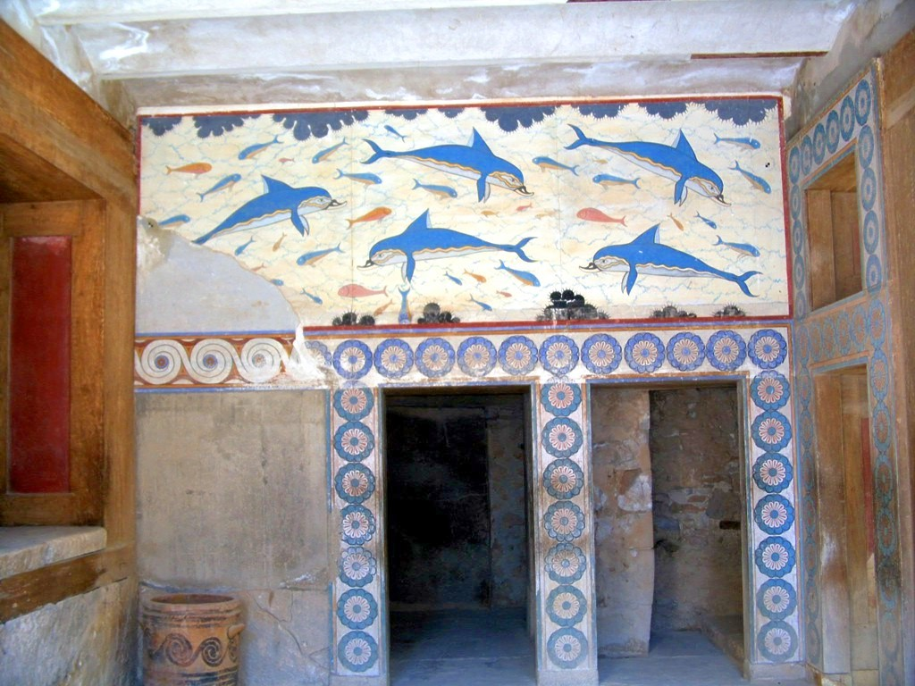
The Minoans
Lived on the island of Crete
Because they lived on an island, the Minoans were seafarers
Traded by sea with Egypt
Explored by sea the area
Their writing is unreadable to us. This means we don’t know a lot about them.

Slide 3
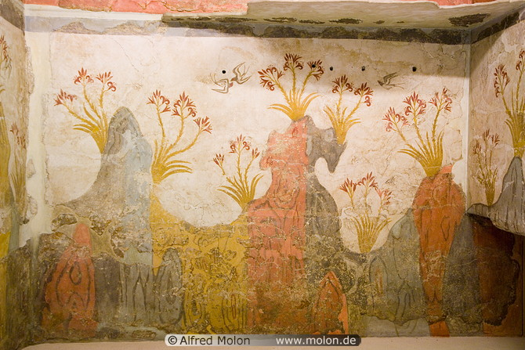
Left behind lots of frescos on their palaces
Cultural tradition of bull jumping
Many mythology stories are about the Minoans
Labyrinth and Minotaur
King Midas and the golden touch
Icarus and more!

Slide 4
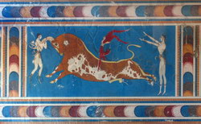

Slide 5
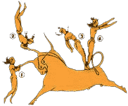

Slide 6
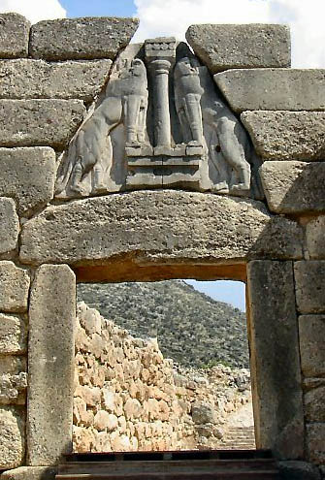
The Mycenaean Culture
Lived on Main land Greece around 1900 B.C.E-1100 B.C.E
Militaristic, took over Minoan Crete 1450 B.C.E
Home city of Mycenae (on the Peloponnese) had 20 ft thick walls

Slide 7
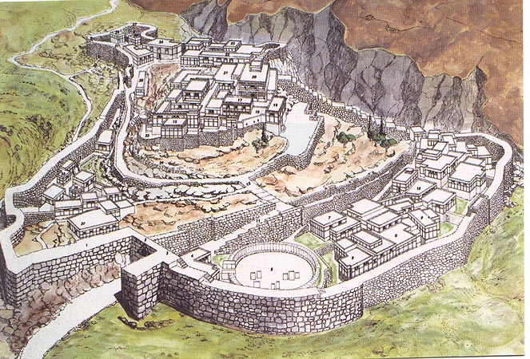

Slide 8
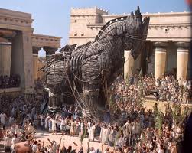
How did these early cultures disappear?
Nobody knows. Around 1200 B.C.E something happened that changed Greece and the surrounding area.
Theories
Famine
Earthquake or volcano
War (did the battle of Troy really happen?)

Slide 9
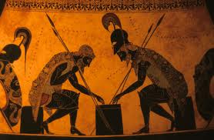
Greek Dark Ages
Dark ages means a time of low progress and culture
1200 – 800 B.C.E
Writing is lost
Civilizations fall apart leaving only city states
Many mythology stories and the two epics come from this time

Slide 10
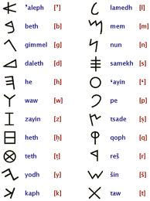
End of the Dark
Dark ages end around 800 B.C.E
New writing system borrowed from the Phoenicians
Phoenicia is seafaring civilization from the coasts of the middle east

