Slide 1
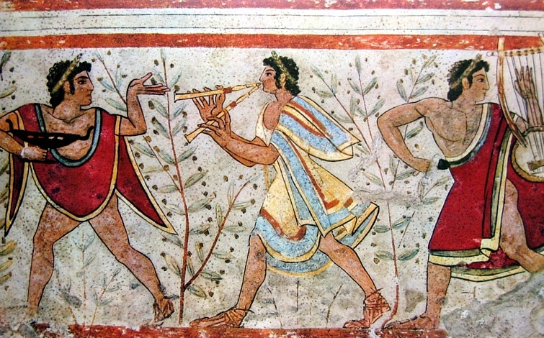
Early History of Rome
truscan kings ruled Rome from 600 B.C. to 509 BC
  Roman aristocrats overthrew the last Etruscan king in 509 BC
  Establish a republic

Slide 2
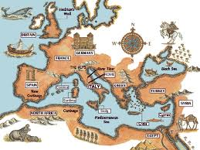
Major Periods in Roman History
Regal- 753-509 B.C.E
Rome is ruled by kings
Republic- 510-27 B.C.E
Lots of growth and prosperity. Citizen rule
Empire- 27 B.C.E- 476 C.E
Emperors. Continued growth, then decline.

Slide 3
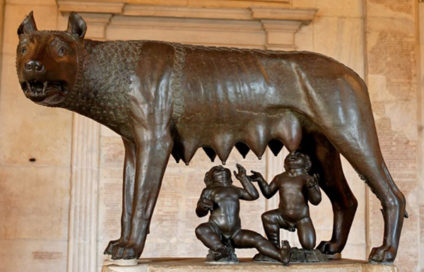
Early History of Rome
The Legend of Romulus and Remus
  Legend states that the city of Rome was founded by two twins, Romulus and Remus.
  Twins were abandoned near the Tiber River and raised by a she-wolf
  Romulus kills Remus and starts Rome

Slide 4
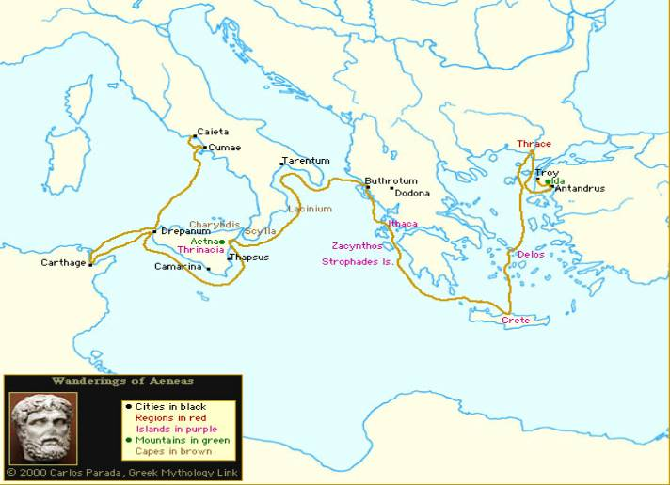
Aeneas’s wanderings

Slide 5
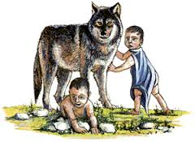
How was Rome Founded?
This myth is a famous version of the Founding of Rome story.

Slide 6
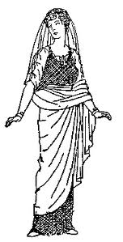
Although we can’t tell what happened for certain, most Romans accept this tale to explain the foundation of Rome:
Romulus, the brother who won, set up the beginnings of a city. He invited people to come and settle there, but there were not enough women to continue to populate it.
He went off in search of women.

Slide 7
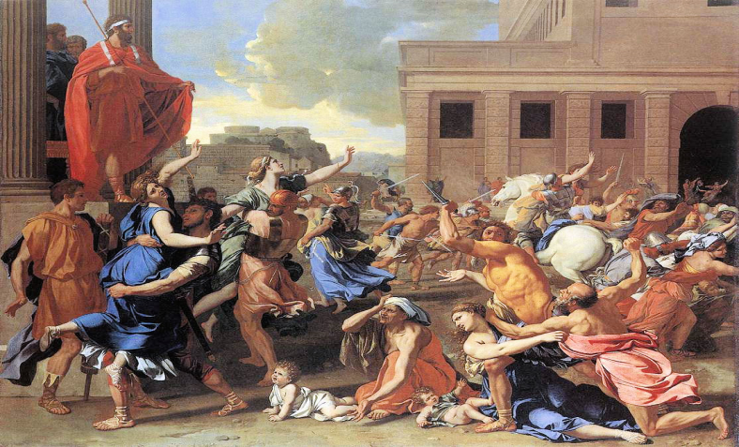
He found what he was looking for in a neighboring village called “Sabine”. The Romans invited the people of Sabine over to hang out and party.
While everyone was distracted, they kidnapped the women and made them become their wives.
The Sabine men were outraged and started a war with Rome, but the women were ok with their new husbands so the whole thing fizzled out.
Rome and Sabine became friends, if you can believe it.

Slide 8
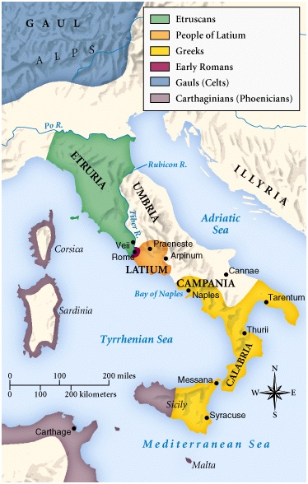
Early Peoples
Indo Europeans
Rome founded circa 753 BC
Foundation myth:
Romulus and Remus
The Early State
Early villages coalesced and
chose a rex, or king
The heads of the old Latin
families, the patres, constituted
an advisory body, the senatus
(body of “old men” or elders)

Slide 9
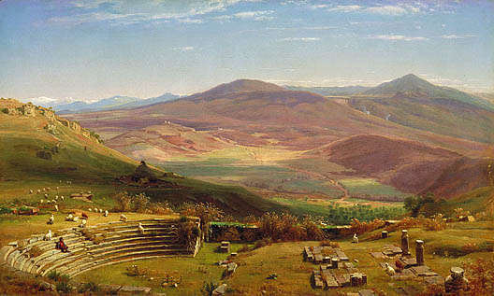
The Latins
The first settlers of Rome were the Latins. They chose this spot because of the mild climate, good farmland, and strategic location.
The settlers farmed in the fertile plain at the base of the hills and built their homes on the hilltops. They built atop the hills so they would be able to defend themselves against an enemy attack.

Slide 10
The Etruscans
Around 600 B.C., the Etruscans invaded the Latins’ little town of Rome and took over. (The Tarquins)
The Etruscans drained the marshes near Rome to give them more land on which to build, thus under Etruscan rule, Rome grew into a city.

Slide 11
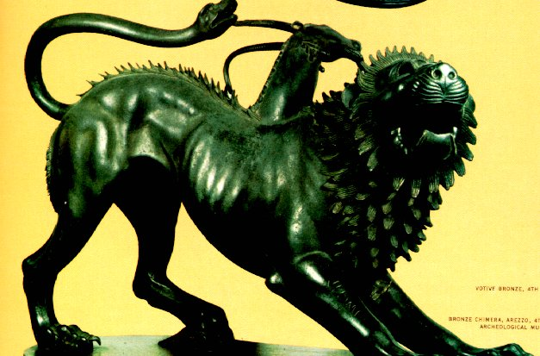
Etruscan Chimira

Slide 12
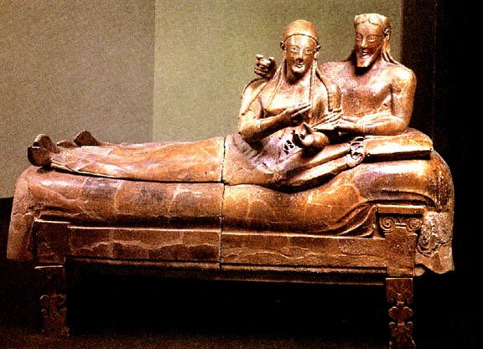
Sarcophagus from Cerveteri, Etruscan sculpture, c. 520 B.C.
husband and wife shown in sculpted form on their tomb terra cotta

Slide 13
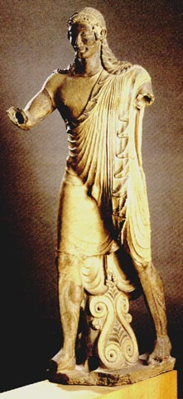
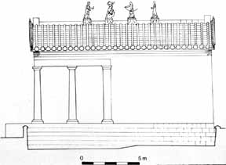
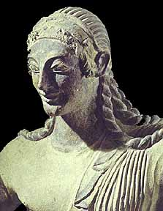
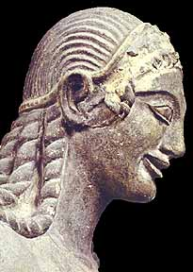
Tension of pose, sinister smile
Apollo of Veii, from the roof of the Portonaccio Temple, Veii, Etruscan, c 510-500 B.C.

Slide 14
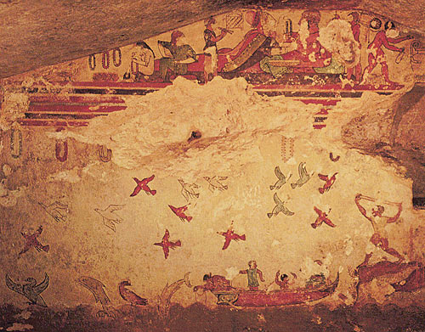
Love of nature, naturalistic observation
Tomb of Hunting and Fishing in Tarquinia, 6th Century B.C.

