Slide 1
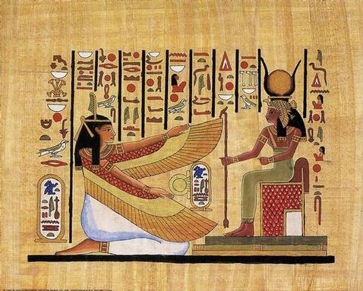
Egypt

Slide 2
Geography
Nile River – 4,100 miles long, flows northward
Every year in July the river flooded REGULARLY leaving behind rich soil.
Forbidden Deserts on either side of the Nile = Natural barriers

Slide 3
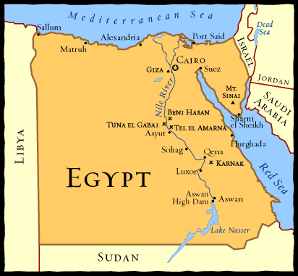

Slide 4
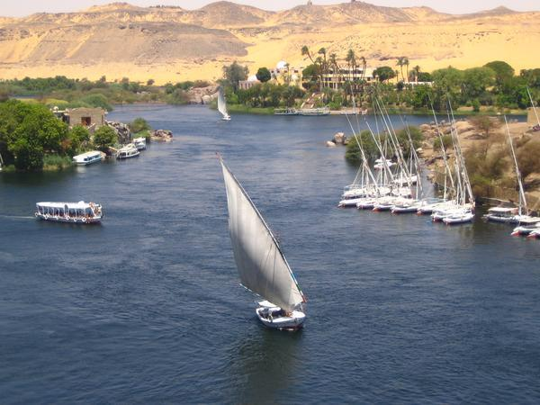

Slide 5
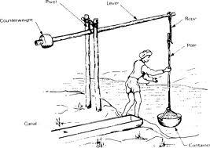
Egyptian’s Agriculture
The banks of the Nile and the Nile delta allowed for farming of wheat.
Every year the Nile flooded bringing water and new soil.
Shadoof- tool for better irrigation= better farming!

Slide 6
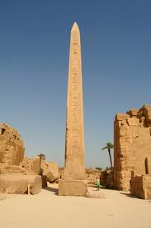
History Outline
Old Kingdom
2700 BCE- 2200 BCE
Pyramid Age
Middle Kingdom
2100 BCE- 1800 BCE
Golden Age
New Kingdom
1500 BCE- 1000 BCE
Expansion/ Decline

Slide 7
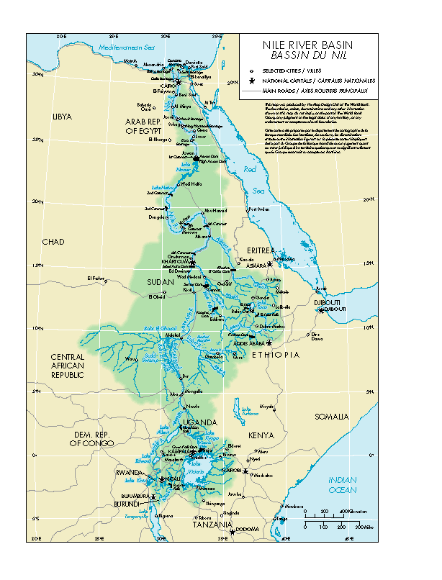
Lower Egypt
Upper Egypt

Slide 8
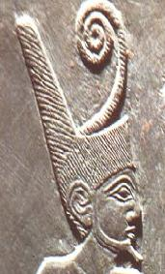
King Menes
Established a capital, Memphis
Established first Egyptian Dynasty
Unites Upper and Lower Egypt

Slide 9
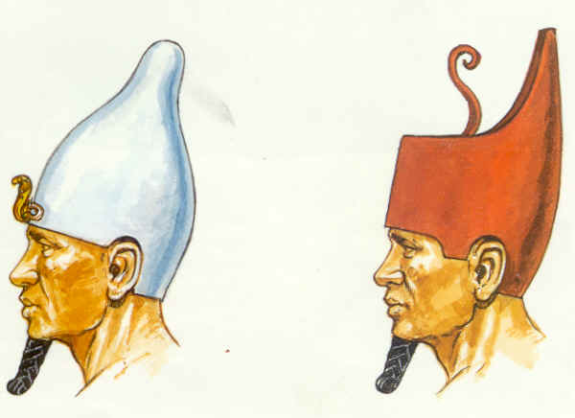
Egypt Unites
In the beginning, Egypt was separated into two kingdoms:
1. Lower Egypt
2. Upper Egypt

Slide 10
Pharaohs
Egyptian kings = pharaohs
The Egyptians viewed their pharaohs the same as the gods
KINGS WERE GODS
Stood as center of religion as well as government and army
Type of Government = Theocracy

Slide 11
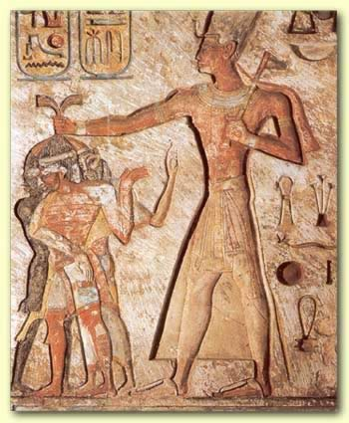
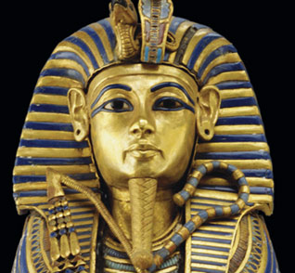

Slide 12
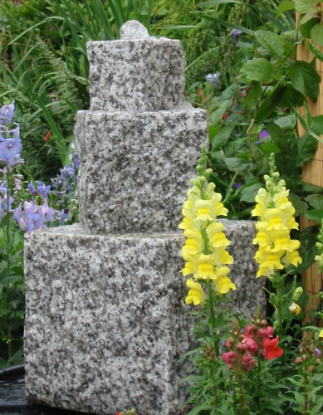
Trade
By 3200 BC, Egyptians were trading with the Mesopotamians
Also traded up and down the Nile
Gold
Ivory
Cattle
Granite blocks
Wheat

Slide 13
Achievements
Knowledge in math = skillful engineers
Pyramids
Palaces
Egyptian Architects first to use stone columns in homes, palaces and temples
12 month, 365 day calendar from studying the stars
So accurate it was only 6 hours off from today’s calendar year

Slide 14
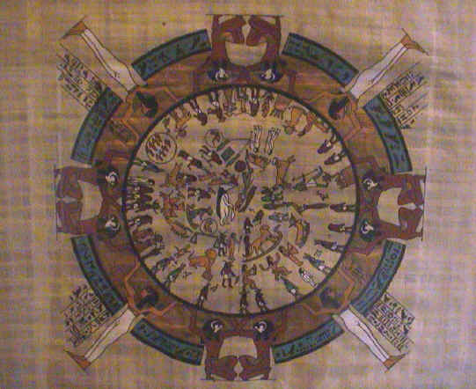

Slide 15
Intellectual
Developed writing = hieroglyphics
Pictographic writing system
Developed written numbers for recording taxes
Addition, subtraction

Slide 17
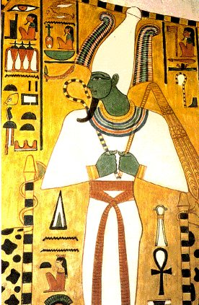
Religion
Polytheistic
2,000 gods and goddesses
Built huge temples to honor gods
Believed in afterlife
Osiris – god of the dead

Slide 18
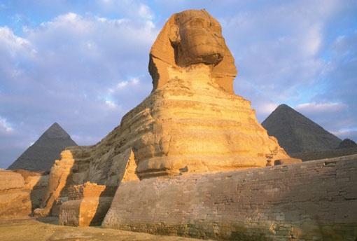
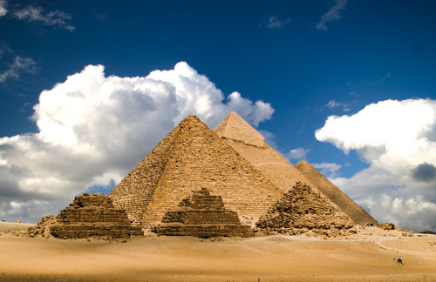

Slide 19
Life in Egyptian Society
Pharaoh
Royal Advisor
Priests
Traders/Merchants
Ordinary Citizens
Slaves

Slide 20
Pictures Cited
Slide 1 – http://www.westga.edu/~llipoma/hieroglyphics.jpg
Slide 2 - http://orford.tased.edu.au/crowns1.jpg, http://www.ancientegypt.co.uk/pharaoh/explore/images/double.gif
Slide 3 - http://academic.evergreen.edu/g/grossmaz/OFORIAA/IMAGES/Nile.jpg
Slide 4 - http://www.homestead.com/wysinger/narmer.jpg
Slide 5 - http://www.internet-at-work.com/hos_mcgrane/egypt/egyptart/crown2.jpg
Slide 6 -
Slide 7 - http://www.gophila.com/go/tut/images/micro/full_tut.jpg
Slide 8 - http://www.waterfeatures2u.com/items_images/11205089253%20GRANITE%20BLOCKS%202_500.jpg,
Slide 9 - http://www.egyptian-gods.net/images/osiris3big.jpg
Slide 10 - http://www.digitaldutch.com/arles/tutorials/thumbnail_tags/galleries/thumbnail_tags_with_size/images/Sphinx.jpg, http://www.planetware.com/i/photo/pyramids-of-giza-gzgrtpy.jpg
Slide 14 - http://www.cwrl.utexas.edu/~howard/314lspring2005/hieroglyphics.jpg,
Slide 15 - http://www.bl.uk/learning/images/whywrite/new/hieroglyphics-lg.jpg
Slide 17 - http://analyzer.depaul.edu/paperplate/2002%20vernal%20equinox/Egyptian_calendar_dark.jpg
Slide 18 - www.africantravelinc.com/AboutATI/egypt.html
Slide 20 – http://www.richard-seaman.com/Travel/Egypt/NileFromAboveNarrowAngle.jpg
Slide 21 - http://www.map-of-egypt.org/aswan-424.jpg

