Slide 1
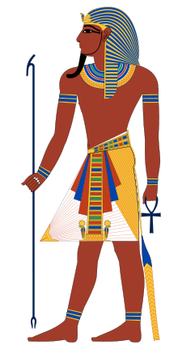
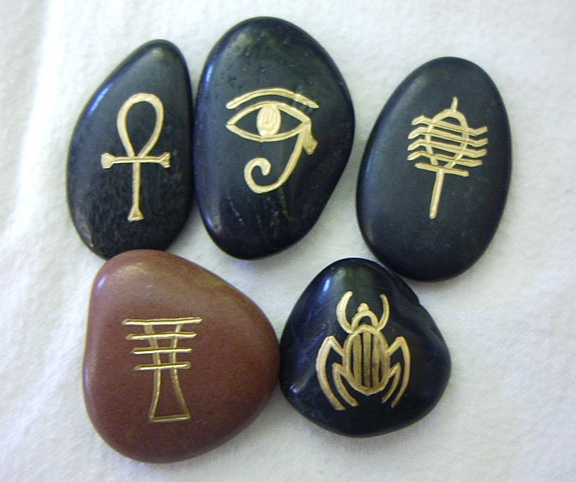
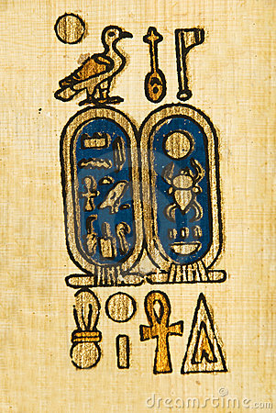
~ Egyptian Symbols ~

Slide 2
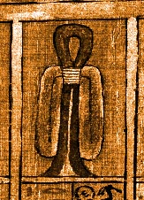
Tyet
Known as the sign or Knot of Isis
Symbol of fertility, welfare, and protection

Slide 3
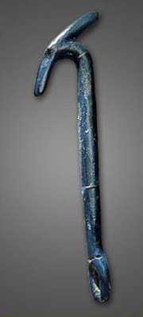
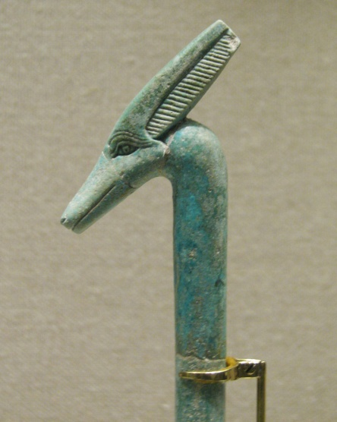
~Was Scepter~
Symbol commonly seen in the hands of the gods or pharaohs.
Head represents evil god Seth
Scepter suggests power over evil and power to be violent in the hand of the holder.
Sign of power and domination
← prong
Head shown with an eye →

Slide 4
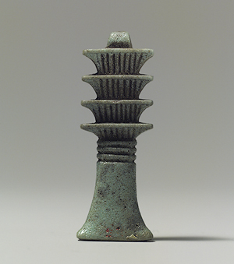
Djed (DD or TET) Pillar
Scholars believe this is the representation of the spinal column or backbone
This symbol stands for endurance solidness and indestructibility.
Sometimes a pharaoh is shown raising a djed to show stability of the kingdom.

Slide 5
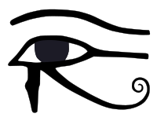
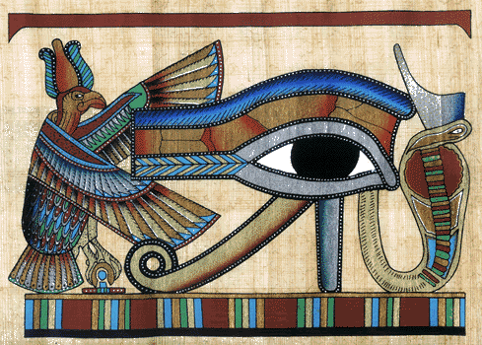
Udja-Eye
Eye of Horus or Ra
Symbol of light and truth
Views life after death (on funeral barks)

Slide 6
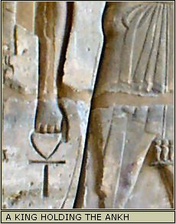
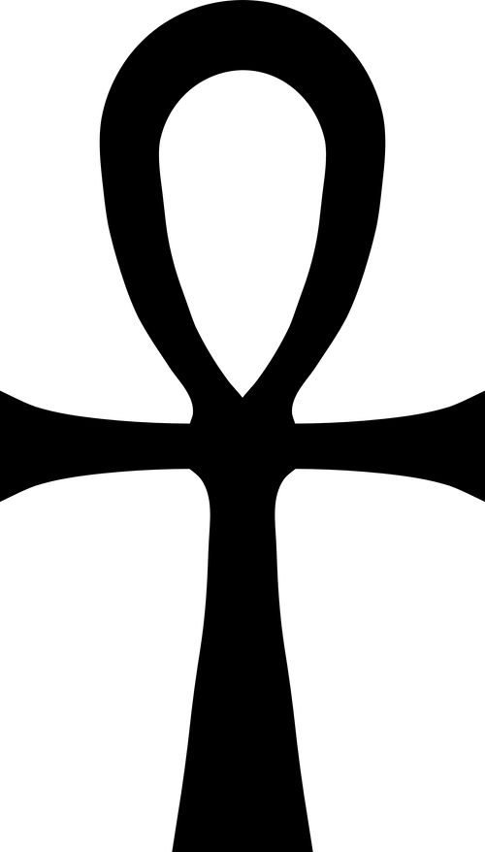
Ankh
One of the most common symbols
Symbol of life (Eternal life)
Found in the right hand of gods
Associated with oaths, swear by life
3 symbols of ancient origin
Horizontal Line: man, earth, life
Vertical Line: god, heaven, spiritual
Circle: symbol of eternity

Slide 7
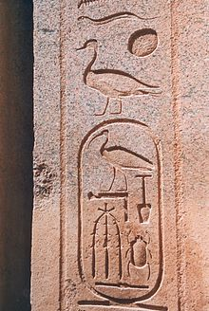
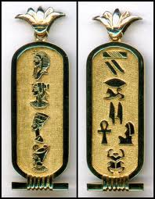
Cartouche
Divine name plate of the gods or pharaohs.
The flat ring on one end may come from the royal ring of the pharaohs.
The Shen symbol of infinity
Ring at the end signifies a royal or divine name

Slide 8
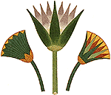
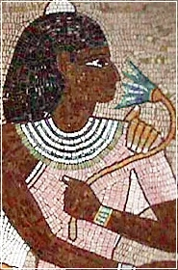
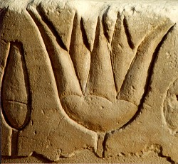
Lotus
Found frequently in upper Egypt.
Symbol of rebirth and resurrection.
Sometimes pictured opened, sometimes closed.

Slide 9
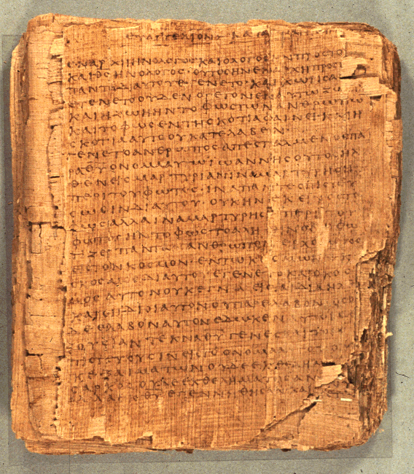
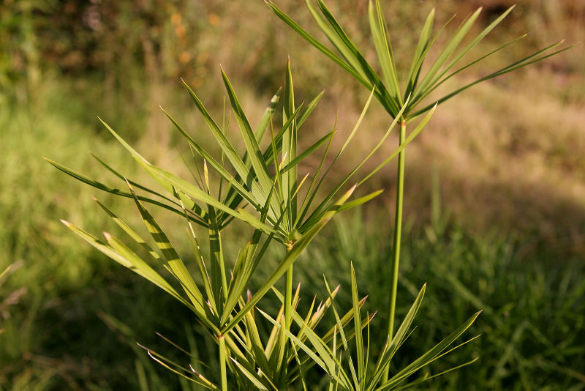
Papyrus
Grew in lower Egypt in the fertile land of the delta
Symbol of lower Egypt
Used to make paper

Slide 10
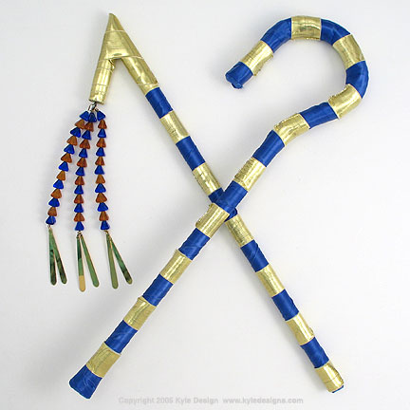
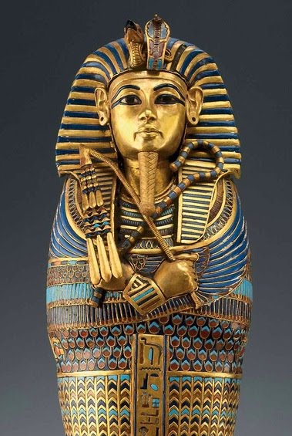
Scepters
Flail
Crook
Flail : symbol of power over subjects
– exact obedience or punishment
Crook: symbol of pharaohs role as shepherd/guardian or watchful protector

Slide 11
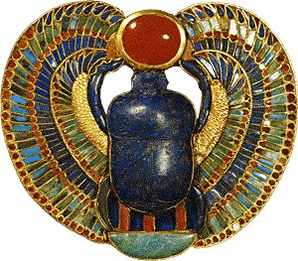
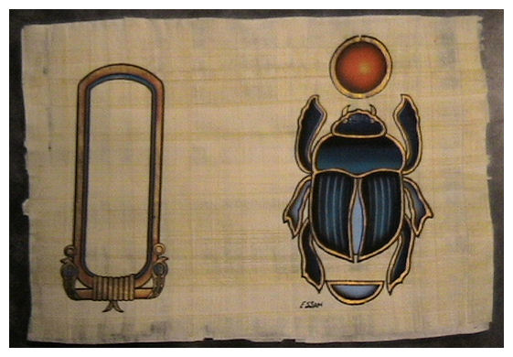
Scarab (Dung Beetle)
Symbol of newness of life.
Push balls of dung to hole. Ancient Egyptians saw this as “the sun being pushed across the sky.”
Associated with resurrection

