Slide 1
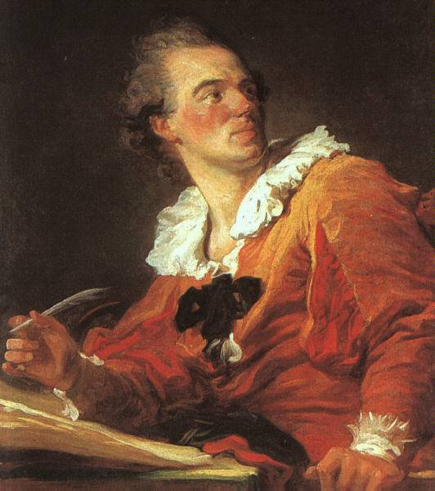
The Enlightenment
Notes:
The era known historically as the Enlightenment marks the intellectual beginning of the modern world. Ideas originating in this era would gradually spread around the world creating challenges to existing traditions and ways of governing. Many governments today have Enlightenment principles as the basis of their constitutions and forms of government. In addition, the expansion of suffrage to women, blacks, and people of all classes is a legacy of the Enlightenment. Enlightenment ideas on equality also helped end the dominance of social elites such as the aristocracy and the church. Enlightenment thought also led many countries to establish systems of public schools and put an end to the idea that education was only a privilege for the upper classes.
Note to teacher: The image in this slide is Jean-Honoré Fragonard’s “Inspiration,” which shows a philosophe at his desk lost deep in thought.

Slide 2
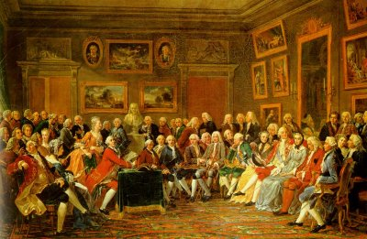
What Was the Enlightenment?
The Enlightenment was an intellectual movement in Europe during the 18th century that led to a whole new world view.
Notes:
When historians discuss the “Enlightenment,” they are usually referring to 18th-century Europe (France and England in particular), although other parts of the world (including the U.S.) are often included as well. The Enlightenment was a period of intellectual ferment that gave rise to a range of new theories about society, government, philosophy, economics, and religion. The period produced more than just abstract theorizing, however: it offered a whole new way of conceptualizing the world and one’s place in it. In many ways, this change in perception marked the beginning of the modern era, as institutions and traditions of the past began to shift—and even crumble—in the face of new ideas and approaches.
Note to teacher: The painting in this slide is Une soirée chez Madame Geoffrin. Created in 1755, it shows a French salon. Among the notable philosophes depicted in the painting are Diderot, d’Alembert, Turgot, and Condillac. A bust of Voltaire appears in the background.

Slide 3
The Scientific Revolution
The Enlightenment grew largely out of the new methods and discoveries achieved in the Scientific Revolution
The equatorial armillary, used for navigation on ships
Notes:
The most important factor in the development of the Enlightenment was the Scientific Revolution of the 16th and 17th centuries.

Slide 4
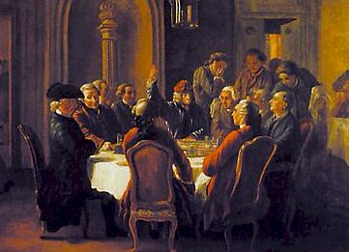
Enlightenment Principles
Religion, tradition, and superstition limited independent thought
Accept knowledge based on observation, logic, and reason, not on faith
Scientific and academic thought should be secular
A meeting of French Enlightenment thinkers
Notes:
The Enlightenment era was characterized by secularism, challenges to authority, and the glorification of reason.
Bullet #1 Many Enlightenment thinkers felt that although the great minds of the medieval and Renaissance eras had achieved much, they also had been overly constrained by religion, tradition, and superstition. To truly achieve independent thought, one had to throw off all limits and rely solely on reason.
Bullet #2 Like the pioneers of the Scientific Revolution, Enlightenment thinkers also strove to make conclusions based on observation, logic, and reason, rather than on faith.
Bullet #3 Enlightenment thinkers revived the spirit of the Renaissance quest for knowledge, choosing to focus on human nature and the workings of society rather than on spiritual matters and religious tenets. This secular approach led to the development of the social sciences.

Slide 5
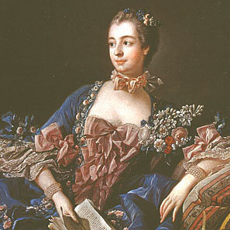
The French Salon and the Philosophes
Madame de Pompadour
Salons: gatherings for aristocrats to discuss new theories and ideas
Philosophes: French Enlightenment thinkers who attended the salons
Madame de Pompadour
Notes:
Madame de Pompadour, mistress of King Louis XV of France, was a devotee of art and philosophy. Around the middle of the 18th century, she began holding what became known as the salon. Salons were a sort of high class cocktail party for socialites, aristocrats, and intellectuals, where people demonstrated their knowledge of new theories and tried to outwit each other. Madame de Pompadour held the most famous and best attended salons in Paris.
Enlightenment thinkers in France who went to salons were known as philosophes. For a salon to be truly successful, it had to have a philosophe in attendance as a sort of showpiece.

Slide 6
The Encyclopédie
Major achievement of the philosophes
Begun in 1745; completed in 1765
Frontspiece to the Encyclopédie
Notes:
Perhaps the most notable achievement of the philosophes as a group was the 17-volume Encyclopédie, known in English as Encyclopedia: The Rational Dictionary of the Sciences, the Arts, and the Crafts. In 1745, French publisher André le Breton asked writer Denis Diderot to help him translate the seminal English Cyclopedia into French. Diderot served as co-editor of the project along with mathematician Jean Le Rond d’Alembert.

Slide 7
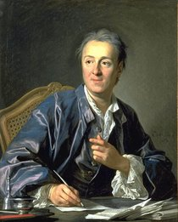
The Encyclopédie (continued)
Denis Diderot and Jean Le Rond d’Alembert
Banned by the Catholic Church
Encyclopédie editor Denis Diderot
Notes:
Shortly after beginning, Diderot came up with a much more ambitious goal than a mere translation. He wanted instead to create a comprehensive work that would include the most up-to-date knowledge on the sciences, arts, and crafts. To this end, he enlisted several of the best thinkers of the era—many of whom were well-known philosophes—to write new articles for the Encyclopédie. He also wanted to make the work accessible to a wide audience rather than just for scholars.
Although Diderot and d’Alembert ended up writing the majority of the articles, contributions also came from many noted figures (especially Voltaire, as well as Rousseau and Montesquieu). By the time the Encyclopédie finally reached completion, it contained nearly 72,000 articles accompanied by numerous illustrations.
The work as a whole represents an outstanding example of Enlightenment thought: it praised science while also questioning religion, social institutions, the legal system, and more. As a result, the Catholic Church viewed it as undermining its authority and placed the Encyclopédie on its index of forbidden works. Nevertheless, it was widely read, with people often obtaining cheaper reprint editions published in Switzerland.

Slide 8
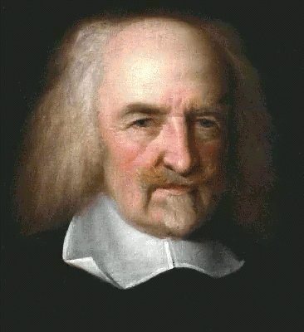
Thomas Hobbes (1588–1679)
Applied rational analysis to the study of government
Attacked the concept of divine right, yet supported a strong monarchy
Believed that humans were basically driven by passions and needed to be kept in check by a powerful ruler
Notes:
Englishman Thomas Hobbes was one of the first thinkers to apply rational analysis to the study of government. In his famous work Leviathan, Hobbes attacked the notion of the “divine right of kings,” which held that monarchs ruled because they had been appointed by God. Instead, he believed that a ruler derived sovereignty from the implicit consent of the people. Not surprisingly, this radical concept met with near-universal disdain.
Although it seemed to many that Hobbes was attacking monarchy, in reality he favored having strong, authoritarian rulers because of conclusions he drew about human nature. Hobbes somewhat pessimistically believed that people were driven by their passions, and that only a powerful ruler could keep society from degenerating into conflict and chaos. Without a monarch to exercise control, Hobbes wrote that people’s lives would be “solitary, poor, nasty, brutish, and short.”

Slide 9
Englishman Thomas Hobbes was one of the first thinkers to apply rational analysis to the study of government. In his famous work Leviathan, Hobbes attacked the notion of the “divine right of kings,” which held that monarchs ruled because they had been appointed by God. Instead, he believed that a ruler derived sovereignty from the implicit consent of the people. Not surprisingly, this radical concept met with near-universal disdain. Although it seemed to many that Hobbes was attacking monarchy, in reality he favored having strong, authoritarian rulers because of conclusions he drew about human nature. Hobbes somewhat pessimistically believed that people were driven by their passions, and that only a powerful ruler could keep society from degenerating into conflict and chaos. Without a monarch to exercise control, Hobbes wrote that people’s lives would be “solitary, poor, nasty, brutish, and short.”

Slide 10
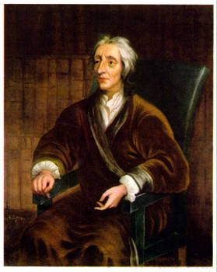
John Locke (1632–1704)
The “State of Nature”
Tabula rasa
Notes:
Bullet #1 John Locke, another English theorist, also disagreed with the notion of divine right; however, he held a very different view of human nature than Hobbes did. Locke posited that in the past, before people formed societies, they lived in a “state of nature.” He believed that all men were equal in the state of nature because they were “creatures of the same species and rank” with the “same advantages” and “same faculties.”
Bullet #2 Locke also had an interest in how humans learn. In his Essay Concerning Human Understanding, he argued that the mind of a newborn baby was a “tabula rasa”—a “blank slate” upon which environment and experience would transcribe ideas and beliefs. Locke saw human nature as something that was externally determined rather than internally determined; correspondingly, he stressed the importance of education.

Slide 11
Locke (continued)
Treatises of Government
Rights
Notes:
Bullet #1 In his two Treatises of Government, Locke attacked the divine right of kings and authoritarian government. He promoted a constitutional monarchy that derived its power from the law and from the consent of the people. He also believed that a government’s primary responsibility was to protect individual property: he wrote, “The great and chief end, therefore, of men uniting into commonwealths, and putting themselves under government, is the preservation of their property; to which in the state of Nature there are many things wanting.”
Bullet #2 Locke believed that in the state of nature, individuals had natural rights, which he referred to as “all the rights and privileges of the law of Nature.” Locke claimed that one such right was to defend one’s “property” (which he defined as “his life, liberty, and estate”) against the “injuries and attempts of other men.” Locke built on this assumption, suggesting that if any ruler or government violated these natural rights, the people would have the right to change the government—by force if necessary.

Slide 12
#1: In his two Treatises of Government, Locke attacked the divine right of kings and authoritarian government. He promoted a constitutional monarchy that derived its power from the law and from the consent of the people. He also believed that a government’s primary responsibility was to protect individual property: he wrote, “The great and chief end, therefore, of men uniting into commonwealths, and putting themselves under government, is the preservation of their property; to which in the state of Nature there are many things wanting.” #2: Locke believed that in the state of nature, individuals had natural rights, which he referred to as “all the rights and privileges of the law of Nature.” Locke claimed that one such right was to defend one’s “property” (which he defined as “his life, liberty, and estate”) against the “injuries and attempts of other men.” Locke built on this assumption, suggesting that if any ruler or government violated these natural rights, the people would have the right to change the government—by force if necessary.

Slide 13
Baron de Montesquieu (1689–1755)
French noble and political philosopher
The Spirit of the Laws
Notes:
The Baron de Montesquieu was a French nobleman whose primary contributions to the Enlightenment’s political thought came in his 1748 treatise The Spirit of the Laws. Years before writing the treatise, Montesquieu had visited several European countries, carefully observing the workings of each nation’s government. In The Spirit of the Laws, he laid out a comparative study of types of governments, then put forward his own theory of government.

Slide 14
The Baron de Montesquieu was a French nobleman whose primary contributions to the Enlightenment’s political thought came in his 1748 treatise The Spirit of the Laws. Years before writing the treatise, Montesquieu had visited several European countries, carefully observing the workings of each nation’s government. In The Spirit of the Laws, he laid out a comparative study of types of governments, then put forward his own theory of government.

Slide 15
Montesquieu (continued)
Separation of powers
Constitutional monarchy
Frontspiece to The Spirit of the Laws
Notes:
Montesquieu identified three sorts of governmental power: legislative, executive “in respect to things dependent on the law of nations,” and executive “in regard to those things that depend on civil law” (i.e., the judiciary). Montesquieu believed that if one person or group of people held any two or all three of these powers, it would result in “tyrannical laws” executed in a “tyrannical manner.” His ideas here provided the basis for the doctrine known as “separation of powers,” which significantly influenced the framers of the U.S. Constitution and thus the shaping of the American government.
Montesquieu did not believe that democracy was the best form of government. Instead, he favored a constitutional monarchy based on the British model. He greatly admired Britain’s government because he felt that Parliament, the king, and the courts worked separately and efficiently since each could limit the power of the other. This idea of the different branches of government each preventing the others from obtaining too much power later led to the theory of “checks and balances,” which also influenced the framers of the U.S. Constitution.

Slide 16
Montesquieu identified three sorts of governmental power: legislative, executive “in respect to things dependent on the law of nations,” and executive “in regard to those things that depend on civil law” (i.e., the judiciary). Montesquieu believed that if one person or group of people held any two or all three of these powers, it would result in “tyrannical laws” executed in a “tyrannical manner.” His ideas here provided the basis for the doctrine known as “separation of powers,” which significantly influenced the framers of the U.S. Constitution and thus the shaping of the American government. Montesquieu did not believe that democracy was the best form of government. Instead, he favored a constitutional monarchy based on the British model. He greatly admired Britain’s government because he felt that Parliament, the king, and the courts worked separately and efficiently since each could limit the power of the other. This idea of the different branches of government each preventing the others from obtaining too much power later led to the theory of “checks and balances,” which also influenced the framers of the U.S. Constitution.

Slide 17
LOCKE AND MONTESQUIEU INFLUENCED THE AMERICAN FOUNDING FATHERS AND THE FRAMERS OF THE CONSTITUTION MORE THAN ANY OTHER PHILOSOPHERS.

Slide 18
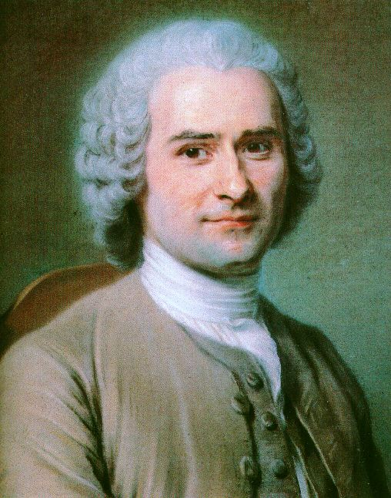
Jean-Jacques Rousseau (1712–1778)
Philosophized on the nature of society and government
The Social Contract
Notes:
Like Locke, Jean-Jacques Rousseau also used the concept of a “state of nature” to draw conclusions about society and government.
Rousseau is probably best known for his idea of the “social compact,” which he outlined in his book The Social Contract. Locke had viewed societies as having been created through mutual consent of all members. Rousseau went a step further, claiming that instead of mere consent, individuals forming a society entered into a “social compact” with one another. The social compact balanced benefits with obligations. Those who entered into it would receive mutual protection and defense, along with assistance in overcoming obstacles that they could not conquer individually. In return, the social compact obligated members of society to subordinate their “natural liberty” (i.e., the freedom enjoyed by individuals in the state of nature) to “the supreme direction of the general will.”

Slide 19
Rousseau is probably best known for his idea of the “social compact,” which he outlined in his book The Social Contract. Locke had viewed societies as having been created through mutual consent of all members. Rousseau went a step further, claiming that instead of mere consent, individuals forming a society entered into a “social compact” with one another. The social compact balanced benefits with obligations. Those who entered into it would receive mutual protection and defense, along with assistance in overcoming obstacles that they could not conquer individually. In return, the social compact obligated members of society to subordinate their “natural liberty” (i.e., the freedom enjoyed by individuals in the state of nature) to “the supreme direction of the general will.”

Slide 20
Voltaire (1694–1778)
Most famous philosophe
Wrote plays, essays, poetry, philosophy, and books
Attacked the “relics” of the medieval social order
Championed social, political, and religious tolerance
Notes:
François-Marie Arouet, known more famously as Voltaire, was the most renowned of the philosophes. A prolific writer, much of his work either satirized or attacked what he called the “relics” of the medieval social order—in particular, the church and the aristocracy. Despite—or perhaps because of—his controversial ideas, he was in high demand at salons not just in France but throughout Europe as well. He lived in the court of Frederick the Great for a time, and he was friends with Catherine the Great.
Above all, Voltaire attacked intolerance in society, politics, and religion. A famous quote usually attributed to Voltaire states, “I disapprove of what you say, but I will defend to the death your right to say it.” He felt that all governments were susceptible to tyranny, but he greatly admired the British model.

Slide 21
François-Marie Arouet, known more famously as Voltaire, was the most renowned of the philosophes. A prolific writer, much of his work either satirized or attacked what he called the “relics” of the medieval social order—in particular, the church and the aristocracy. Despite—or perhaps because of—his controversial ideas, he was in high demand at salons not just in France but throughout Europe as well. He lived in the court of Frederick the Great for a time, and he was friends with Catherine the Great. Above all, Voltaire attacked intolerance in society, politics, and religion. A famous quote usually attributed to Voltaire states, “I disapprove of what you say, but I will defend to the death your right to say it.” He felt that all governments were susceptible to tyranny, but he greatly admired the British model.

Slide 22
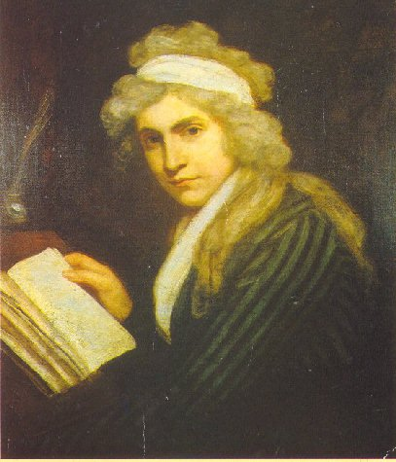
Women and the Enlightenment
Changing views
Role of education
Equality
Mary Wollstonecraft
Olympe de Gouges
Notes:
One of the offshoots of Enlightenment philosophy was a changed view of the role of women in society. Enlightenment thinkers held reason supreme and valued education as the best way to develop a person. They also viewed education as crucial for moral development and for society to function as close to ideal as possible. Many thinkers, therefore, advocated education for women; however, they differed on the specific things they believed women should be taught, and most male thinkers did not extend their arguments to advocate full equality for women. Not surprisingly, some women disagreed with this position and wrote important works advocating equality for women.

Slide 23
Mary Wollstonecraft
Declaration of the Rights of Man
A Vindication of the Rights of Women
Notes:
During the early days of the French Revolution, the National Assembly adopted the Declaration of the Rights of Man. The document drew equally upon Enlightenment ideas and current events at the time to make statements both about basic political rights and the particular abuses which many had suffered under the rule of Louis XVI.
In 1792, Mary Wollstonecraft, a teacher and writer from Great Britain, composed A Vindication of the Rights of Women. Wollstonecraft had been living in Paris during the French Revolution and knew many of its leaders. The publication of the Declaration prompted her to outline her philosophy on the inequalities that existed between the sexes. She was disheartened by the fact that in spite of their belief in equality, the leaders of the Revolution did not extend that equality to women. She saw this as hypocritical and hoped her work would convince French leaders (especially Talleyrand, to whom she dedicated the book) to recognize that women had the same natural rights and intellectual capacity as men.

Slide 24
During the early days of the French Revolution, the National Assembly adopted the Declaration of the Rights of Man. The document drew equally upon Enlightenment ideas and current events at the time to make statements both about basic political rights and the particular abuses which many had suffered under the rule of Louis XVI. In 1792, Mary Wollstonecraft, a teacher and writer from Great Britain, composed A Vindication of the Rights of Women. Wollstonecraft had been living in Paris during the French Revolution and knew many of its leaders. The publication of the Declaration prompted her to outline her philosophy on the inequalities that existed between the sexes. She was disheartened by the fact that in spite of their belief in equality, the leaders of the Revolution did not extend that equality to women. She saw this as hypocritical and hoped her work would convince French leaders (especially Talleyrand, to whom she dedicated the book) to recognize that women had the same natural rights and intellectual capacity as men.

Slide 25
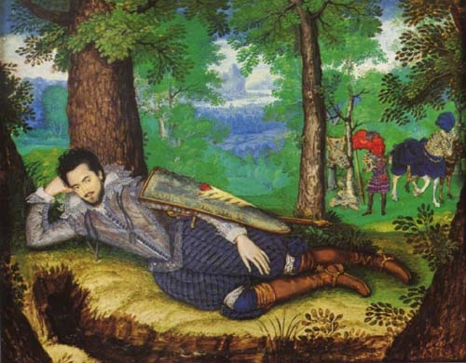
Deism
Deists believed in God but rejected organized religion
Morality could be achieved by following reason rather than the teachings of the church
Lord Edward Herbert of Cherbury, founder of deism
Notes:
Voltaire was also a deist, as were many other leading figures of the Enlightenment. Founded by Lord Edward Herbert in the early 1600s, the philosophy of deism took the technique of rational analysis and applied it to religion, coming up with conclusions that were not to the liking of many followers of Christianity. Deists firmly believed in God, but rejected organized religion. Rather than looking to the church or the supernatural for moral guidance, deists believed that morality could be achieved by following reason. Even though deism affirmed the existence of God, it discarded virtually all Church traditions and practices as irrational and unnecessary, a fact which led many to criticize deists as anti-Christian, or even to portray them as atheists.

Slide 26
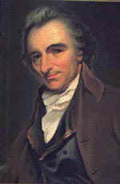
Deism (continued)
The “great watchmaker”
Thomas Paine
Thomas Paine
Notes:
Enlightenment philosophy emphasized experience and reason, while the Church asked worshipers to accept its principles on faith, so a conflict here was inevitable. Deists viewed God as the “great watchmaker” whose creation—the universe—operated as smoothly as a fine Swiss watch. The task, as Enlightenment thinkers envisioned it, was to try to discover the principles that governed the functioning of this “watch.” Deism thus centered around a belief in a God who operated according to reason and whose existence could be seen in the natural order and logic of all that He had created.
Thomas Paine, famous primarily for writing the classic pamphlet Common Sense, was also a key theorist of deism. In his essay “Of the Religion of Deism Compared with the Christian Religion,” Paine asserted that “there is a happiness in Deism, when rightly understood, that is not to be found in any other system of religion” because deism did not force its followers to “stifle reason” in order to accept its tenets.

Slide 27
Enlightenment philosophy emphasized experience and reason, while the Church asked worshipers to accept its principles on faith, so a conflict here was inevitable. Deists viewed God as the “great watchmaker” whose creation—the universe—operated as smoothly as a fine Swiss watch. The task, as Enlightenment thinkers envisioned it, was to try to discover the principles that governed the functioning of this “watch.” Deism thus centered around a belief in a God who operated according to reason and whose existence could be seen in the natural order and logic of all that He had created. Thomas Paine, famous primarily for writing the classic pamphlet Common Sense, was also a key theorist of deism. In his essay “Of the Religion of Deism Compared with the Christian Religion,” Paine asserted that “there is a happiness in Deism, when rightly understood, that is not to be found in any other system of religion” because deism did not force its followers to “stifle reason” in order to accept its tenets.

