Slide 1
Features of Civilization
[Civilization] is roughly anything we do and the monkeys don't.
~Lord Raglan~

Slide 2
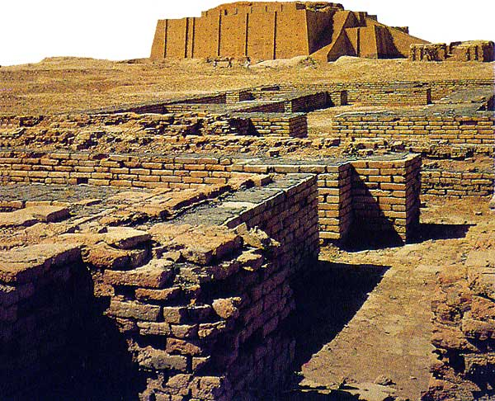
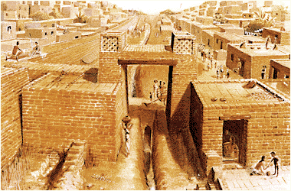
1- Cities
The central feature of civilizations.
Cities emerged when farmers began to produce surplus food to support larger populations.

Slide 3
2- Economy
the way in which goods and services are made, sold, and used in a country or area

Slide 4
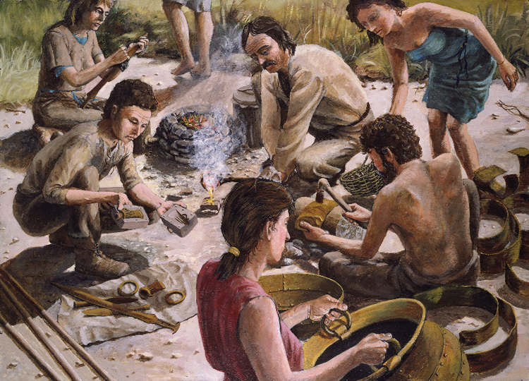
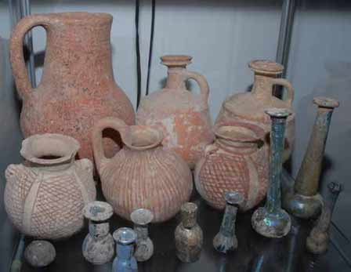
Job Specialization
New technologies developed so rapidly, no individual could master all the skills needed.
As artisans emerged, who focused only a single craft, quality & diversity of products increased.
Bronze Age- copper & bronze tools & weapons

Slide 5
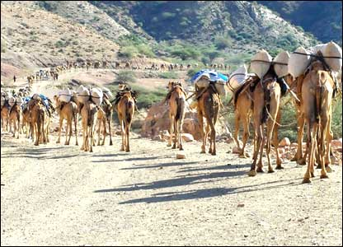
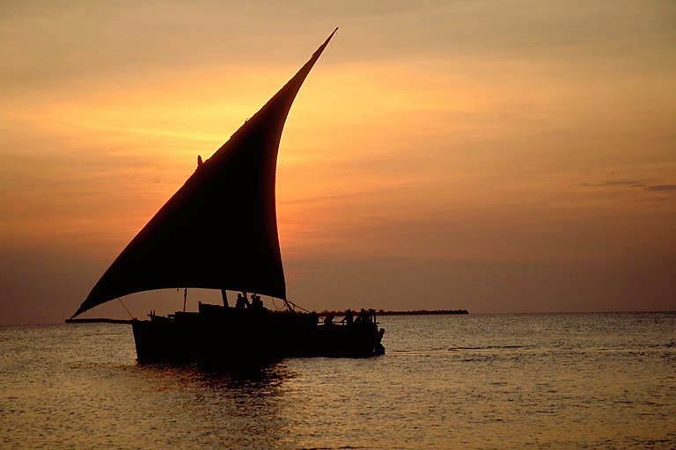
Long Distance Trade
As people travelled farther afield in search of natural resources, trade routes developed.
A specialized class of traders called merchants arose & trade expeditions covered ever longer distances.
Along with goods, ideas were actively traded. Cultural diffusion allowed people to improve their own skills & way of life.

Slide 6
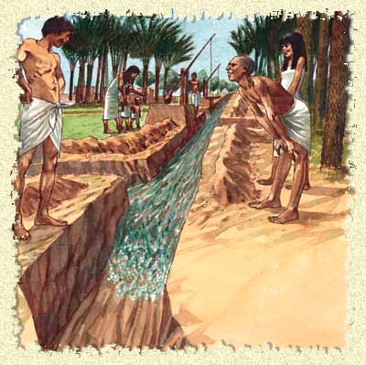
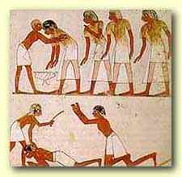
3- Government
A well organized central government was needed to:
Oversee complex public works (irrigation & construction)
Ensure a steady supply of food was available
Maintain order (laws & punishments)
Organize defense
Collect taxes
Provide planning & leadership

Slide 7
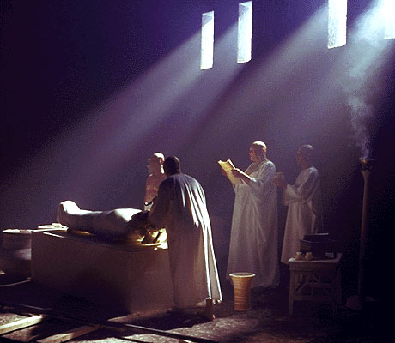
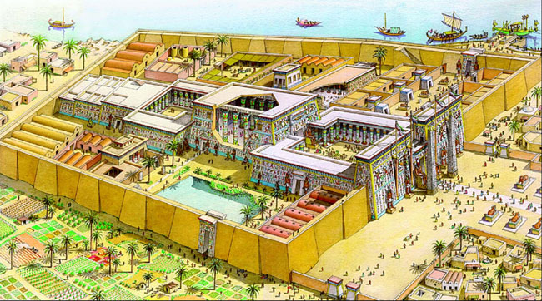
4- Organized Religion
Ancient people believed they must appeal to gods who control nature & human activities.
Polytheistic
According to ancient belief, the land only produced food if the gods looked favorably upon the people.
Priests were necessary to carry out religious ceremonies that would please the gods & ensure an abundant harvest.

Slide 8
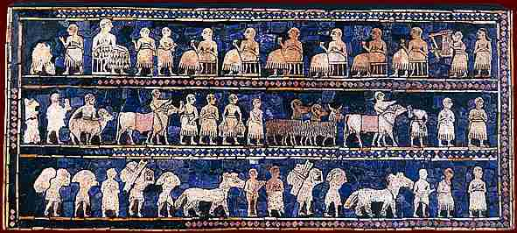
5- Social Organization
A complex social hierarchy emerged as people were ranked in society according to the job they performed.
Nobility & Priests
Warriors
Merchants & Artisans
Farmers & fishermen
Slaves

Slide 9
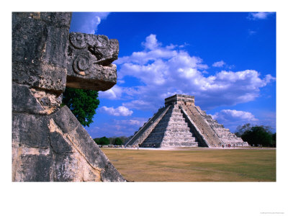
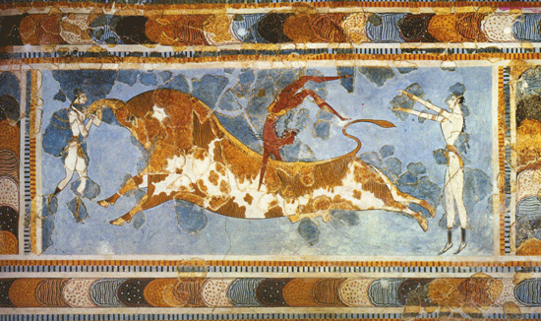
6- Arts & Architecture
Art & buildings expressed the values of the people who created them.
People often integrated myths, symbols, & religious imagery into pottery, weaving, buildings, etc.

Slide 10
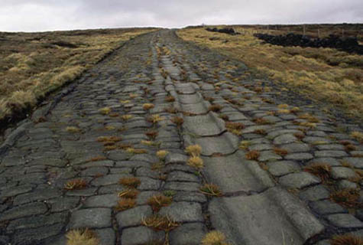
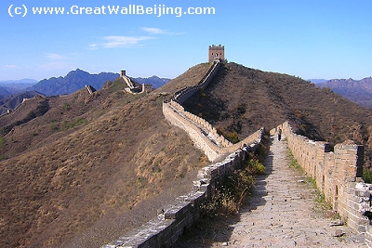
Public Works
Construction projects paid for through taxes & constructed by a government for the benefit or use of the people.
Includes temples, palaces, roads, sewers, irrigation systems, defensive walls, etc.

Slide 11
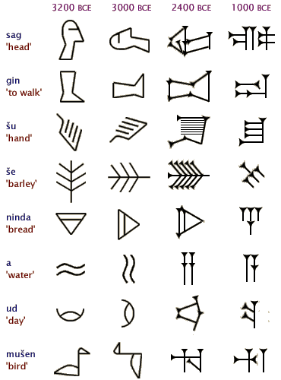
7- Writing
Most likely began in temples where priests needed to record information about rituals & prayers.
Scribes developed a complex system of pictograms that represented things in life.
Writing allowed people to record & later refer to treaties, contracts, tax rolls, laws, & history.

Slide 12
Features of Civilization
Cities
Job Specialization
Bureaucracy
Organized Religion
Social Organization
Arts and Architecture
Public Works
Long Distance Trade
Writing

