Slide 1
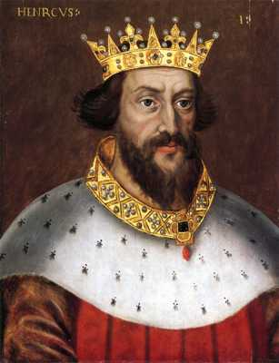
Kings & Royalty
Highest position
Controlled large amounts of land
Provided fiefs (land) to noblity in exchange for loyalty & service
Lived in a Castle
  Wooden strongholds at first
  By 1100, made of stone

Slide 2
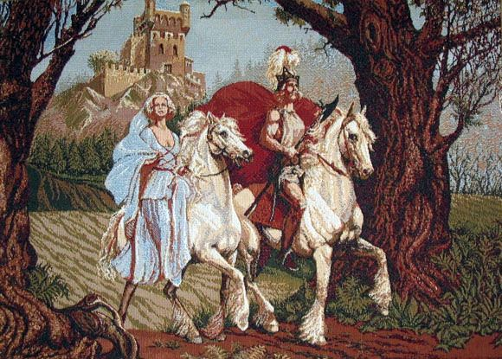
Nobles & Lords
Owned their fief & everything on it
Lived on a Manor
Serfs & Peasants worked the land for the lord
Provided food, services, & soldiers for their liege

Slide 3
Clergy
Each manor had some sort of religious building
Clergy lived in monasteries or churches on the Manor
Served the lord & people on the manor for the Church
Received land & support from the lord’s Manor
High ranking clergy could become lords with vassals

Slide 4
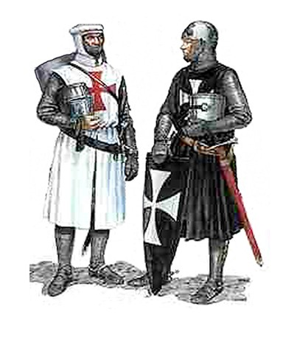
Knights
Received land from lord in exchange for fighting
Starting training as a Paige at age of 7-8
Became Squire at 13-14
Knighthood at 18 years old
Lived by code of Chivalry
  Bravery in battle
  Fight fair
  Keep promises
  Defend the Church
  Treat noble women with courtesy

Slide 5
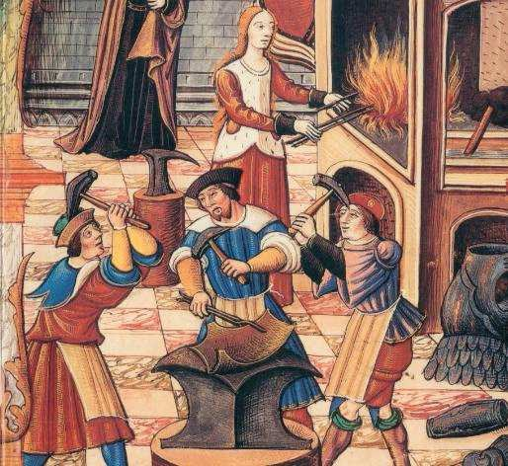
Tradesmen
Medieval guilds: A group of artisans engaged in the same occupation.
Commercial Monopoly:
Controlled membership & wages
Apprentice
  ⬇
  Journeyman
  ⬇
  Master Craftsman
Controlled quality of the product [masterpiece]
Controlled prices & supplies of goods

Slide 6
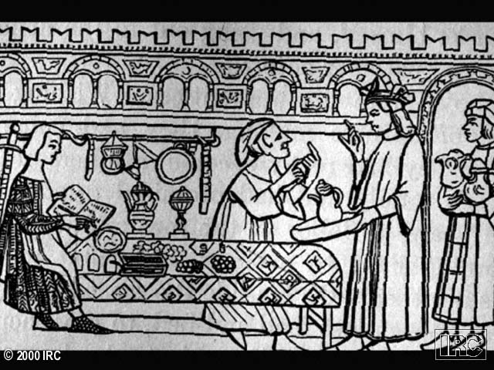
A Silversmith’s Shop

Slide 7
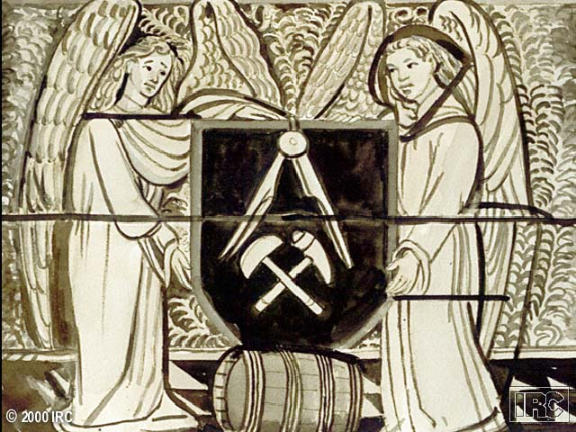
Crest of a Cooper’s Guild

Slide 8
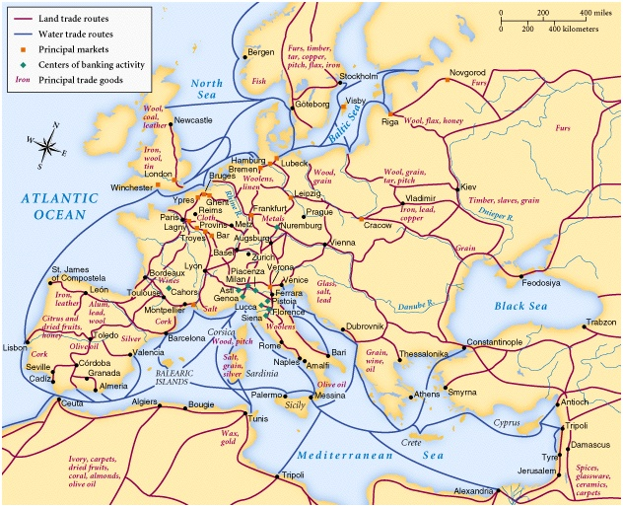
Medieval Trade

Slide 9
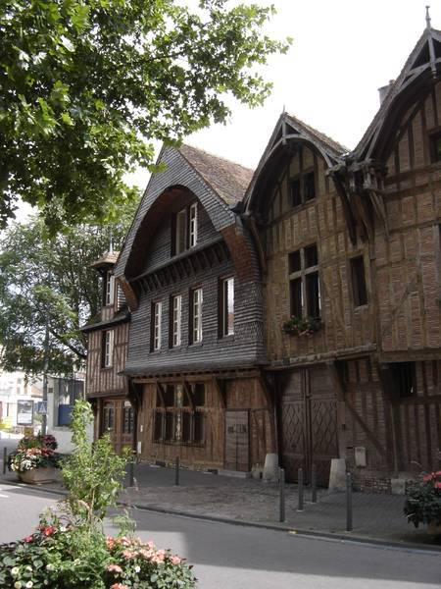
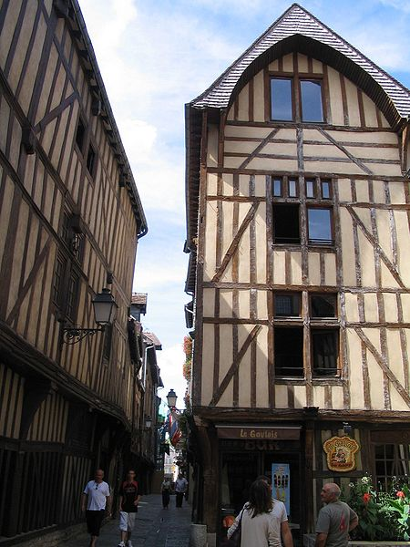
Late Medieval Towns

Slide 10
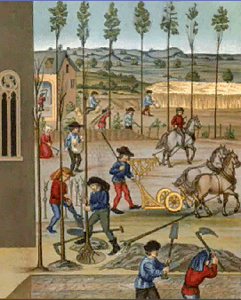
Peasants
Serfs were part of the land granted in fiefs
Some were freemen & worked for wages
Remained in serfdom for life, close to slavery
Lord allowed peasants to live on land in exchange for food & services

Slide 11
