Slide 1
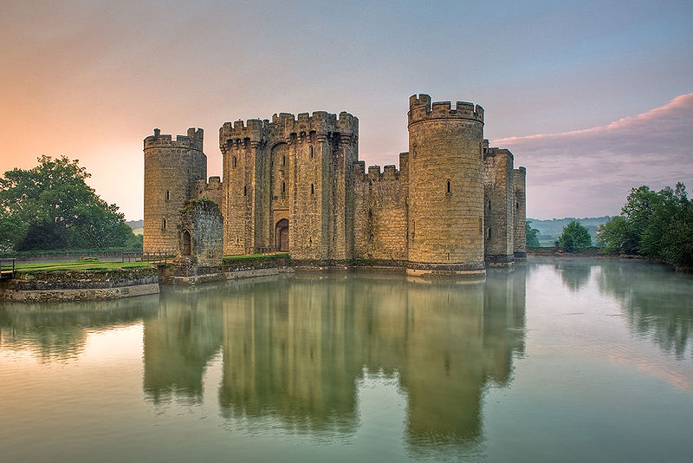
Feudal Europe

Slide 2
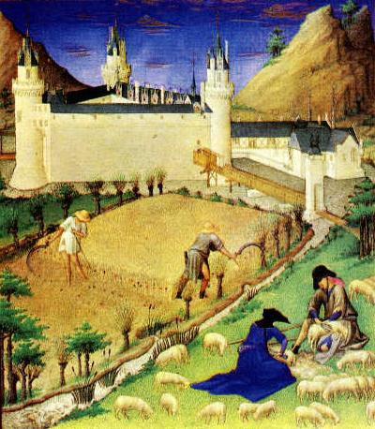
Medieval European Society
The fall of the Roman Empire leads to a time of chaos in Europe:
No central authority
Constant warfare
Decline in learning & trade
Smaller kingdoms
Increased power of the Church
Most people reverted to farming

Slide 3
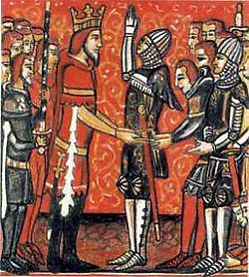
Feudalism
A political & social system based on military service & protection.
It worked because ALL needed the system in order to survive.
The concept of vassalage provided the structure.

Slide 4
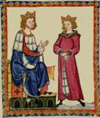
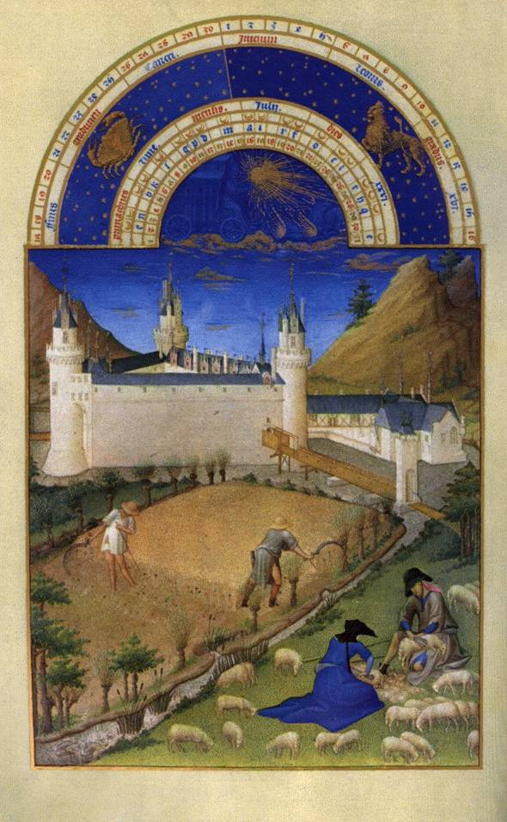
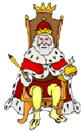
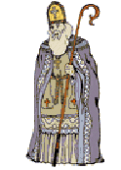
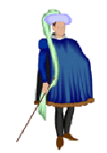
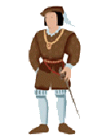
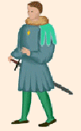
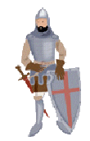
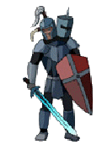
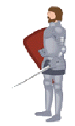
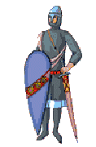
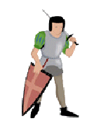
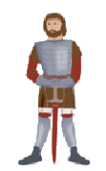
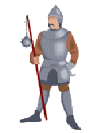
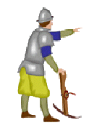
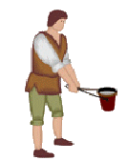
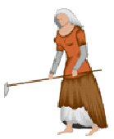
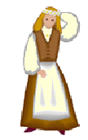
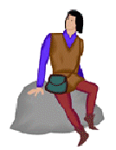
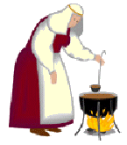
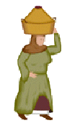
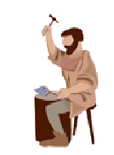
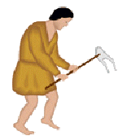
Cooperation & Mutual Obligations
KING
Fief and Peasants
Fief and Peasants
FEUDALISM: POLITICAL SYSTEM
Loyalty
Military Aid
LORDS (VASSALS TO KING)
MANORIALISM: ECONOMIC SYSTEM
Food Protection Shelter
Food Protection Shelter
Homage
Military Service
KNIGHTS (VASSALS TO LORDS)
Food Protection Shelter
Farm the Land
Pay Rent
PEASANTS (SERFS)

Slide 5
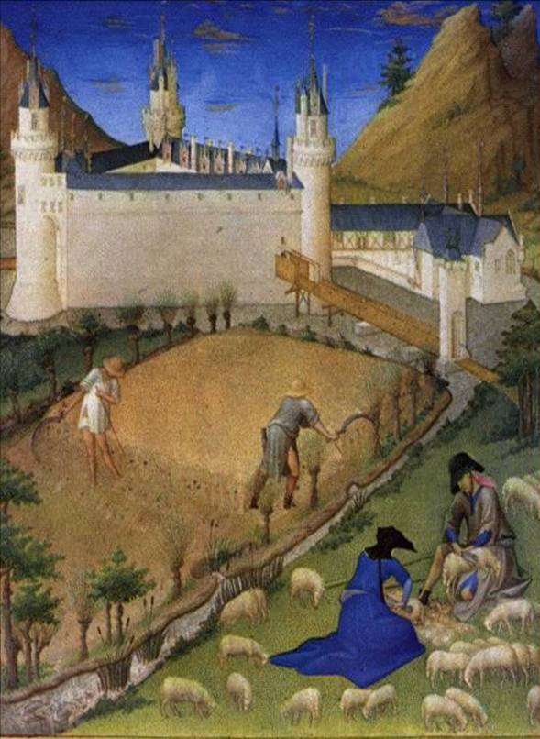
Manorialism
An economic system supporting a lord & his vassals
The manor was an estate where the community worked in agriculture
Manors were self-sufficient, providing all of the necessary goods for its inhabitants
Barter was the usual form of exchange
Everyone had certain jobs to perform

