Slide 1
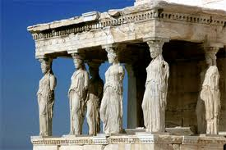
Welcome to Ancient Greece!

Slide 2
GEOGRAPHY
Greece is a peninsula, which means that it is surrounded on three sides by water. Greece has a lot of smaller peninsulas sticking out from it, which means Greece enjoys many natural harbors.

Slide 3
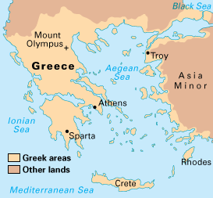
VOCAB WORD
Peninsula: a portion of land that is nearly surrounded by water.

Slide 4
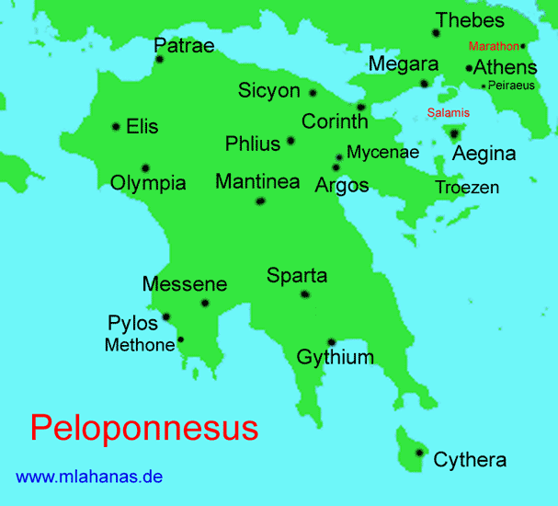
VOCAB WORD
Peloponnesus: The large southern peninsula in Greece.

Slide 5
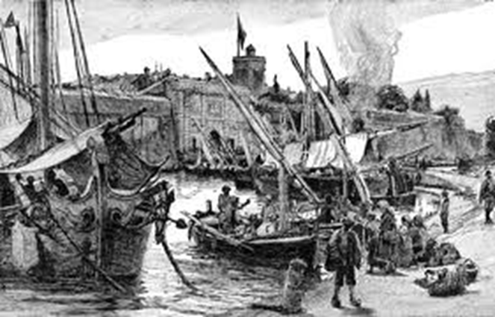
VOCAB WORD
Harbor: a sheltered port where ships can take on or discharge cargo.

Slide 6
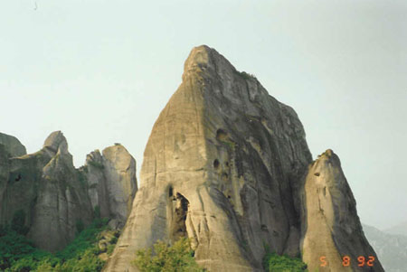
Greece is also covered with mountains, which made it hard to get around by foot, and hard to grow grain in some parts.
Three thousand years ago, it was very difficult to get from place to place in ancient Greece by walking. But it was easy to get from place to place in Greece by boat.

Slide 7
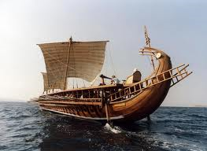
In the ancient world that grew up around the Mediterranean Sea, the Greeks became known as great sailors. They sailed about the Mediterranean, setting up colonies and outposts where they could.

Slide 8
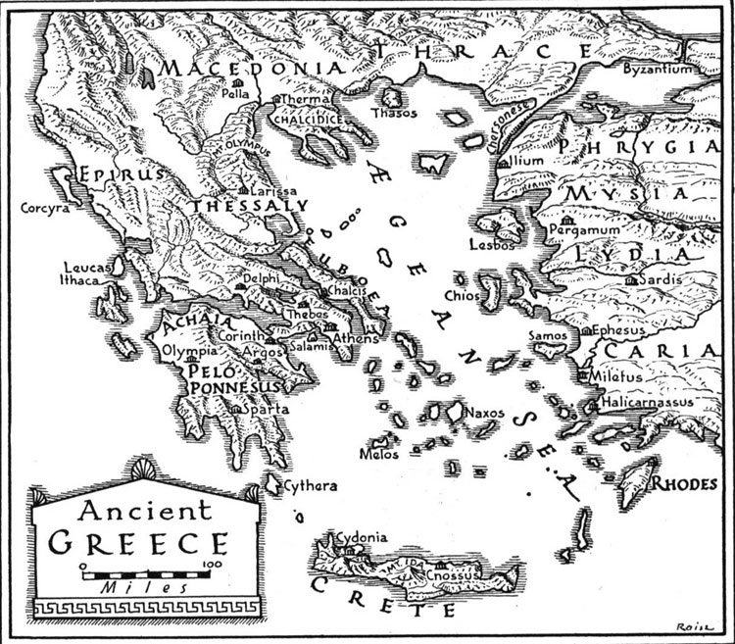

Slide 9
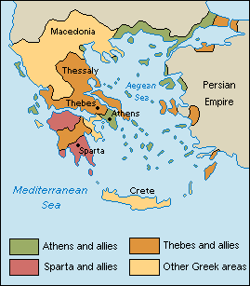
VOCAB WORD
City-State: A city that acts like its own nation.
It’s kind of like if Logan acted
like its own country, with its own
President, laws, and flag.

