Slide 1
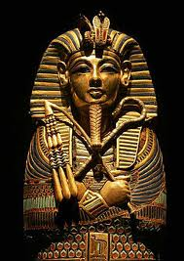
King Tutankhamen
The Boy King

Slide 2
Tutankhamen The Boy King
Reigned as King from about age 9 to 18
5’6 feet tall, slender build
Fond of athletics, love for hunting and driving chariots
Most important contribution was restoring religion
Unknown cause of death
Inherited the throne through marriage (at age 12) to his wife
It was believed that the queen wife of King Tut was also married to her own father

Slide 3
Howard Carter
November 1922 Howard Carter discovers the steps leading to King Tutankhamen's tomb.

Slide 4
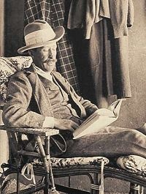
Lord Carnarvon
Doctors order him to stay in Egypt because he was in a serious wreck
Became interested in archeological finds
Financed Howard Carter’s work for fifteen years
Carnarvon suffered a severe mosquito bite infected by a razor cut
This led to the story of the "Curse of Tutankhamen", the "Mummy's Curse"

Slide 5
Plan of the Tomb

Slide 6
Stairway
16 steps discovered
there were several seals on the bottom of the door with Tutankhamen's name on them.
Now that the door was fully exposed, they also noticed that the upper left of the doorway had been broken through, presumably by tomb robbers, and resealed

Slide 7
First sealed doorway/Entrance
the workers had cleared the staircase, now exposing all 16 of its steps.
there were several seals on the bottom of the door with Tutankhamun's name on them.
they also noticed that the upper left of the doorway had been broken through, by tomb robbers, and resealed.
The tomb was not intact; yet the fact that the tomb had been resealed showed that the tomb had not been emptied.

Slide 8
The Passageway
The passageway was 40 feet long and only 7 feet high
At the end of the passage way was another re-sealed doorway
It was filled to the top with limestone chips. Carter could tell that tomb robbers had dug a hole through the upper left section of the passageway (the hole had been refilled in with larger, darker rocks than used for the rest of the fill).
This meant that the tomb had probably been raided twice .The first time was within a few years of the king's burial and before there was a sealed door and fill in the passageway (scattered objects were found under the fill). The second time, the robbers had to dig through the fill and could only escape with smaller items.
Tension mounted. If there was anything left inside, it would be a discovery of a lifetime for Carter. If the tomb was relatively intact, it would be something the world had never seen.

Slide 9
Antechamber
First chamber entered
With trembling hands I made a tiny breach in the upper left-hand corner. Darkness and blank space, as far as an iron testing-rod could reach, showed that whatever lay beyond was empty, and not filled like the passage we had just cleared. Candle tests were applied as a precaution against possible foul gases, and then, widening the hold a little, I inserted the candle and peered in, Lord Carnarvon, Lady Evelyn and Callender standing anxiously beside me to hear the verdict. At first I could see nothing, the hot air escaping from the chamber causing the candle flame to flicker, but presently, as my eyes grew accustomed to the light, details of the room within emerged slowly from the mist, strange animals, statues, and gold - everywhere the glint of gold.

Slide 10
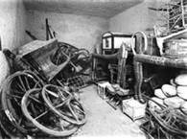
Antechamber/ Wall to Burial Chamber

Slide 11
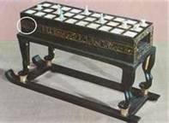
Annexe
Two known robberies
Left in a mess
Two game boards (senet)
Many funeral objects
Left in a mess
34 vases
they noticed another sealed door behind the couches on the far wall. This sealed door also had a hole in it, but unlike the others, the hole had not been resealed. Carefully, they crawled under the couch and shone their light.

Slide 12
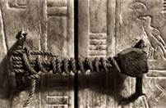
Sealed doorway to the Burial Chamber The seal of the Necropolis

Slide 13
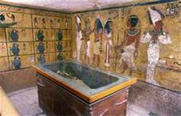
Burial Chamber
The inside of the Burial Chamber was almost completely filled with a large shrine over 16 feet long, 10 feet wide, and 9 feet tall. The walls of the shrine were made of gilded wood inlaid with a brilliant blue porcelain.
the walls of the Burial Chamber (excluding the ceiling) were covered with a gypsum plaster and painted yellow. Upon the yellow walls were painted funerary scene
On the ground around the shrine were a number of items, including portions of two broken necklaces that looked as if they had been dropped by robbers and magic oars "to ferry the king's barque [boat] across the waters of the Nether World.
As Carter and his team worked to disassemble the shrine they found that this was merely the outer shrine, with four shrines in total. Each section of the shrines weighed up to half a ton

Slide 14
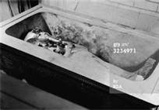
Coffins of tut
When they lifted the lid of the coffin, they found another, smaller coffin. The lifting of the lid of the second coffin revealed a third one, made entirely of gold. On top of this third, and final, coffin was a dark material that had once been liquid and poured over the coffin from the hands to the ankles. The liquid had hardened over the years and firmly stuck the third coffin to the bottom of the second. The thick residue had to be removed with heat and hammering. Then the lid of the third coffin was raised.
the whole interior of the golden coffin, was an impressive, neat and carefully made mummy, over which had been poured ointments
A brilliant, magnificent, burnished gold mask [picture] of the king, covered his head and shoulders death mask
Carter and his team found over 150 items - almost all of them gold - on the mummy, including amulets, bracelets, collars, rings, and daggers.

Slide 15
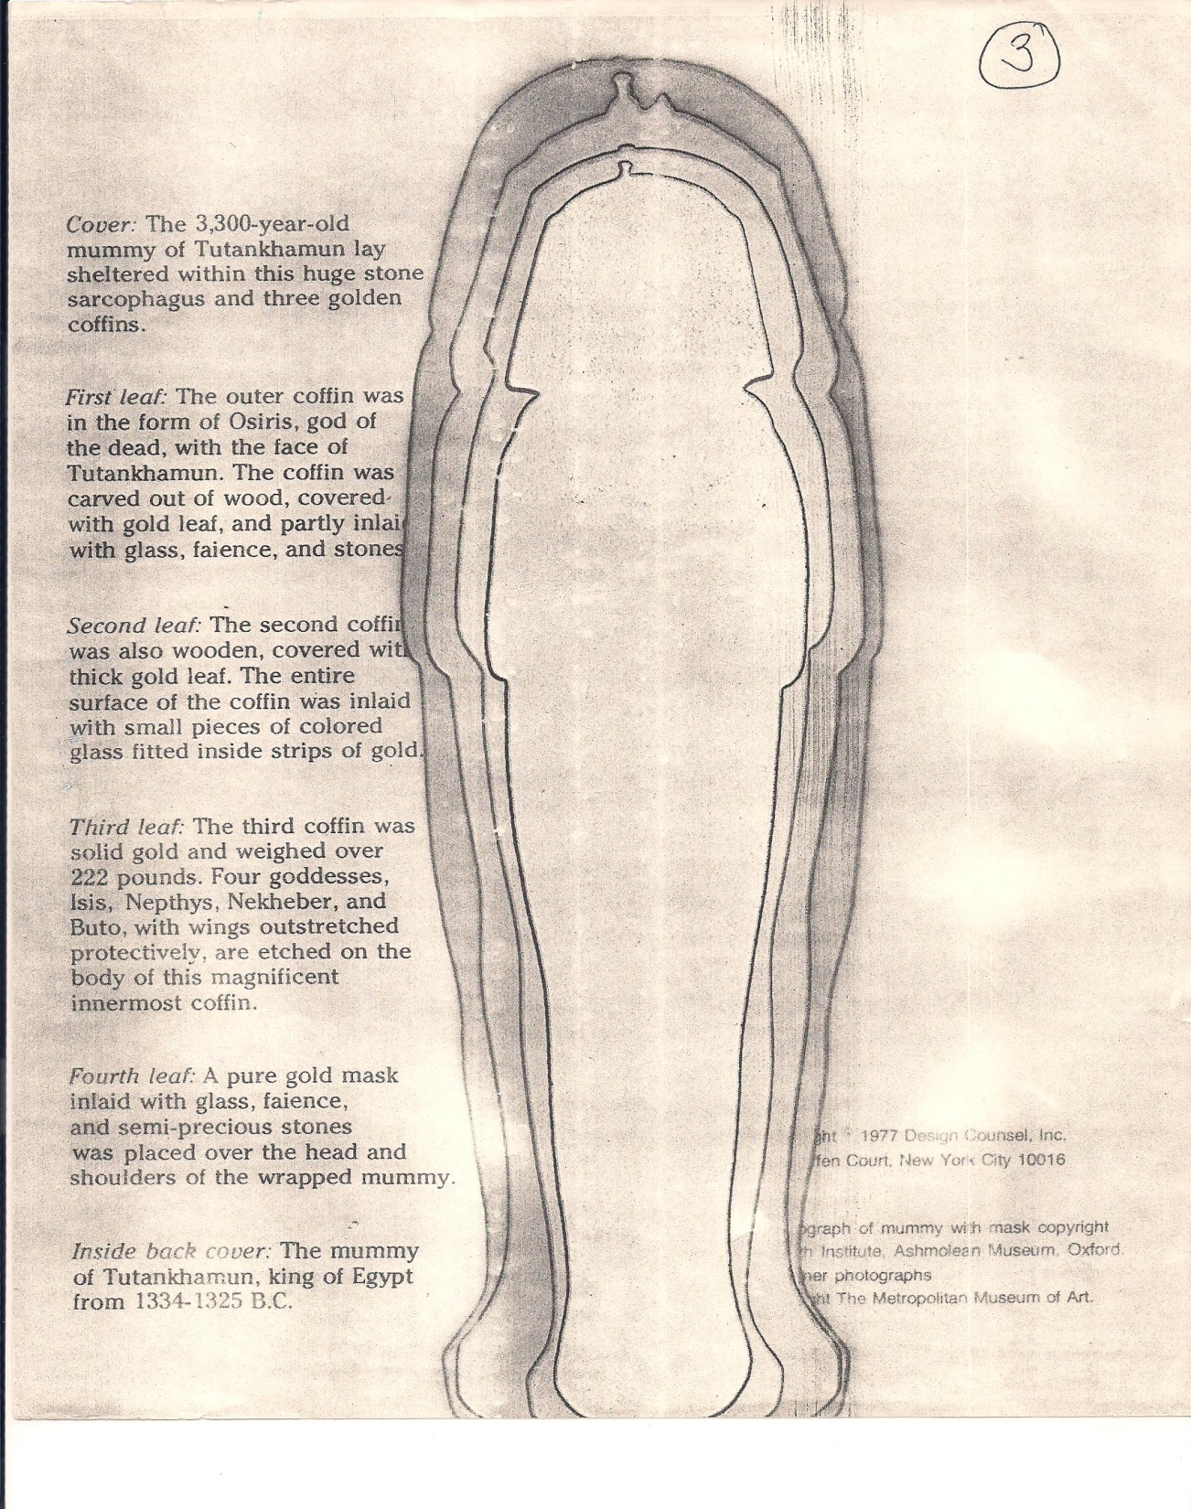

Slide 16
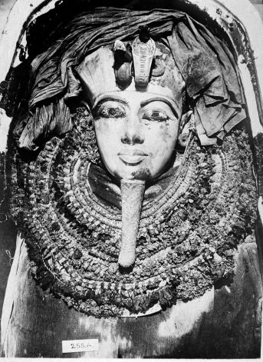
Burial Chamber continued
When the fourth shrine was disassembled, the king's sarcophagus was revealed. The sarcophagus was yellow in color and made out of a single block of quartzite. The lid did not match the rest .
The contents were completely covered by fine linen shrouds. The lid being suspended in mid-air, we rolled back those covering shrouds, one by one, and as the last was removed a gasp of wonderment escaped our lips, so gorgeous was the sight that met our eyes: a golden effigy of the young boy king, of most magnificent workmanship, filled the whole of the interior of the sarcophagus. A gilded wooden coffin was revealed. The coffin was in a distinctly human shape and was 7 feet 4 inches in length.

Slide 17
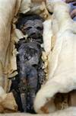
Burial Chamber continued
Only decorated room
Untouched for over 3,300 years
Coffins of two babies

Slide 18
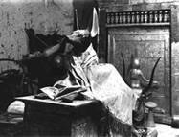
Treasury

Slide 19
Treasury
Treasury, like the Antechamber, was filled with items including many boxes and model boats. In this room was the large gilded canopic shrine. Inside the gilded shrine was the canopic chest made out of a single block of calcite. Inside the canopic chest were the four canopic jars, each in the shape of an Egyptian coffin and elaborately decorated, holding the pharaoh's embalmed organs - liver, lungs, stomach, and intestines.

