Slide 1
knights
and castles

Slide 2
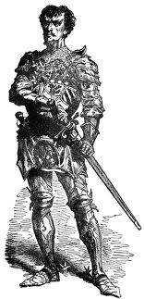
Vocab Word
What is a knight?
Knight: soldier who was trained to fight to defend the King, armor and weapons.

Slide 3
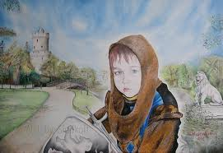
First step to becoming a knight

Slide 4
Vocab word
Page: First step in knighthood- began around age 8.
At age eight, a nobleman's son began training for knighthood. During this first step of training, boys were called pages.
As a page, a boy learned how to fight, how to use weapons, and how to ride a horse into battle. He learned manners from the nobleman's wife.

Slide 5
Page duties
Like everyone, pages had a strict rule of conduct, a certain way of behaving that they had to follow. The rules were very detailed and very clear. Some of the rules were:
When you enter a lord's place, say, "Good Speed" and with humble cheer, greet all who are present.
Do not rush in rudely, but enter with head up and at an easy pace, and kneel on one knee only to your lord.
Make obeisance (bow) to your lord always when you answer, otherwise stand as still as a stone until he speak.

Slide 6
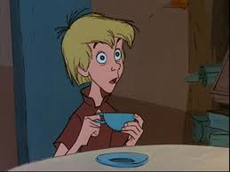
Disney page duties

Slide 7
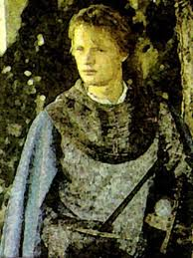
Second step

Slide 8
Vocab word
Squire: Second step to becoming a knight. About age 14.
At age 14, a page could become a squire. Each squire was assigned to a knight. A knight could have several squires. The squire assisted the knight to whom he was assigned. Squires continued to learn how to fight and how to behave.

Slide 9
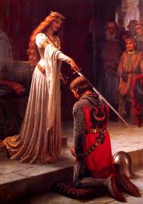
Final stages
Once a squire proved himself in battle, and his knight felt he was ready, he could become a knight himself. Squires were knighted in elaborate ceremonies.

Slide 10
Proper behavior
All knights, like all people from all walks of life in the Middle Ages, had to behave in a certain way. This way was called the Code of Chivalry. The code said that all knights had to be brave in battle. They had to keep their promises. They had to defend the church. They had to treat noblewomen in a courteous manner. Over time, chivalry became the basis of good manners in Western society.
Chivalry: a code of conduct on how to treat women, honor, truth, and obedience.

Slide 11
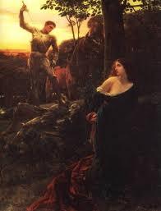
What does this painting teach us about chivalry?

Slide 12
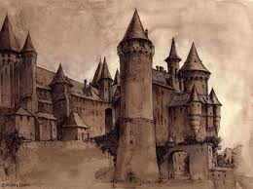
castles

Slide 13
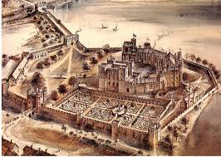
Vocab word
Castle: a fortified structure
(show video)
Show movie

Slide 14
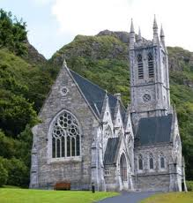
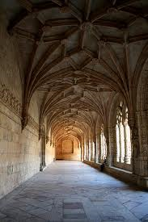
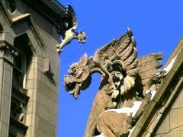
Vocab word
Gothic: style of architecture characterized by pointed arches, ribbed vaulting, stained glass, and gargoyles.

