Slide 1
The Magna Carta
England
June 15, 1215

Slide 2
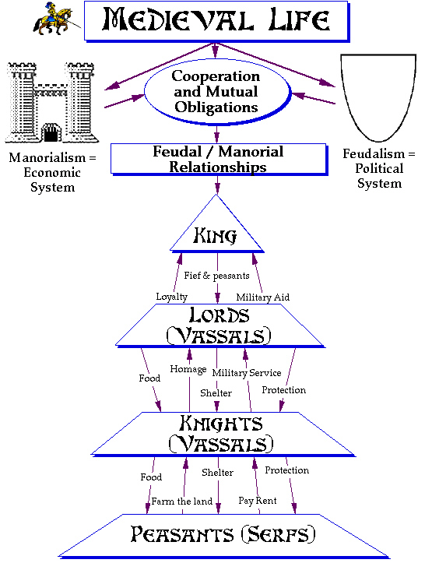

Slide 3
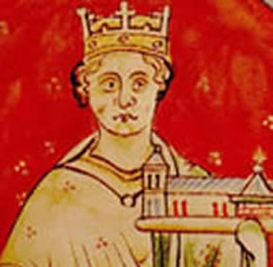
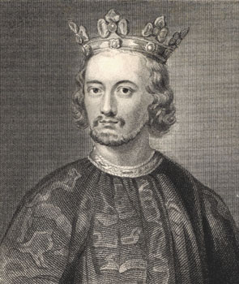
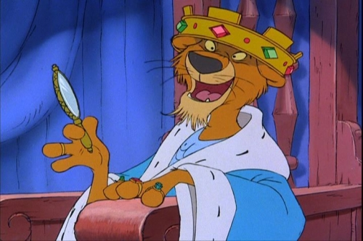
King John of England
Notes:
What do we know about King John, based on the handout you received yesterday?

Slide 4
You are King John – are you the weakest link?
With your partner you need to consider how King John should react to various situations.
Record your decisions on your sheet – you will later get a score for each answer
Your aims as king are:
Always appear to be strong and powerful
Stop other rulers stealing your land or interfering in your rule
Keep the Empire together – lose no land
Keep the barons on your side – you need them to fight for you and pay taxes
Keep your promises so people trust you

Slide 5
You are King John – are you the weakest link?
Decision 1
It is 1199. Your brother Richard has just died. Arthur - your 12 year old nephew – says he should be king. He is supported by most of the barons of the Empire in France, and by the king of France. You are supported by the barons in Normandy and England. Do you:
Agree to share the Empire with Arthur
Have yourself crowned king and then meet Arthur to discuss an agreement
Have yourself crowned king and then go to war against Arthur and France
Notes:
Decision 1
Which of Your aims will be achieved if you choose a?
1 2 3 4 5
Which of Your aims will be achieved if you choose b?
1 2 3 4 5
Which of Your aims will be achieved if you choose c?
1 2 3 4 5
Your final choice – John should
Because

Slide 6
You are King John – are you the weakest link?
Decision 1
Lose 2 crowns – what a weak choice!
Decision 1
b. Lose 1 crown – not quite as bad as (a)
Decision 1
c. Gain 1 crown - good choice – makes you look strong

Slide 7
You are King John – are you the weakest link?
Decision 2
Arthur allied with the king of France against you. You capture him. He is only 14, but he has just led an army against you. What should you do with him?
Make him promise to be loyal to you and then set him free
Keep him prisoner
Secretly execute him
Notes:
Decision 2
Which of Your aims will be achieved if you choose a? 1 2 3 4 5
Which of Your aims will be achieved if you choose b? 1 2 3 4 5
Which of Your aims will be achieved if you choose c? 1 2 3 4 5
Your final choice – John should
Because

Slide 8
You are King John – are you the weakest link?
Decision 2
Lose 3 crowns – are you mad to set him free?
Decision 2
b. Gain 1 crown – make sure he can’t escape
Decision 2
c. Lose 1 crown – executing him means he won’t be a problem – but will people ever trust you again?

Slide 9
You are King John – are you the weakest link?
Decision 3
You have lost the war against France and so lost all your lands in France. What will you do about this?
Accept this defeat and give up hope of having an Empire like your brother and father
Discuss the problem with your barons and accept their suggestions
Plan to win the lands back – whether the barons support you or not
Notes:
Decision 3
Which of Your aims will be achieved if you choose a? 1 2 3 4 5
Which of Your aims will be achieved if you choose b? 1 2 3 4 5
Which of Your aims will be achieved if you choose c? 1 2 3 4 5
Your final choice – John should
Because

Slide 10
You are King John – are you the weakest link?
Decision 3
Lose 2 crowns – you would look like a weak failure!
Decision 3
b. Gain 1 crown – it’s your best chance
Decision 3
c. Lose 1 crown – you can’t win without barons’ support

Slide 11
You are King John – are you the weakest link?
Decision 4
You need money to pay soldiers to fight for you. How do you raise money?
Ask the barons about how much tax they will pay
Double the amount of tax paid by landowners when they inherit land
Make the tax paid when land is inherited ten times what it used to be – or even more if you can get away with it.
Notes:
Decision 4
Which of Your aims will be achieved if you choose a? 1 2 3 4 5
Which of Your aims will be achieved if you choose b? 1 2 3 4 5
Which of Your aims will be achieved if you choose c? 1 2 3 4 5
Your final choice – John should
Because

Slide 12
You are King John – are you the weakest link?
Decision 4
Gain 1 crown – you really must consult the barons about tax
Decision 4
b. Lose 1 crown – everyone will hate double taxes
Decision 4
c. Lose 2 crowns – Everyone will be furious

Slide 13
You are King John – are you the weakest link?
Decision 5
The Archbishop of Canterbury has just died. The monks at Canterbury have chosen who they want to be the next archbishop. In the past, the king has been able to choose the Archbishop. What do you do?
Accept the man the monks want
Make your own choice and force the monks to accept your man
Ask the Pope to make an arrangement
Notes:
Decision 5
Which of Your aims will be achieved if you choose a? 1 2 3 4 5
Which of Your aims will be achieved if you choose b? 1 2 3 4 5
Which of Your aims will be achieved if you choose c? 1 2 3 4 5
Your final choice – John should
Because

Slide 14
You are King John – are you the weakest link?
Decision 5
Gain 1 crown – you will look a bit weak, but it won’t cause any further problems
Decision 5
b. Gain 1 crown – a bit risky but you’ll probably get away with it
Decision 5
c. Lose 1 crown – it looks as though you’re giving power away to the Pope

Slide 15
You are King John – are you the weakest link?
Decision 6
The Pope chooses Stephen Langton to be next archbishop. He says you must accept Langton or he will close down all churches in England
Refuse to accept Langton because the Pope has no right to interfere in your reign
Accept the Pope’s choice because Langton will be a good Archbishop
Notes:
Decision 6
Which of Your aims will be achieved if you choose a? 1 2 3 4 5
Which of Your aims will be achieved if you choose b? 1 2 3 4 5
Your final choice – John should
Because

Slide 16
You are King John – are you the weakest link?
Decision 6
Lose 2 crowns – you really don’t need another problem right now!
Decision 6
b. Gain 1 crown – at least it keeps the Pope on your side

Slide 17
You are King John – are you the weakest link?
Decision 7
You are just about to invade Wales when you hear that some of your barons are planning to murder you. What do you do?
Order the rebellious barons to send their sons as hostages and carry on with the invasion. Then tell the barons you will kill their sons if they carry on rebelling
Abandon your invasion and deal with the problem of the barons instead
Notes:
Decision 7
Which of Your aims will be achieved if you choose a? 1 2 3 4 5
Which of Your aims will be achieved if you choose b? 1 2 3 4 5
Your final choice – John should
Because

Slide 18
You are King John – are you the weakest link?
Decision 7
Lose 1 crown – you look strong, but no one will ever trust you and they’ll hate you even more than they do now!
Decision 7
b. Gain 1 crown – it looks a little weak but it’s more important to deal with the threat from the barons

Slide 19
You are King John – are you the weakest link?
Decision 8
You are still worried about rumours of rebellions and plots among your barons. What do you do?
Agree to discuss the way you are ruling the country with the barons
Bring in foreign advisers and soldiers you can trust. Give them castles and important lands to keep them loyal.
Notes:
Decision 8
Which of Your aims will be achieved if you choose a? 1 2 3 4 5
Which of Your aims will be achieved if you choose b? 1 2 3 4 5
Your final choice – John should
Because

Slide 20
You are King John – are you the weakest link?
Decision 8
Gain 1 crown – a difficult choice but you might be able to reduce the opposition!
Decision 8
b. Lose 2 crowns – bringing in more foreigners will increase people’s distrust

Slide 21
You are King John – are you the weakest link?
Decision 9
You want to invade France to win back some of the land you lost. The barons will not support you. They also will not pay scutage – a tax paid by lords who did not want to fight themselves
Threaten the barons who won’t fight or pay with really harsh punishment
Abandon the plans to invade France
Notes:
Decision 9
Which of Your aims will be achieved if you choose a? 1 2 3 4 5
Which of Your aims will be achieved if you choose b? 1 2 3 4 5
Your final choice – John should
Because

Slide 22
You are King John – are you the weakest link?
Decision 9
Lose 3 crowns – do you really want the barons to rebel – that’s what will happen!
Decision 9
b. Gain 1 crown – you have so many problems you will have to forget about France for now

Slide 23
You are King John – are you the weakest link?
Decision 10
You invaded France, but the French troops defeated your army in battle. The barons are still complaining about high taxes, foreign advisers and the way you run the country. There are still no church services in England and the Pope is threatening to help the French King The Pope suggests a peace agreement if you accept Langton. What will you do?
Agree reluctantly to the agreement
Refuse the pope’s offer
Notes:
Decision 10
Which of Your aims will be achieved if you choose a? 1 2 3 4 5
Which of Your aims will be achieved if you choose b? 1 2 3 4 5
Your final choice – John should
Because

Slide 24
You are King John – are you the weakest link?
Decision 10
Gain 1 crown – at least that gets the Pope on your side!
Decision 10
b. Lose 2 crowns – refuse the Pope’s offer? – you’re in big trouble now!

Slide 25
You are King John – are you the weakest link?
Decision 11
The King of France is threatening to invade England and some of the barons might help him. They want you to lower taxes, get rid of foreign advisers and soldiers, and agree to consult them about how to govern. What do you do?
Agree reluctantly with them
Tell them you were chosen by God and can do whatever you want.
Notes:
Decision 11
Which of Your aims will be achieved if you choose a? 1 2 3 4 5
Which of Your aims will be achieved if you choose b? 1 2 3 4 5
Your final choice – John should
Because

Slide 26
You are King John – are you the weakest link?
Decision 11
Gain 1 crown – you really don’t have any choice!
Decision 11
b. Lose 2 crowns – there will be a civil war!

Slide 27
You are King John – are you the weakest link?
Decision 12
You agree to Magna Carta only because you were forced to. Now the barons are having their own discussions. What do you do?
Hold meetings to get the barons to work together in the hope that they will help you win back land in France
Build up your army to attack the rebel barons and put an end to Magna Carta
Notes:
Decision 12
Which of Your aims will be achieved if you choose a? 1 2 3 4 5
Which of Your aims will be achieved if you choose b? 1 2 3 4 5
Your final choice – John should
Because

Slide 28
You are King John – are you the weakest link?
Decision 12
Gain 1 crown – you must try to stop the barons attacking you
Decision 12
b. Lose 2 crowns – the barons will now get rid of you – permanently!

Slide 29
You are King John – are you the weakest link?

Slide 30
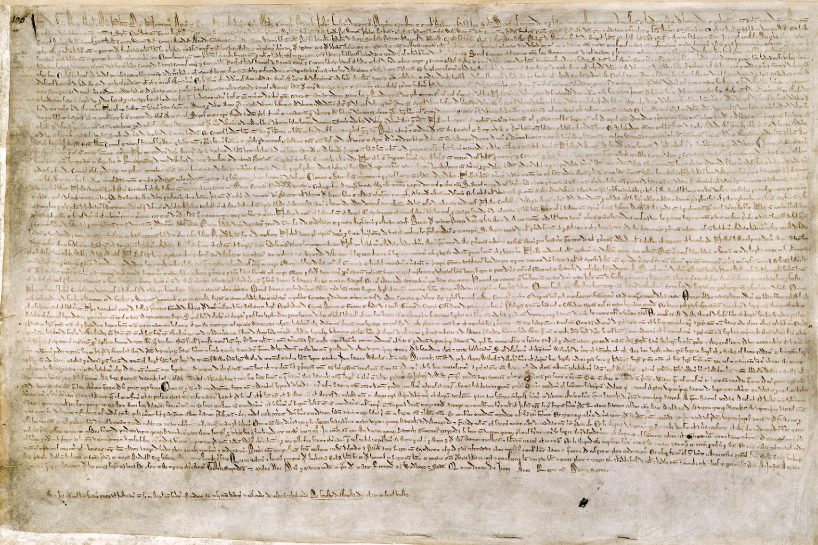
The Great Charter
Notes:
Read out loud. What is the point of the first paragraph? The 2nd, 3rd, 4th and 5th? Do any of these ideas seem familiar, from out own lives?

Slide 31
Four major concepts
1- Rule of law
  Powers and privileges of the king are clearly defined and limited
  Charter provides for enforcement of restrictions placed on the king

Slide 32
We also have granted to all the freemen of our kingdom, for us and for our heirs forever, all the underwritten liberties, to be had and holden by them and their heirs, of us and our heirs forever…

Slide 33
No scutage [tax] or aid shall be imposed in our kingdom, unless by the general council of our kingdom; except for ransoming our person, making our eldest son a knight and once for marrying our eldest daughter; and for these there shall by paid no more than a reasonable aid.

Slide 34
Four major concepts
2-Fairness of the laws and their execution
  "Reasonable" rules and regulations
  Equal justice under the law
  Recognition of customs, traditions, and established rights
  Restoration of property and fines if not justly taken
  Punishment in proportion to the crime

Slide 35
3- Commitment to “due process of law”
  Established procesdures
  No trial without evidence/testimony to support accusations
  Reliance on local courts and magistrates
  Trials held in a timely manner
  Trials open to the public
  Trial by a jury of one’s peers

Slide 36
No freeman shall be taken or imprisoned, or deprived, or outlawed, or banished, or in any way destroyed…unless by the lawful judgment of his peers, or by the law of the land.

Slide 37
4- Respect for economic rights
  Right to property
  Fairness in economic transactions—standard weights and measures
  Reimbursement for and/or restoration of property
  Freedom for merchants to move in order to conduct business

Slide 38
We will sell to no man, we will not deny to any man, either justice or right.
HAVE YOU SEEN THIS BEFORE?

Slide 39
Assignment!!!
As a reporter for the Medieval Times newspaper in London, write a front-page headline story about the signing of the Magna Carta. Be sure to explain who, what, when, where, why and how, as well as use vocabulary words.

