Slide 1
Features of Civilization
[Civilization] is roughly anything we do and the monkeys don't.
~Lord Raglan~

Slide 2
Physical Geography
Every civilization arises and adapts to the climate and the lay of the land.
You will need to create and title a map that shows your civilization’s boundaries, a mountain range, 2 rivers, a lake, a forest, a desert, and includes a scale, legend, and cardinal directions.

Slide 3
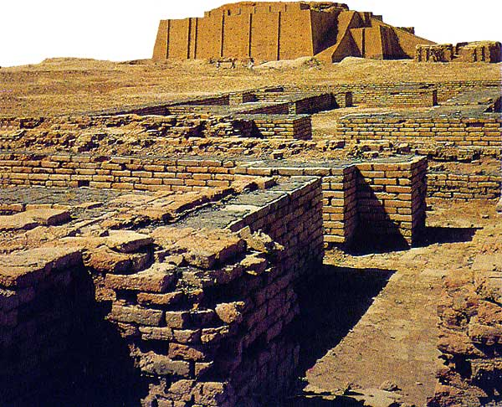
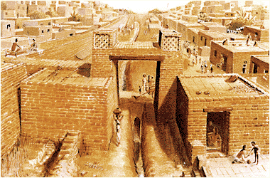
Cities
The central feature of civilizations.
Your civilization will need a capital city and at least 3 other cities.

Slide 4
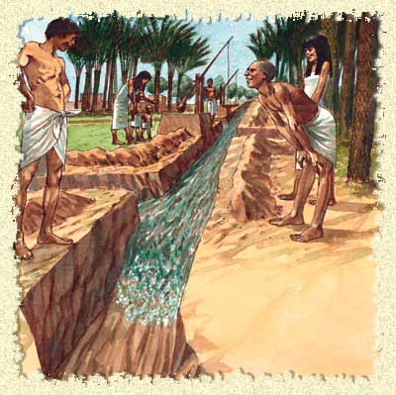
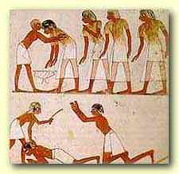
Government
Civilizations created central governments to:
Oversee complex public works
Ensure a steady supply of food was available
Maintain order (laws & punishments)
Organize defense
Collect taxes
Provide planning & leadership
You will need to describe who will make decisions in your government. Will you have a monarchy, democracy, republic, oligarchy, or another system?

Slide 5
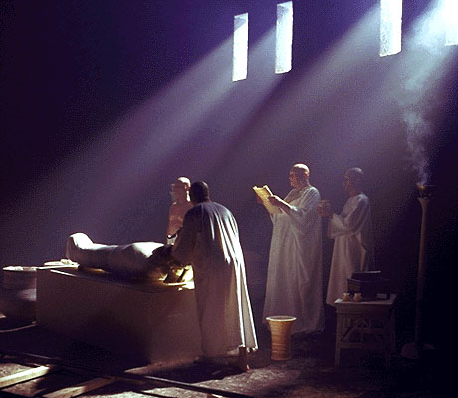
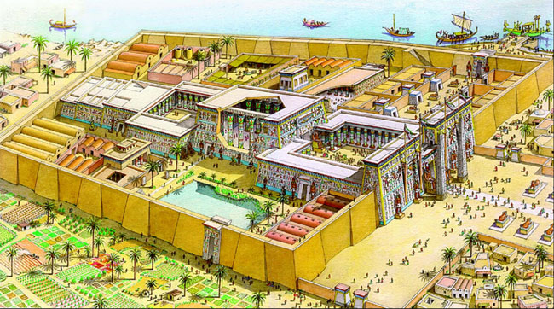
Organized Religion
Ancient people believed they must appeal to gods who control nature & human activities.
What will be the religious beliefs and practices of the people in your civilization?

Slide 6
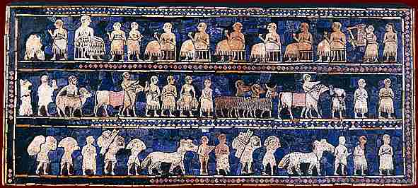
Social Organization
A complex social hierarchy emerged as people were ranked in society according to the job they performed.
Nobility & Priests
Warriors
Merchants & Artisans
Farmers & fishermen
Slaves
You will have to describe how people relate to one another in your society. Also, is there a system of education? Who goes and what is taught?

Slide 7
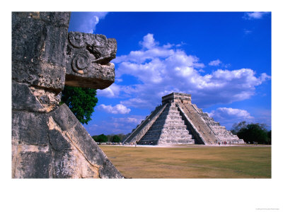
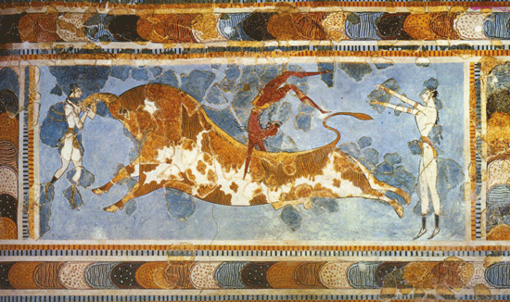
Arts & Architecture
Art & buildings expressed the values of the people who created them.
What kinds of culture, arts, and entertainment will be popular in your civilization?

Slide 8
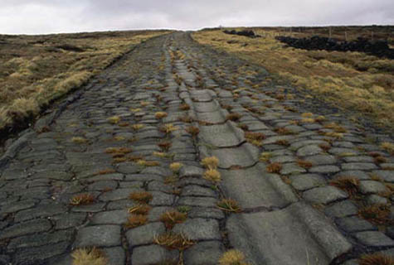
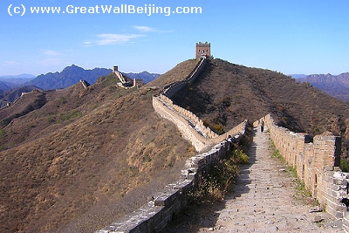
Public Works
Construction projects paid for through taxes & constructed by a government for the benefit or use of the people.
Includes temples, palaces, roads, sewers, irrigation systems, defensive walls, etc.
What will your pyramid be? What architectural structures will you have?

Slide 9
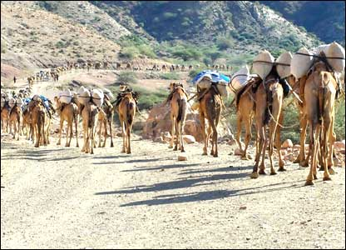
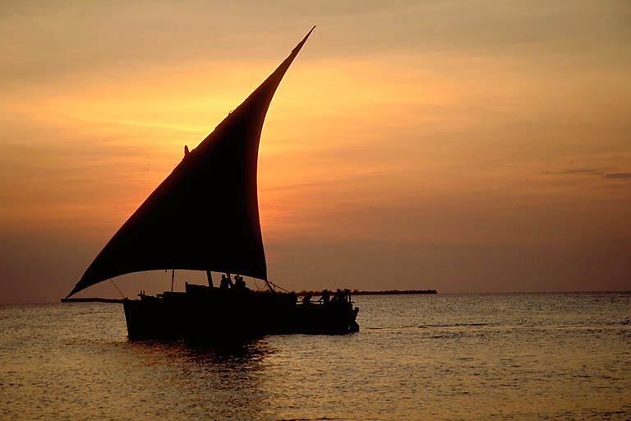
Economy
Job specialization and long distance trade are important features of a civilization.
How will people in your civilization support themselves economically (food, money, and jobs)? What will your civilization produce? What will be your staple crop?

Slide 10
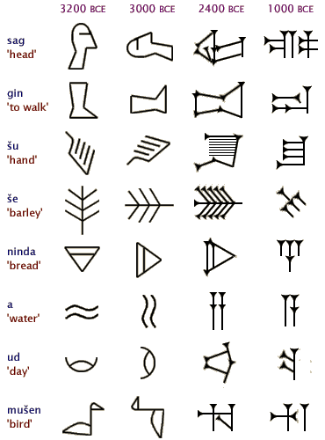
Writing
Civilizations develop their own systems of recording important information.
What will your civilization’s system of writing look like?

