Slide 1
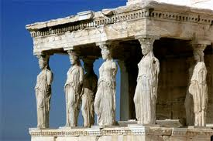
Welcome to Ancient Greece!

Slide 2
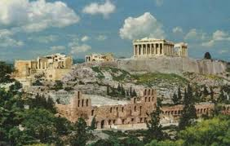
Vocab word
Polis: A City-State in ancient Greece.

Slide 3
What is the polis or city-state?
A town that governed itself and usually had no more than 20,000 people.
Included a walled off town and surrounding farmland.
It covered an area of only about 100 square miles.
They developed due to the terrain of Greece which naturally separated people (seas and mountains)

Slide 4
What is the polis or city-state?
All city-states spoke Greek, though dialects varied.
Religion and the worshiping of Greek gods united city-states.
Each city-state had its own legends, traditions, and local heroes.
City-states were largely independent which made wars and invasion common.
Each city-state worshiped a main god or goddess as its patron, or central god most important to the city's well-being.

Slide 5
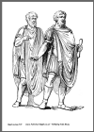
Who were citizens?
A citizen is a person who has rights and responsibilities in their community. Only men could be citizens, and not even all men were granted this right. Women had few rights, and slaves could not be citizens either.

Slide 6
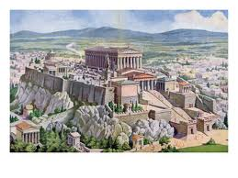
Vocab word
Acropolis: A large hill in ancient Greece where city residents found shelter in times of war.

Slide 7
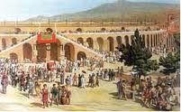
Vocab word
Agora: The marketplace and meeting place in Greece cities.

Slide 8
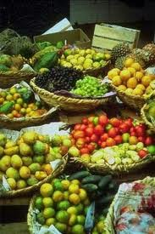
Vocab word
Commodity: Something that can be bought or sold.

Slide 9
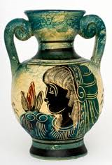
Common commodities
One of the most important commodities of ancient Greece was pottery.
It was used to store goods and wine on long voyages.
It was also collected as a work of art.

Slide 10
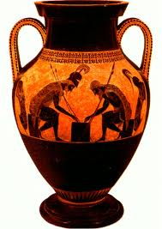

Slide 11
30 second discussion
What kind of commodities come from our community?

Slide 12
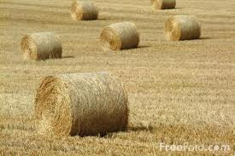
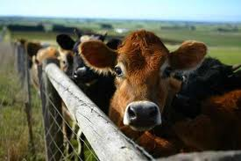
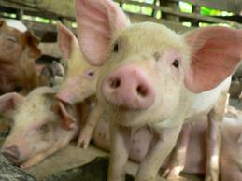
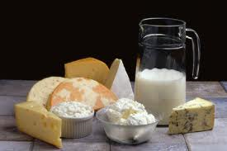

Slide 13
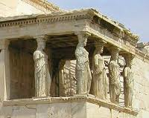
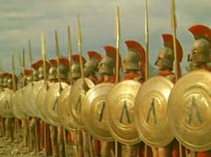
Star city-states
ATHENS and SPARTA were the most famous Greek city-states.
Athens Sparta

Slide 14
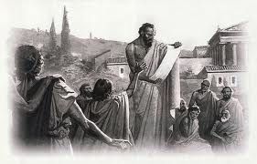
Vocab word
Athens: A city-state known for democracy.

Slide 15
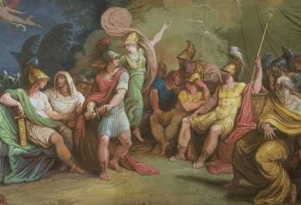
Who makes the law?
Assembly: A law-making part of government made up of citizens.

Slide 16
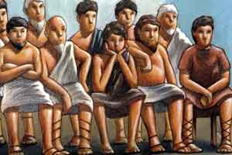
What if you break the law?
Jury: A group of citizens that make a decision in court.

Slide 17
Vocab word
Athens was also the intellectual center for Greece. People were able to sit and ponder the mysteries of life.
Philosophy: The search for truth, wisdom, or the right way to live.

