Slide 1
The Renaissance
Began in Italy
Later spread to the rest of Europe
What was the difference between the Italian Renaissance and the Northen Renaissance?

Slide 2
The Italian Renaissance
They were interested in human achievement (rather than spiritual or religious achievement)
The figures in their artwork looked like Greek or Roman gods (i.e. perfect)

Slide 3
The Northern Renaissance
They were interested in the early Christian period.
The figures in their artwork were more realistic.

Slide 4
Both Italian and Northern
Both interested in Greek and Roman culture (the “classics”)
Use of perspective in paintings
Believed in humanism
Used a critical method of study

Slide 5
What is humanism?
Hint: What word is inside the word?
Idea started in the Renaissance that people have worth, value
Middle Ages: Only God can do good
Renaissance: Humans can do good
Basis on a liberal arts education

Slide 6
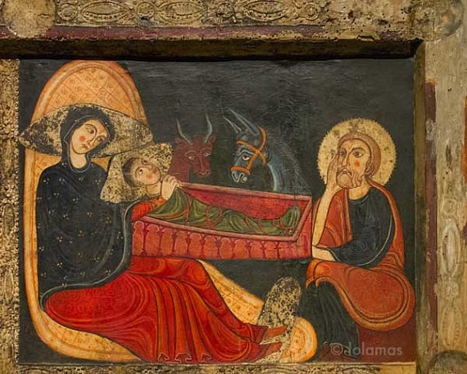
Medieval vs. Renaissance Art
Medieval-
No proportion
No perspective
Religious themes are central
Little kid drawings?

Slide 7
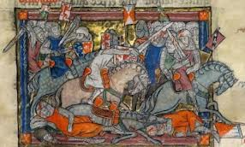
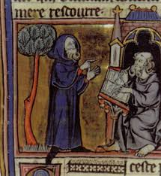
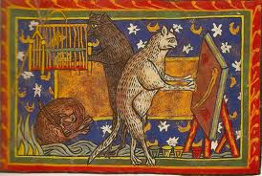
Art From the Middle Ages

Slide 8
Renaissance Art
Scenes from everyday art
Paintings have perspective (3 dimensional depth)
Paintings look more realistic

Slide 9
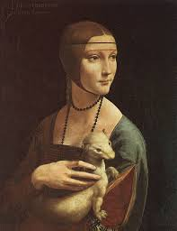
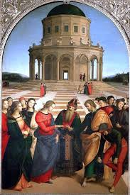
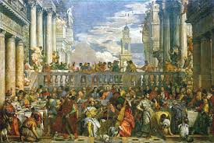
Renaissance Art

Slide 10
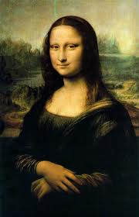
Da Vinci’s Mona Lisa

Slide 11
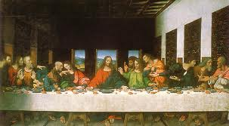
Da Vinci’s Last Supper

Slide 12
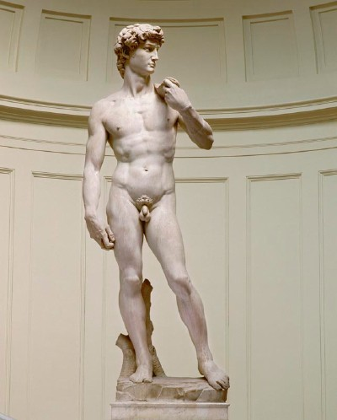
Michelangelo’s David

Slide 13
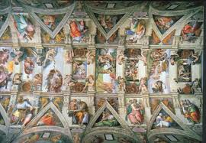
Michelangelo’s Sistine Chapel

Slide 14
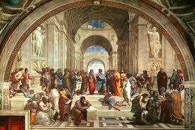
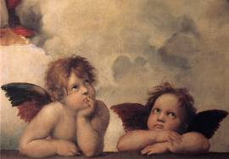
Raphael

Slide 15
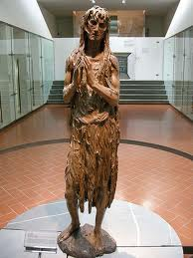
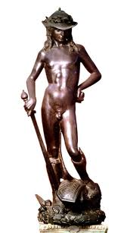
Donatello

Slide 16
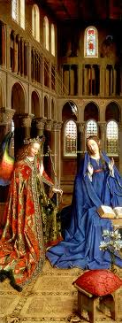
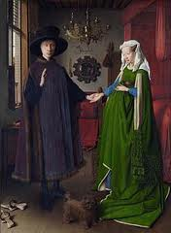
Jan Van Eyck

Slide 17
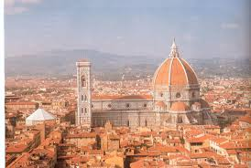
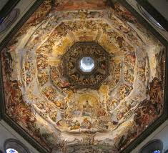
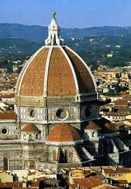
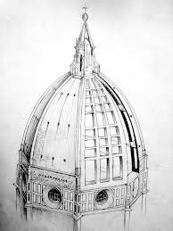
Architecture- Brunelleschi

