Slide 1
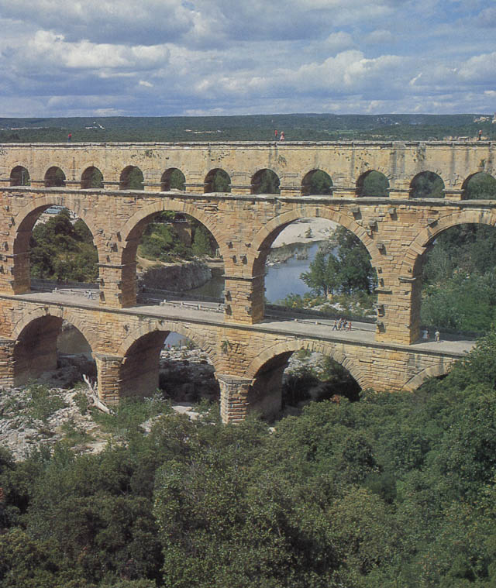
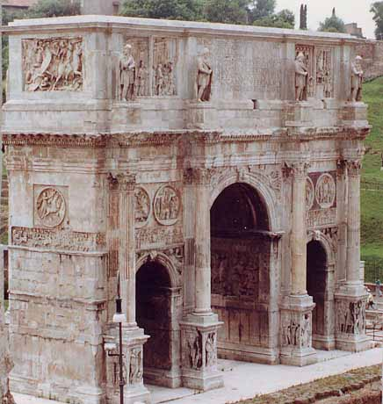
Rome: Republic to Empire

Slide 2
The Roman Forum

Slide 3
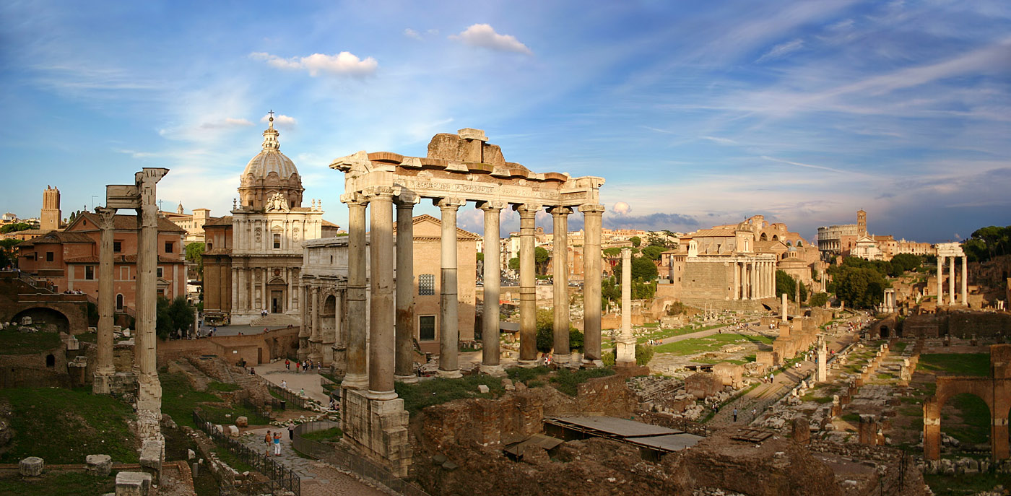
The Roman Forum Today
Forum was the political, judicial, economic, and religious center of the Republic—emerged in the 7th c. BCE and abandoned by the 4th c. CE

Slide 4
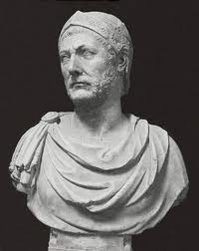
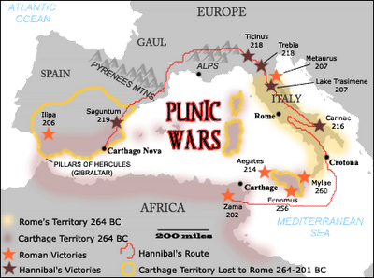
Hannibal & the Punic Wars 264-201 BCE
Rome and the powerful city-state of Carthage fought a series of 3 wars over control of the Mediterranean trade routes
Legendary general Hannibal attempted a surprise attack on Rome in the Second Punic War by crossing the Alps with a herd of unfortunate war elephants
Rome defeated Hannibal at the Battle of Zama but Carthage remained a regional competitor until the Romans completely destroyed the city in the 3rd war (149-146 BCE) and sold off its inhabitants as slaves

Slide 5
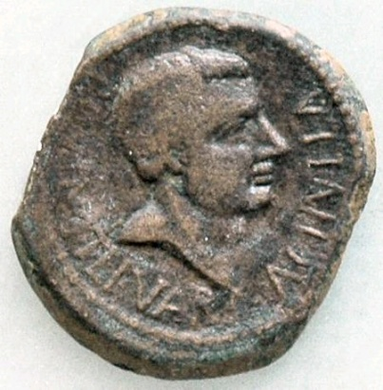
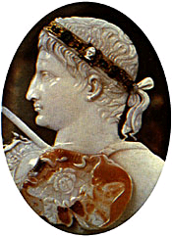
Roman Conquests
After Rome defeated Carthage in 146 BCE, it seemed no Mediterranean force could stop the Romans
Victory over Carthage gave Rome a taste of imperialism—wealth from plunder, slaves for cheap labor, new farm lands, control of trade routes, provinces for taxation, glory for generals (who could resist all of this?)
Rome then launched a series of wars on the Eastern Mediterranean
One by one, Macedonia, Greece, and parts of Asia Minor (Turkey) surrendered and became Roman provinces
Other regions, like Egypt, allied with Rome
By 133 B.C., Romans called the Mediterranean Mare Nostrum, or “Our Sea”

Slide 6
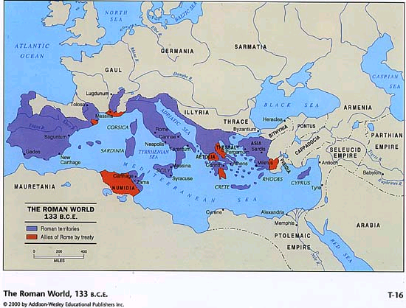

Slide 7
Republic
Rome was very successful under the republic.
It grew wealthy, strong, and conquered most of the land that would be its empire
Yet, the Republic was overthrown during times of prosperity
How did this happen?
The wealthy and war heroes had lots of power and popularity

Slide 8
Julius Caesar
Caesar was from a wealthy and important Roman family
He wanted to have political power
In Rome that often meant he need military success as well
Caesar led an army into Gaul (France) and during a 9 year campaign conquered most of Gaul
He conquered more land than anyone else in Roman history he extended Rome’s borders all the way to the English Channel
Back in Rome he became very popular

Slide 9
Triumvirate and Civil War
To control the senate the three most powerful generals agreed to work together
Crassus had stopped slave revolts and wanted tax breaks and respect
Pompey won victories east of Greece and wanted land for soldiers/ consul position
Caesar wanted a Triumph (monument) for his victories and government positions

Slide 10
Caesar
Pompey flees to Greece to gather his army
Caesar is able to defeat him
Pompey runs to Egypt where he is killed by Egyptians hoping to make Caesar happy
Caesar goes back to Rome in 46 B.C.E and the senate names him Dictator for 10 years
A Dictator is similar to a tyrant

Slide 11
Caesar’s Rule
46 B.C.E Caesar is named Dictator for life
He fixes many problems. Rebuilds city center, cuts taxes, pays off Rome’s debts, founds 20 new colonies, lowers crime, etc
Yet, on March 15 44 B.C.E he is assassinated by members of the senate
Why?
Not everyone likes him, senate wants power back, people of Rome don’t want a King

Slide 12
Augustus
After Caesar’s death you may think the Republic was reestablished. It was not!
Octavian Augustus was the adopted heir of Caesar.
During Caesar’s assassination Augustus was in Greece studying
At age 19 he came to Rome to claim Caesar’s popularity and position
With Caesar’s military friend Mark Antony, Augustus was able to control the government

