Slide 1
The Rise of Christianity

Slide 2
Judaism in the Roman World
Roman Compromise
63 BC, Romans conquered Judaea & chose a new ruler for the region.
Jews unwilling to abandon their monotheistic religion for the Romans’ polytheism.
Roman leaders allowed Jews to practice their religion as long as they maintained civic order & paid tribute.
Reactions to Roman Rule
Jewish zealots wanted to drive Romans from Judaea & reestablish the Kingdom of Israel.
Jewish tradition held that a Messiah, or Savior, would rise to free them.

Slide 3
A New Religion
In the 30s AD, the teachings of Jesus of Nazareth developed into Christianity
Christos, Greek for “savior”; some Jews viewed Jesus as the Messiah.
Many of his teachings were rooted in the beliefs of Judaism, but he criticizes the Jewish leaders for their hypocrisy.
Some Jewish & Roman leaders felt threatened by Jesus’ teachings & popularity.
Authorities who feared political uprisings had him crucified.
Diaspora
After Jewish uprising, AD 66–70, Romans sacked Jerusalem, killed thousands of Jews, & destroyed the Second Temple
After another failed revolt in the AD 130s, all Jews were banned from Jerusalem & scattered

Slide 4
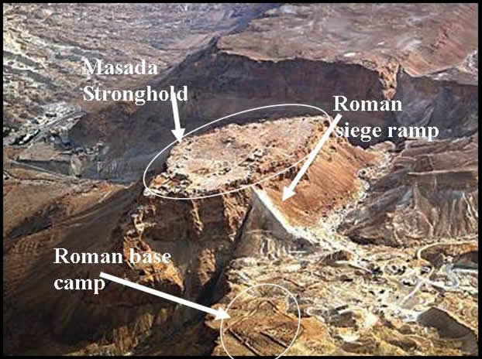
The Jewish Revolt AD 66-70
Masada

Slide 5
Christians Oppressed
Romans viewed Christians as a threat because:
They refused to honor the emperor with sacrifices
They refused to worship Roman gods to protect the state
They taught that the Kingdom of God would come to earth & displace other kingdoms
Jesus’ message equalizes, ignoring wealth & status
They were close-knit, secretive & traded only within their own community
Christians were used as scapegoats- blamed for social & economic problems
Some Christians became martyrs- people who suffer or die for their beliefs
Christianity continued to spread due to the fact that all people were welcome & equal
5
Notes:
5

Slide 6
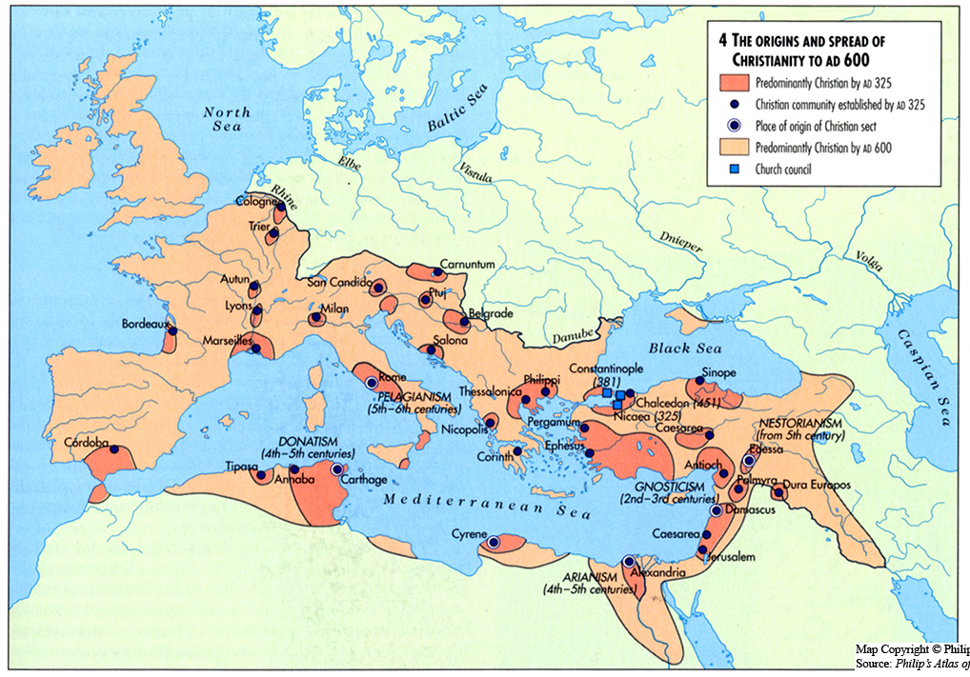

Slide 7
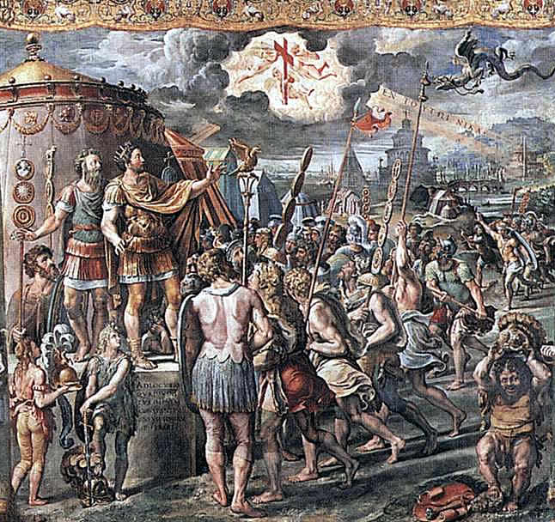
From Persecution to Preeminence
AD 312- Emperor Constantine issues the Edict of Milan after a military victory where he won under the sign of the cross.
The edict grants freedom of worship to all citizens of the Roman empire & Constantine himself converts.
392 AD- Emperor Theodosius makes Christianity the official religion of the Roman empire.
7
Notes:
7

