Slide 1
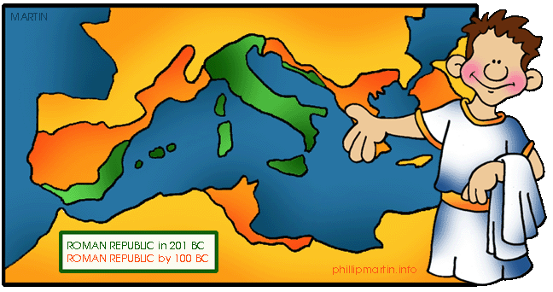
The Roman Republic
(509-31 B.C.)

Slide 2
Patricians & Plebians
Patricians: upper class, nobility & wealthy land owners.
Plebeians: lower classes. The plebs included everyone else in ancient Rome, from well-to-do tradesmen all the way down to the very poor.

Slide 3
The Republic
The last Etruscan king was expelled in 509 B.C. & Rome was declared a republic.
The Roman state included the Senate & the People of Rome- “Senatus Populus Que Romanus”.
SPQR was engraved on anything belonging to the state.
It was a publicity campaign that reassured the Romans that they would never again be ruled by tyrants.

Slide 4
The Senate
Composed of leaders from the patricians.
They were the law makers & controlled spending.
Senators served for life. There were 300 seats in the Senate.
When a seat opened, a new Senator was selected by the current Consuls.

Slide 5
Consuls
2 members of the Senate elected to serve for a one year term as the head of government.
Were the highest position in the Republic.
Ran the government, overseeing the work of other government officials.
Their most important power was that they controlled the army.

Slide 6
The Assembly
Composed of the plebeian citizens of Rome. Did not have a building, but gathered in the Forum to vote.
Could vote for or suggest laws, but the Senate could block their decisions.
Had one very impressive power: it voted each year on who would serve as Consuls.

Slide 7
Tribunes
Elected by the plebeian assembly that could argue for plebeian demands.
Their power was exercised through the veto, which could invalidate the acts of consuls & the Senate.
Anyone who attacked them or interfered with their duties could be killed.

Slide 8
Dictator
A ruler with complete control over the government in times of war or emergency.
His decisions could not be vetoed or appealed.
There could only be one dictator at a time, & no dictator could be held legally responsible for any action during his time in office.

Slide 9
Bread & Circuses
A plan Roman politicians devised about 140 B.C. to win the votes of the poor.
By giving out cheap food & entertainment, politicians used this policy as an effective way to gain political power.

