Slide 1
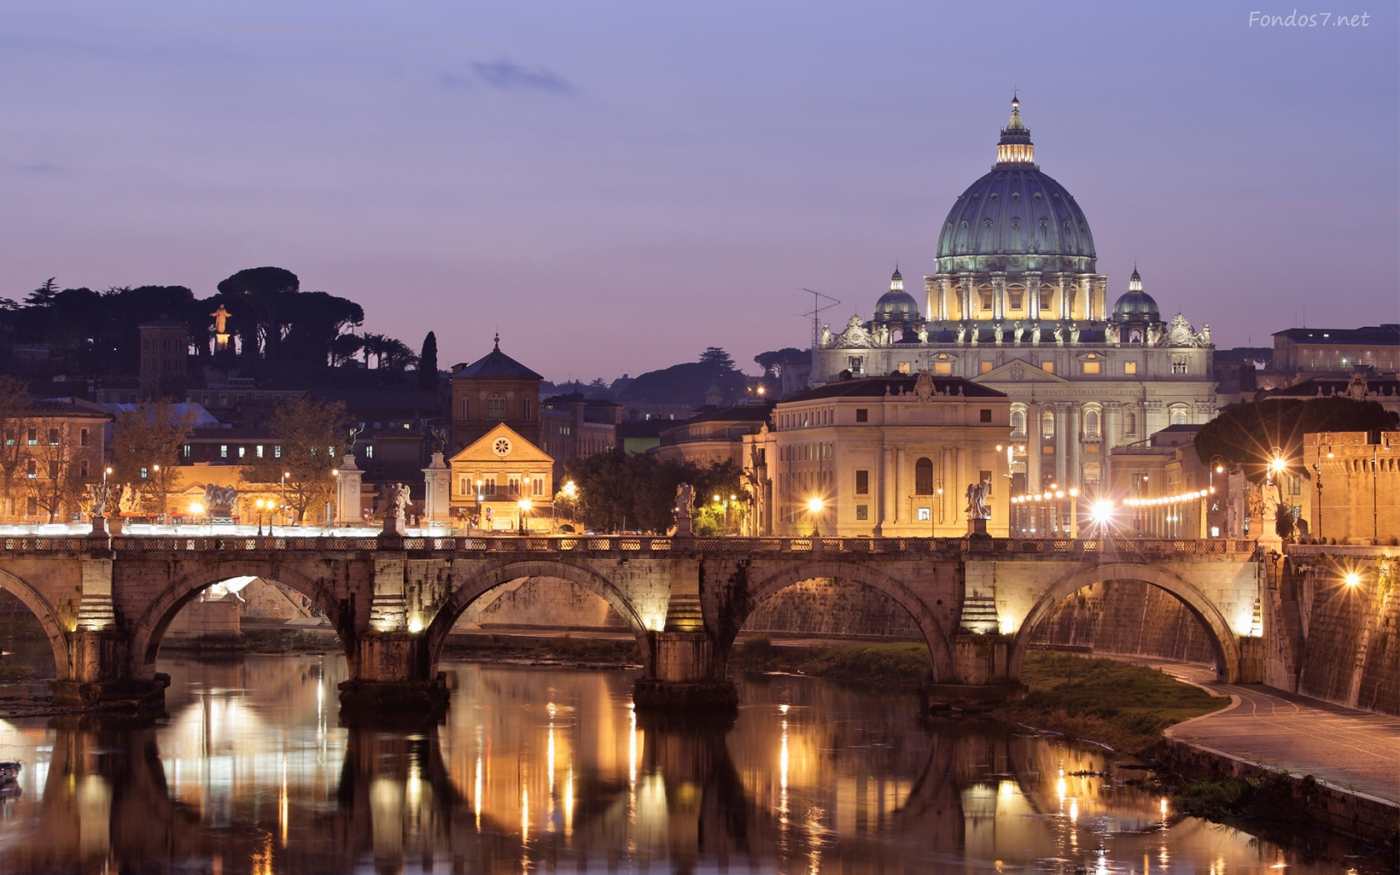
Rome Becomes an Empire

Slide 2
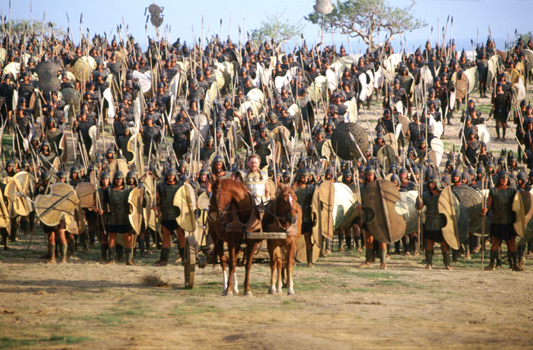
Rome Becomes an Empire
Main Idea:
The Roman Republic, weakened by civil wars, became an empire under Augustus.

Slide 3
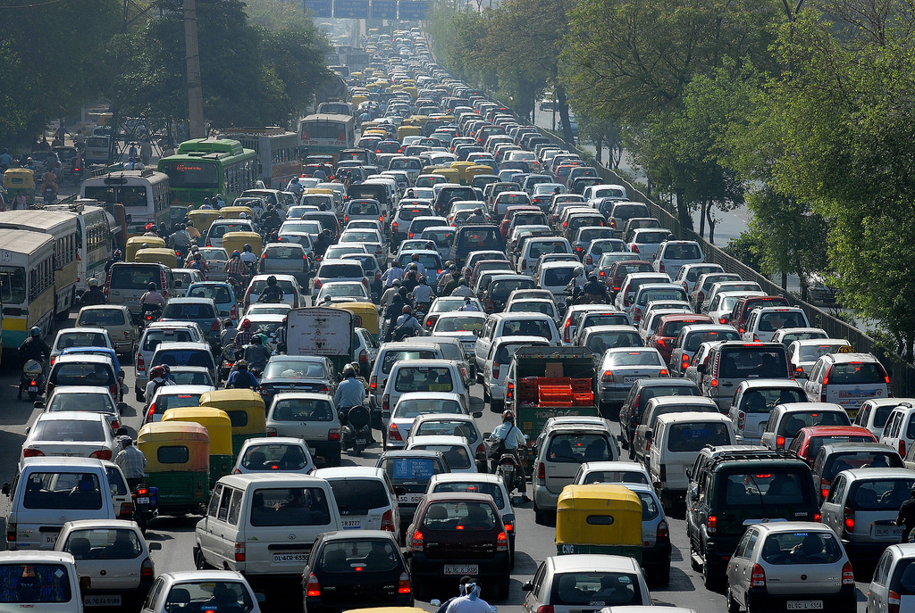
Rome Becomes an Empire
Have you ever been in a traffic jam and wished that a police officer would show up to get things going?
That is kind of how Rome was under a Republic…there was so much arguing and confusion that the people could not get moving.

Slide 4
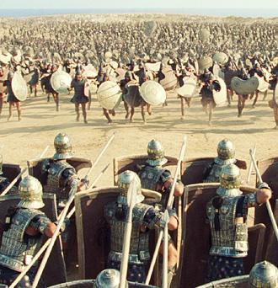
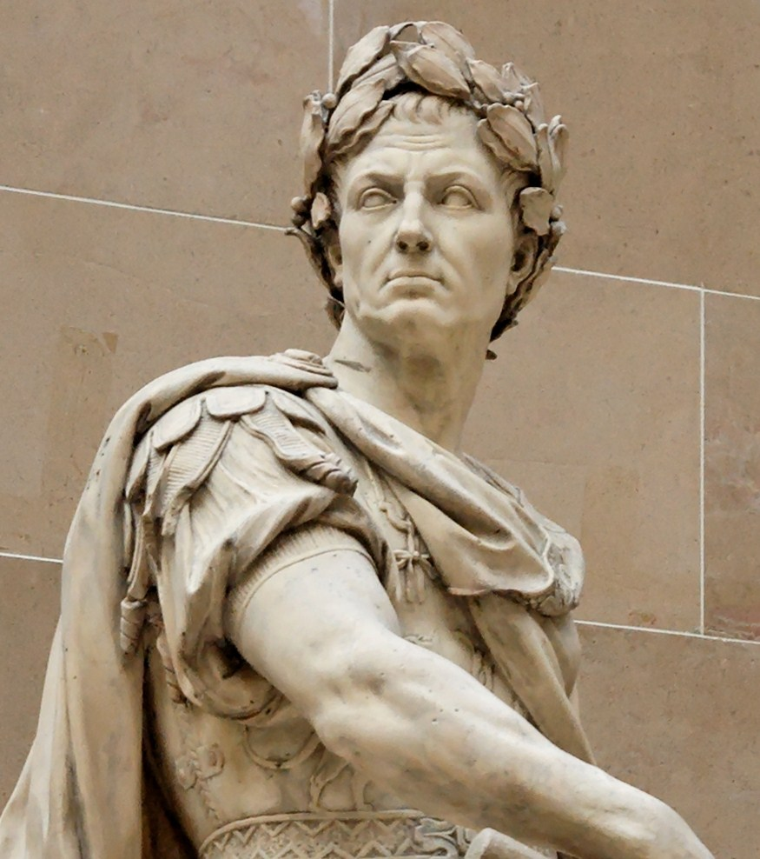
Rome Becomes an Empire
Caesar’s death plunged Rome into another civil war.
On one side were the forces led by the men who had plotted and killed Caesar

Slide 5
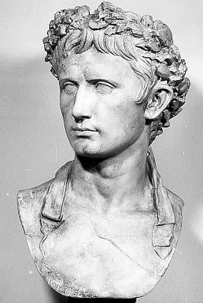
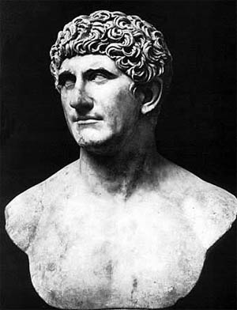
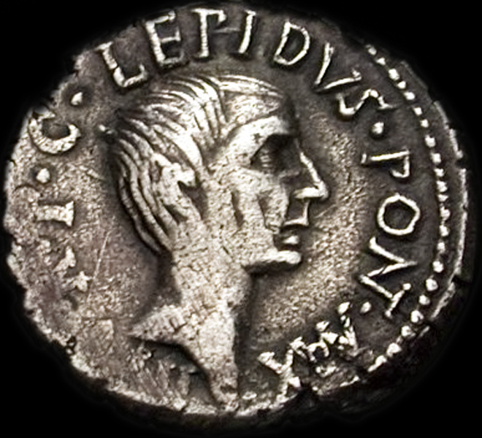
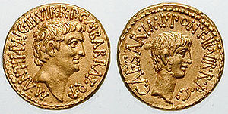
Rome Becomes an Empire
On the other side was Caesar’s grandnephew Octavian, who had inherited Caesar’s wealth and two of Caesar’s top generals, Mark Antony and Marcus Lepidus.
After defeating Caesar’s assassins, these three men created the second Triumvirate in 43 B.C.E.

Slide 6
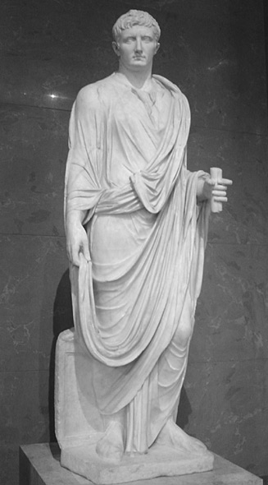
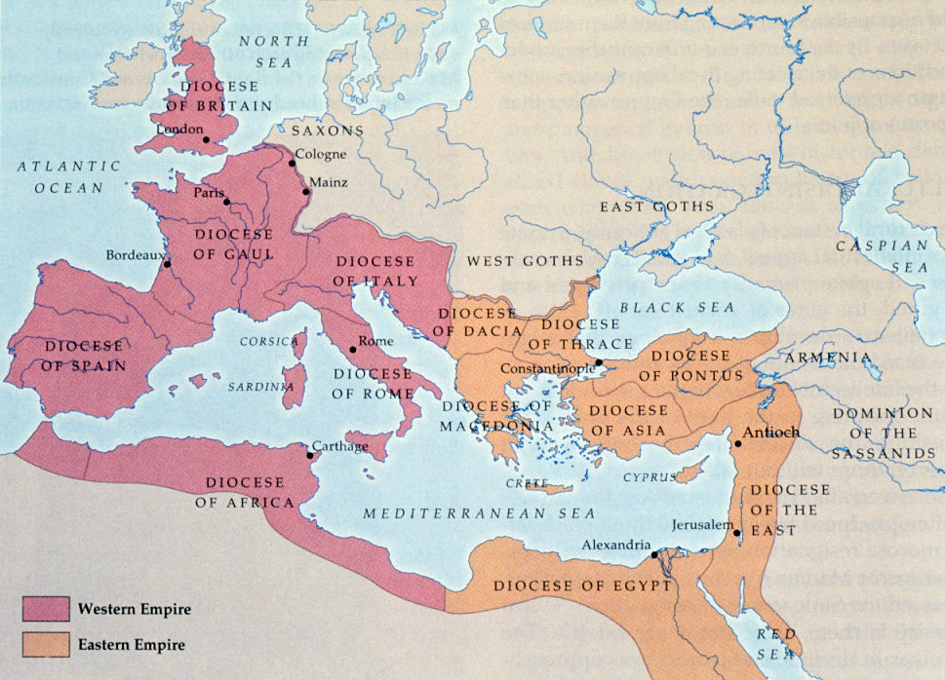
The Second Triumvirate
The members of the second Triumvirate began quarreling almost at once.
Octavian soon forced Lepidus to retire from politics and divided the Roman lands into two different parts, the East which was controlled by Mark Anthony and the West that Octavian controlled.

Slide 7
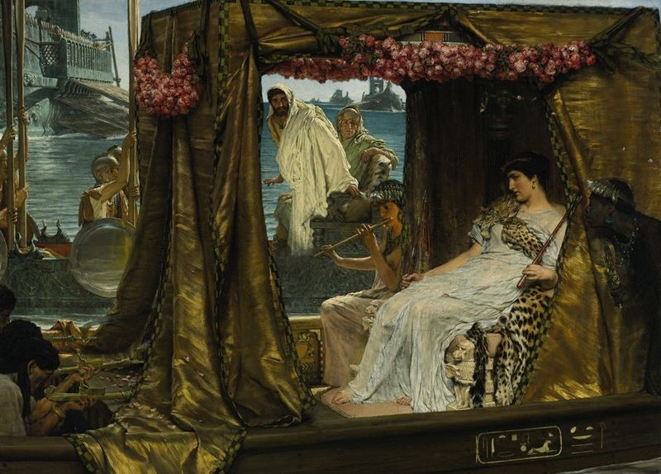
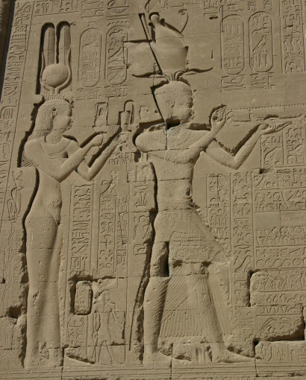
The Second Triumvirate
In short order, Octavian and Mark Antony came into conflict.
Mark Anthony fell in love with the Egyptian queen Cleopatra VII and formed a powerful military alliance with her kingdom.

Slide 8
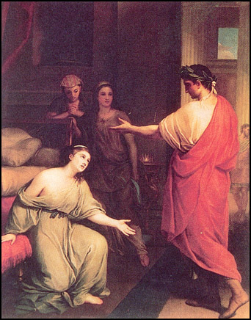
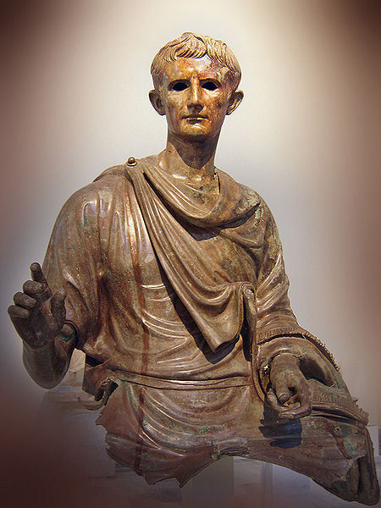
The Second Triumvirate
Octavian was extremely angry at this, so he told the Romans that Antony, with Cleopatra’s help, planned to make himself sole ruler of Rome!
This alarmed many Romans and enabled Octavian to declare war on Mark Anthony.

Slide 9
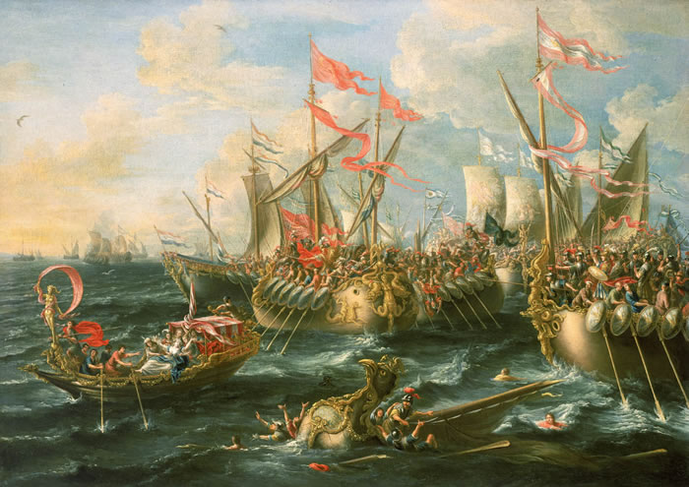
The Second Triumvirate
In 31 B.C.E., at the Battle of Actium off the west coast of Greece, Octavian crushed the army and navy of Cleopatra and Mark Anthony.
Without the Battle of Actium, there might not have been a Roman emperor…the battle is that important.

Slide 10
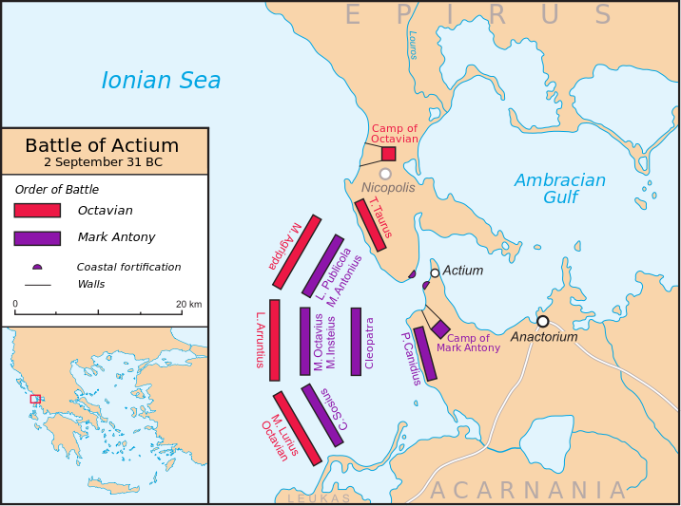
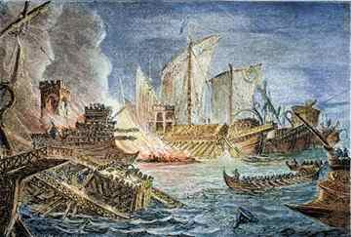
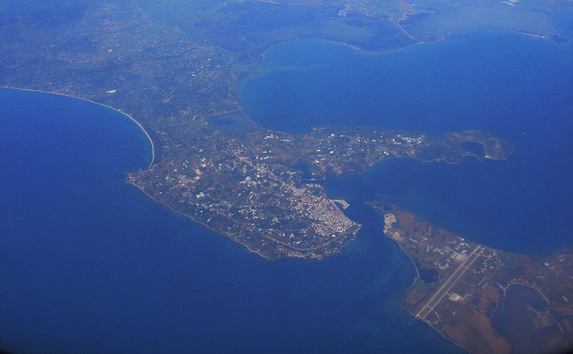
The Second Triumvirate
The Battle of Actium was also an important turning point in the history of the relationship between Egypt and Rome.
When Octavian met the combined forces of Mark Antony and Queen Cleopatra of Egypt, Roman forces faced Roman forces, pretty evenly matched.

Slide 11
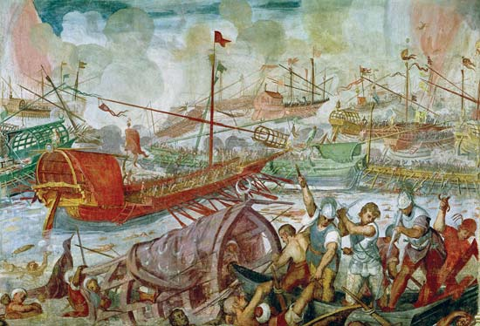
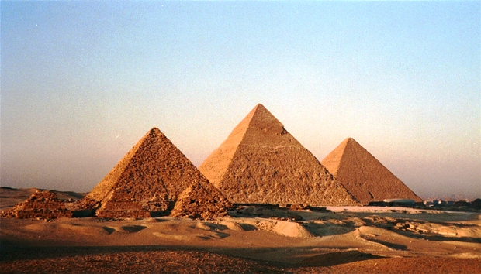
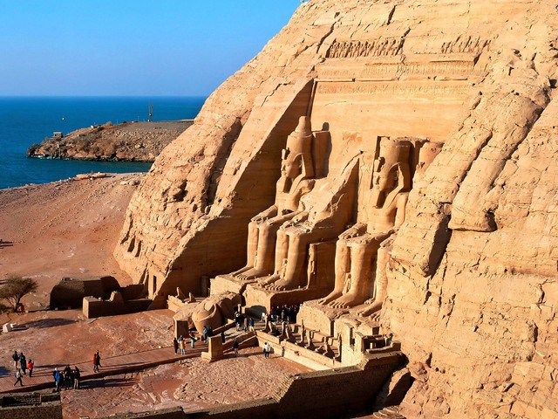
The Second Triumvirate
The fighting continued throughout the day of September 2, 31 B.C., until, mysteriously, Cleopatra took her troops and left the naval battle.
Mark Antony, leaving his troops behind, followed her to Egypt.

Slide 12
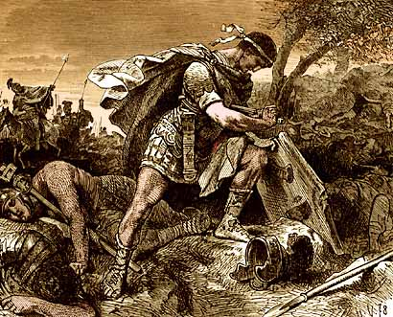
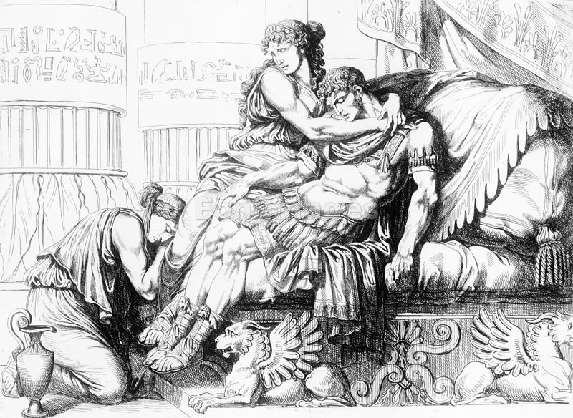
The Second Triumvirate
A year later, as Octavian closed in on them in Egypt, Mark Antony and Cleopatra killed themselves.
Mark Antony, as a soldier, took the soldier's way out by stabbing himself with his sword…the ancient term for this is "falling on his sword".

Slide 13
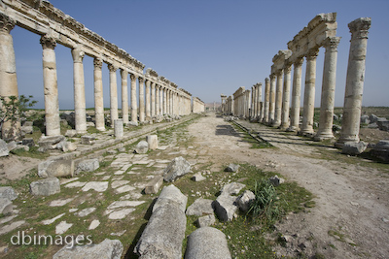
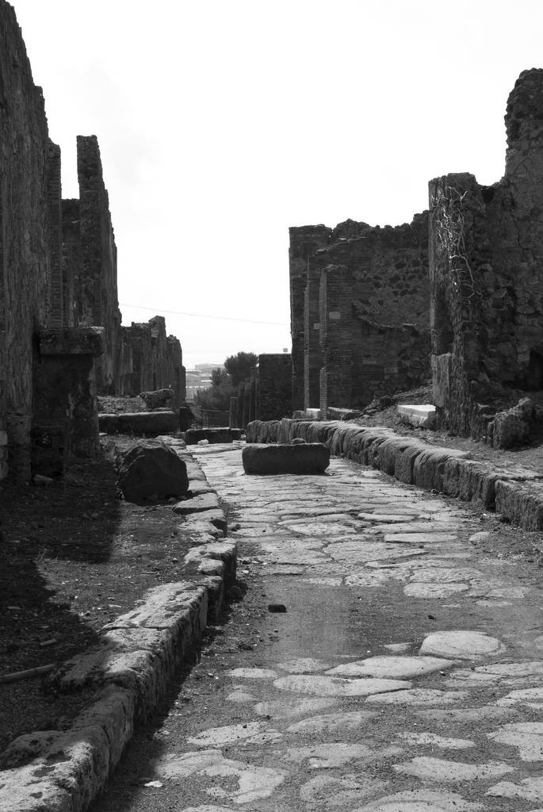
The Second Triumvirate
What happened to Cleopatra…Roman custom was to put the leaders of conquered peoples in chains, displaying the defeated person to the people of Rome during a March of Triumph throughout the city.
Following the parade the Romans would burn the conquered leader alive in the public square…Cleopatra obviously did not want this….her sister Arsinoe had gone through a brutal Roman death.

Slide 14
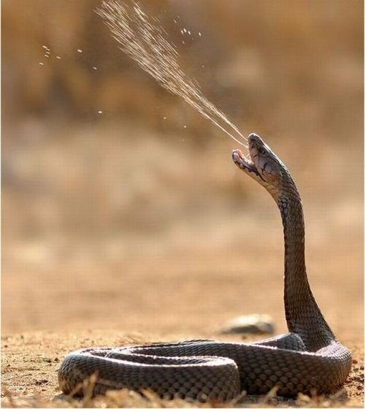
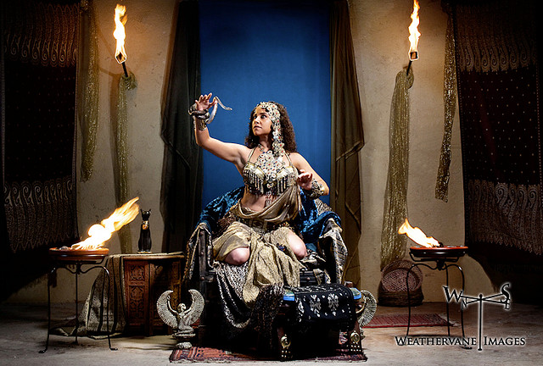
The Second Triumvirate
It is said that when Cleopatra heard of the disaster at the battlefield, she knew that all was lost.
She went into her tomb along with her two handmaidens and a basket of figs which contained two asps, which are incredibly poisonous.

Slide 15
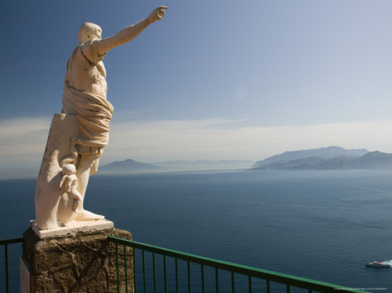
The Second Triumvirate
Octavian, at the age of 32, now stood alone on the top of the Roman world.
The period of civil war was over, but so was the Republic of Rome…Octavian would lay the foundation for a new system of government…the Roman Empire.

Slide 16
The Second Triumvirate
Questions:
1) What grandnephew of Caesar inherited his wealth?
2) Who were the three members of the Second Triumvirate?
3) What was the Battle of Actium?
4) Why was the Battle of Actium called a turning point in Rome?
5) What happened to Mark Antony and Cleopatra?

Slide 17
The Second Triumvirate
Questions:
1) What grandnephew of Caesar inherited his wealth?
Octavian
2) Who were the three members of the Second Triumvirate?
Mark Antony, Marcus Lepidus and Octavian
3) What was the Battle of Actium?
Battle where Octavian crushed the army and navy of Cleopatra and Mark Antony
4) Why was the Battle of Actium called a turning point in Rome?
There might not have been a Roman emperor
5) What happened to Mark Antony and Cleopatra?
Committed Suicide

Slide 18
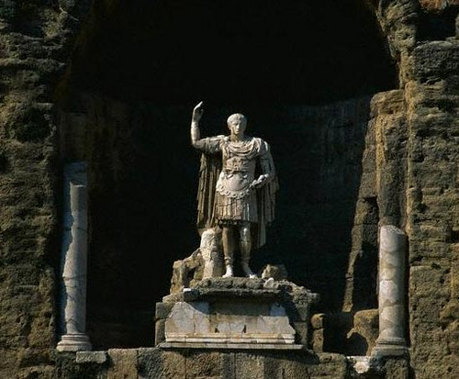
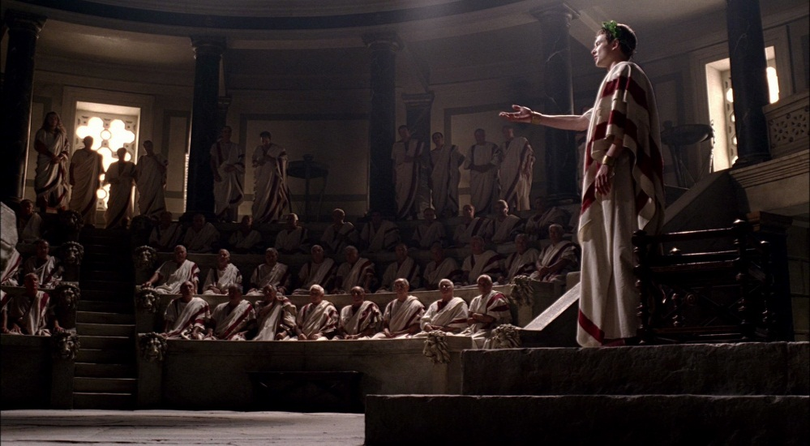
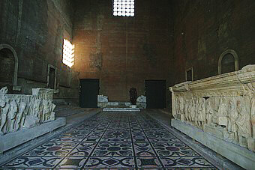
Who was Augustus?
Octavian could have made himself dictator for life, like Julius Caesar did.
He knew, though, that many people favored a republic form of government…who remembers what a republic is?

Slide 19
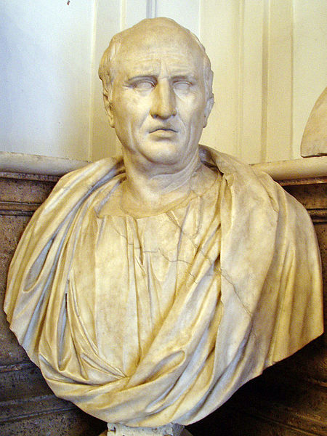
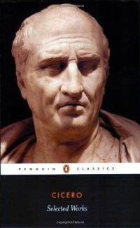
Who was Augustus?
One such person was Marcus Cicero, a political leader, writer and Rome’s greatest public speaker.
His writings, including speeches and letters, are some of the most important sources of Roman history…they give an insight into the political and social structure of the Roman Republic.

Slide 20
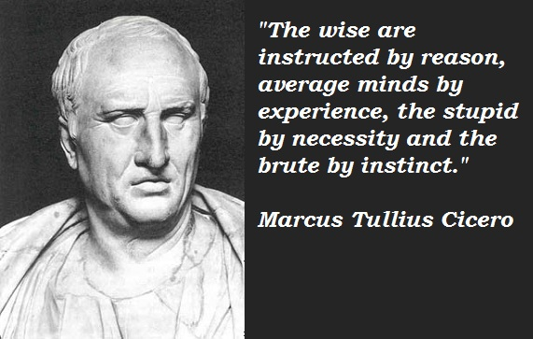
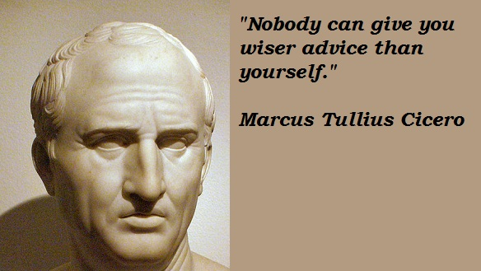
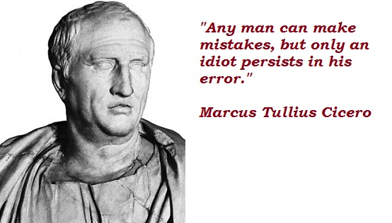
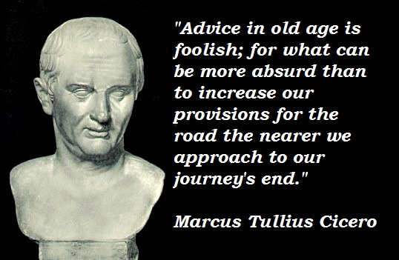
Who was Augustus?
Cicero had argued against dictators and called for a representative government with limited powers.
Cicero’s speeches and books swayed many Romans.

Slide 21
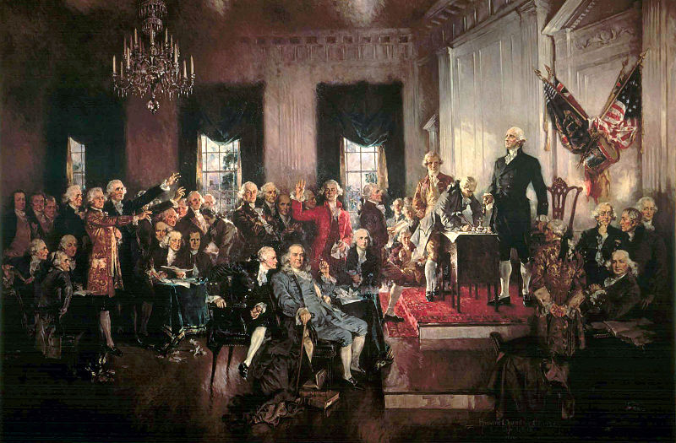
Who was Augustus?
Centuries later, his ideas would profoundly influence the writers of the United States Constitution.

Slide 22
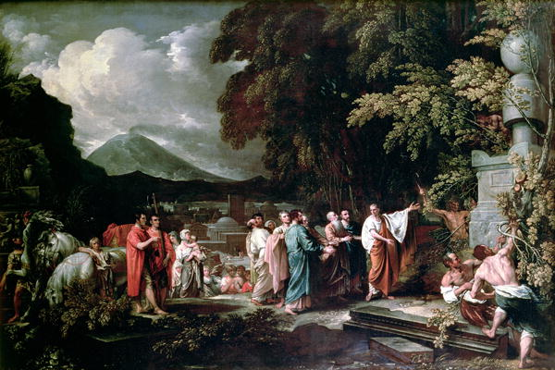
Who was Augustus?
Although Cicero did not live to see Octavian rule, he had supported him, hoping that he would restore the Republic.
In 27 B.C.E. Octavian announced that he was going just that, restoring the Roman Republic.

Slide 23
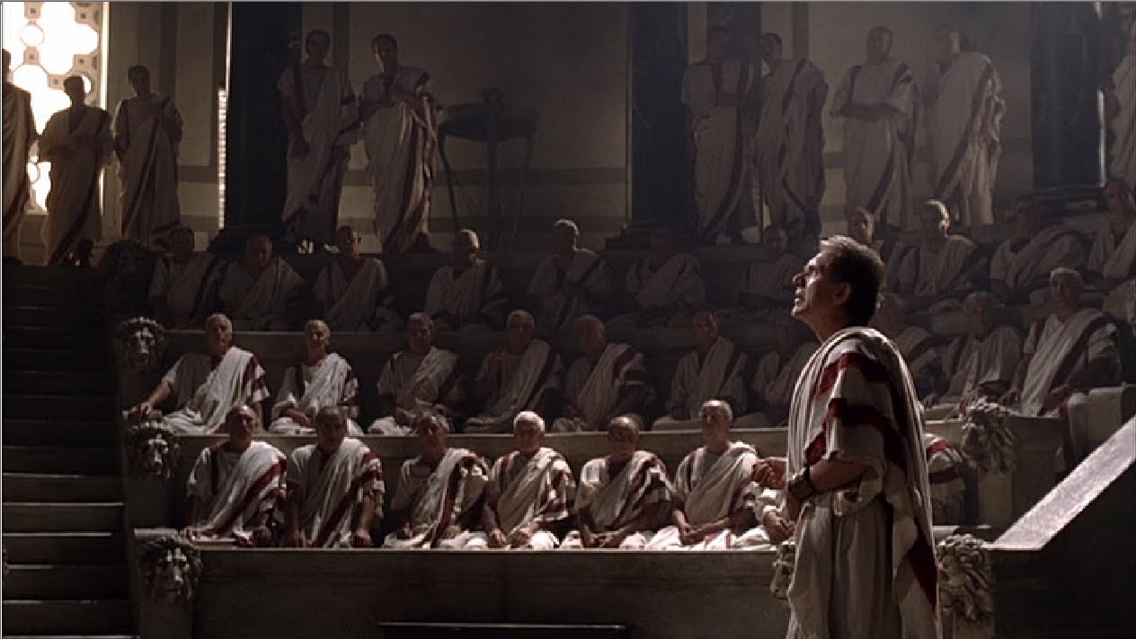
Who was Augustus?
He knew the Senate wanted this form of government.
However, Octavian also knew that the Republic had been too weak to solve Rome’s problems.

Slide 24
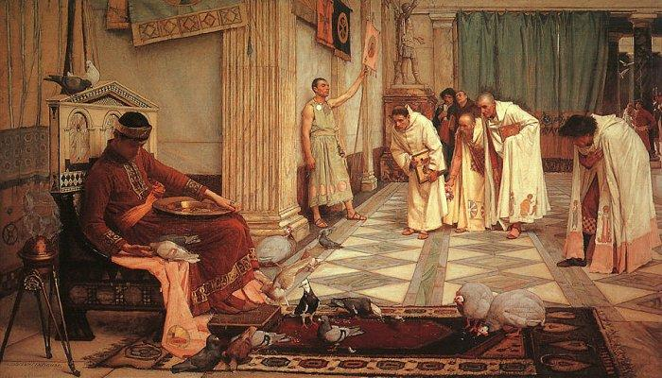
Who was Augustus?
Although he gave some power to the Senate, he really put himself in charge of the entire operation.
He called himself “princeps” which means “first citizen.”

Slide 25
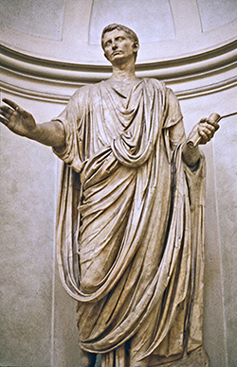
Who was Augustus?
The senate called him, “Imperator”, which translates to “Commander in Chief”, but it would eventually come to mean “Emperor”.

Slide 26
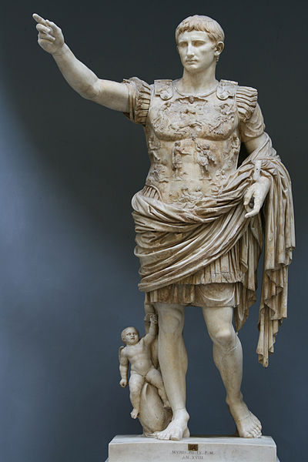
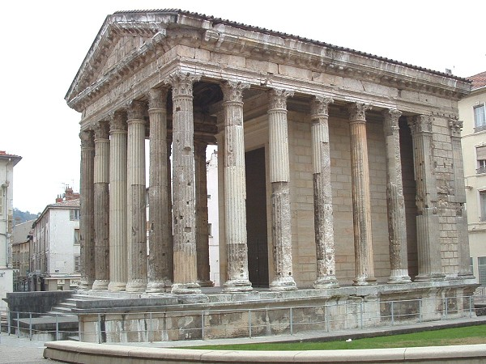
Who was Augustus?
Octavian then went on to adopt a new name.
He took the title of “Augustus” which means “the revered or majestic one”… from this point on, he was known by this name.

Slide 27
Who was Augustus?
Questions:
6) Who was Cicero?
7) What document, written centuries after Cicero died did he influence?
8) What does Octavian's title “Imperator” translate too and also mean?
9) What was the new name that Octavian took?
10) What did Octavian's new name mean?

Slide 28
Who was Augustus?
Questions:
6) Who was Cicero?
A political leader, writer and Rome’s greatest public speaker
7) What document, written centuries after Cicero died did he influence?
The United States Constitution
8) What does Octavian's title “Imperator” translate too and also mean?
“Commander in Chief” but really meant “Emperor”
9) What was the new name that Octavian took?
Augustus
10) What did Octavian's new name mean?
“The revered or Majestic One”

Slide 29
Who was Augustus?
Persuasive Writing:
Imagine you are a Roman Citizen. Decide whether you would have been for or against Julius Caesar’s rise to power and his reforms.
Then write a newspaper article explaining your views…be sure to include facts to support your opinions.

