Slide 1
The Franks
And the early middle ages

Slide 2
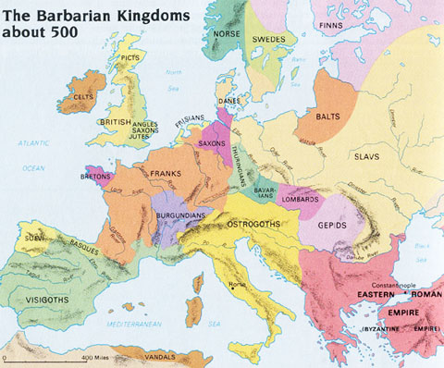
As the Roman Empire fell, many barbarian tribes came into the area

Slide 3
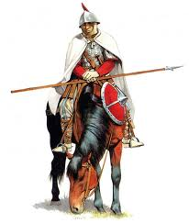
The Franks
Of all the groups, the Franks had the most impact.
Franks lived in modern day France.
Skilled Calvary
What advantage would that give them?

Slide 4
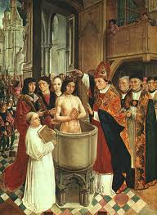
Clovis
United Frank tribes
First King of the Franks
Baptized on Christmas day 496 A.D
Unites Kingdom of the Franks with the Catholic Church.
What impact will this have?

Slide 5
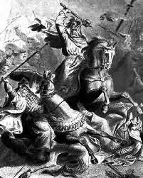
Charles Martel (the hammer)
Charles was not the king, he was like the king’s right hand man
He acted like the king since the real king didn’t do much (or have much respect by the people)
He stopped the Islamic invasion on the France/ Spain border
If not for him all of Europe may have become Muslim

Slide 6
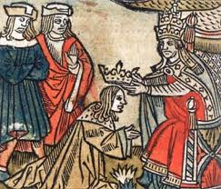
Pepin the Short
Son of Charles Martel
Has the Pope crown him king of the Franks in exchange for protection of Rome.
Continues and grows the Catholic-Frank partnership

Slide 7
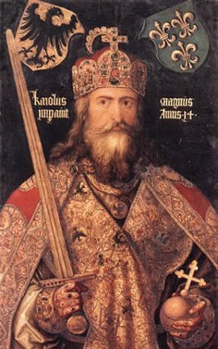
Charlemagne
Rules Franks from 768-814 AD
Named Holy Roman Emperor by the Pope
  A Fancy title that continues the relationship and protection of Catholicism
The relationship between the Franks and the Catholic Church sets up both as the powerhouses of the middle ages!!

Slide 8
He changed the course of history
By spreading Christianity
By uniting almost all of Europe
By protecting the Holy Roman Church
By documenting history
By turning enemies into friends
By using the feudal system
By introducing education

Slide 9
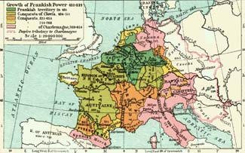

Slide 10
Medieval Life
War, death and disease
Populations were clustered around strongholds
The narrow lanes in towns were crawling with beggars and lepers
Agriculture was the common man’s duty
People were Superstitious and fearful of change
Education was mainly for the Church and nobility
The common story told of the former Roman Empire was that God had given and God had taken away.

Slide 11
Structure of government:
Feudalism
Like a pyramid: King at top, lords, nobles, vassals and finally serfs.
King had final word, lords and nobles enforce
There was no standing army, only militia
No civil service or merchant class
On a Democratic aspect, Charlemagne held meetings of higher classes to debate the state of the Empire.

Slide 12
“Homage and Fealty”
This was the glue of the feudal system
It was romanticized and very symbolic but just like contract.
Means to be faithful to king and noble until your death.
The vassal swore on bended knee:
  “To do service and reverence as far as a freeman may, and not at any time of my life withdraw myself from your power. At my death my property shall return to your hands.”

