Slide 1
The Road To World War II

Slide 2
A Totalitarian Government is….
A form of government that restricts personal freedoms and prohibits political opposition.

Slide 3
A Totalitarian Dictator is….
The leader of a totalitarian government which does not allow political opposition and seeks to control all areas of society and citizens’ lives.

Slide 4
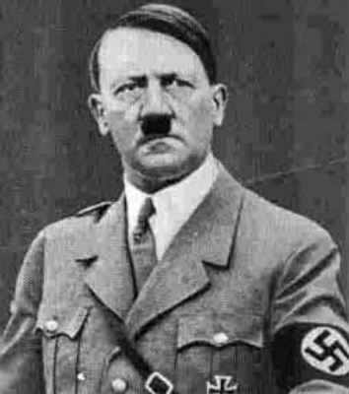
Totalitarian Governments & Leaders
Adolf Hitler
Germany
Socialist (Nazi)
Socialist (Nazi) Ideology
State over individuals and human rights.
Control all aspects of German society.
Redistribute wealth, welfare state, nationalism & pride through propaganda.
Sought ownership of key industries: banks, schools, Germany’s healthcare system, segments of the church.

Slide 5
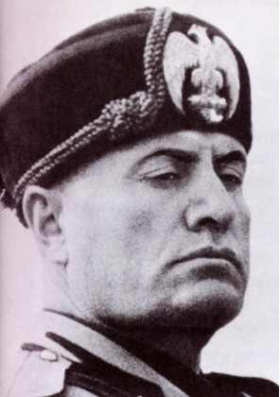
Totalitarian Governments & Leaders
Benito Mussolini
Leader of Italy
Fascist
Fascist Ideology
State over individual.
Uses power to control property owners.
Citizens are expected to support the government.
Everything serves the government: businesses, schools, the media.

Slide 6
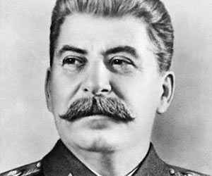
Totalitarian Governments & Leaders
Joseph Stalin
Soviet Union
Communist
Communist Ideology
Workers unite to overthrow capitalism.
Governments not necessary, people share resources to survive.
Welfare of state over individuals.
State owned nearly all property; limited personal freedoms.

Slide 7
Germany Invasions, Pre-1939
Rhineland--------March 1936
Austria-----------March 1938
Sudetenland----September 1938
Bohemia-Moravia------March 1939
Slovakia----------March 1939

Slide 8
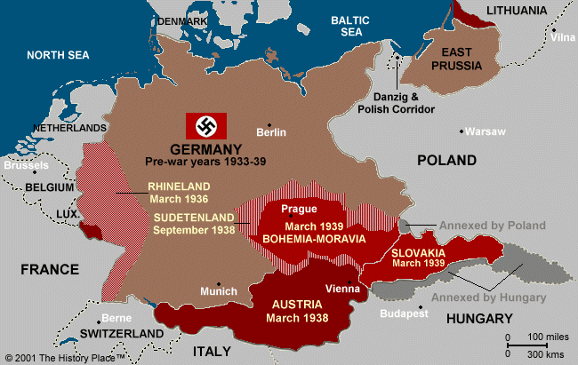
Countries Invaded By Germany, Pre-1939

Slide 9
Meeting at Munich, 1938
A treaty was signed agreeing to Hitler’s capture of Sudentenland in exchange for his promise not to invade anymore territories.
Such an approach is known as appeasement, the practice of giving aggressors what they want and hoping they will be satisfied and stop the aggressive behavior.

Slide 10
Meeting at Munich, 1938
Who were the three signers of the Munich treaty?
Germany
France
Great Britain

Slide 11
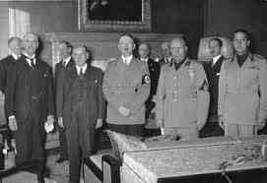
Meeting at Munich, 1938
Leaders:
Center:
Adolf Hitler,
Germany
Left:
Neville Chamberlain,
Great Britain
Right:
Edouard Daladier, France

Slide 12
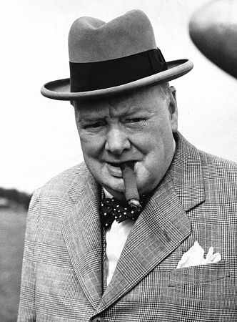
Winston Churchill
Prime Minister of Great Britain during WWII.
Said after the Meeting at Munich (when he was a member of Parliament): “Britain and France had to choose between war and dishonor. They chose dishonor. They will have war.”

Slide 13
Japanese Aggression
Natural Resources are the main reason Japan decided to conquer territory in the South Pacific.
Japan invaded Manchuria, a province of China, in 1931.

Slide 14
Japanese Aggression
Between 1937 and 1939 Japan tried to seize the rest of China. They were successful along the coast, but not in the countryside.
In 1940 Japan allies with Germany and Italy to form the Axis Powers.

Slide 15
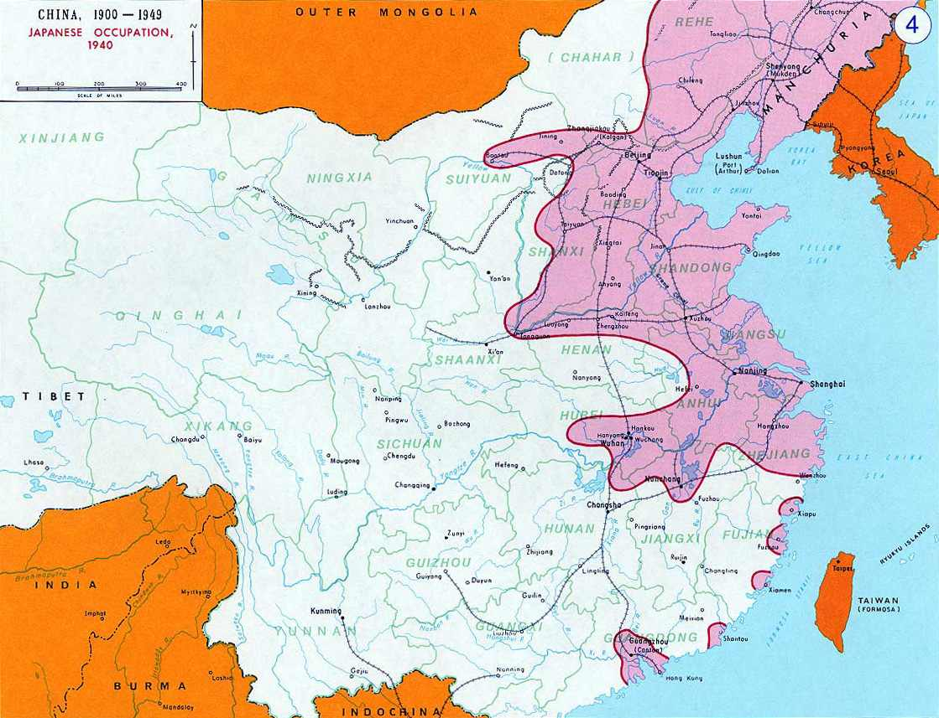
Japanese Aggression in China

Slide 16
U.S. Policy: Isolation & Neutrality
Despite the concerns caused by aggressive dictators in Europe and Japan, the United States continued to practice isolationism, the policy of:
The U.S. staying out of any alliances that could drag it into war in Europe or Southeast Asia.

Slide 17
U.S. Policy: Isolation & Neutrality
Responding to the isolationist sentiment, Congress passed the Neutrality Act of 1935. The Act:
Prohibited the sale of weapons to warring nations and was meant to keep the U.S. from forming alliances that might drag the nation to war.

Slide 18
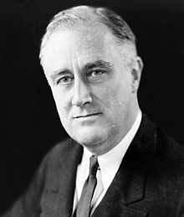
U.S. Policy: Isolation and Neutrality
President Roosevelt—
Knew that it would be difficult for the U.S. to stay out of a conflict in Europe.

Slide 19
U.S. Policy: Isolation and Neutrality
Video Clip:
PBS American Experience:
FDR on Policing The World
Video: FDR on Policing the World: Hitler's Threat | Watch American Experience Online | PBS Video

Slide 20
World War II Begins in Europe
Hitler believed the German people needed lebensraum, which means “living space”. He intended to achieve this goal by conquering the Soviet Union, use its land for the German people, and control its rich natural resources.
*[This is why Hitler invaded the Soviet Union!!]

Slide 21
WWII Begins in Europe
Hitler signed a non-aggression pact with Joseph Stalin. The pact was an agreement that neither country would attack the other. Both men believed the pact was a strategic move: Hitler saw it as a way to keep the USSR from attacking Germany, while Stalin saw it as a way to provide the USSR with time to prepare for Germany’s inevitable invasion.

Slide 22
WWII Begins in Europe
In September 1939 Hitler’s army invaded Poland. The new type of military strategy the Germans used is called blitzkrieg (meaning “lightening war”). This strategy involved striking fast and hard with tanks and airplanes, catching other nations off guard and allowed Germany to quickly overwhelm the nations it invaded.

Slide 23
The Lend-Lease Act
1941: Roosevelt is convinced that the U.S. cannot stay out of the war much longer, even though most citizens favor neutrality.
March 1941: Congress passes the Lend-Lease Act, which enables the president to send aid to any nation whose defense is considered vital to the United States’ national security. This enables the U.S. to aid Great Britain.

Slide 24
The Lend-Lease Act
One of the greatest dangers to the U.S. Lend-Lease policy was the German U-boats, which were submarines that traveled underwater and could torpedo and sink ships believed to be carrying weapons and supplies to Great Britain.

Slide 25
The Lend-Lease Act
To help carry out Lend-Lease trade, the United States manufactured Liberty Ships, which were cargo ships especially for the purpose of transporting U.S. goods to Great Britain to support its war effort against the Nazis.

Slide 26
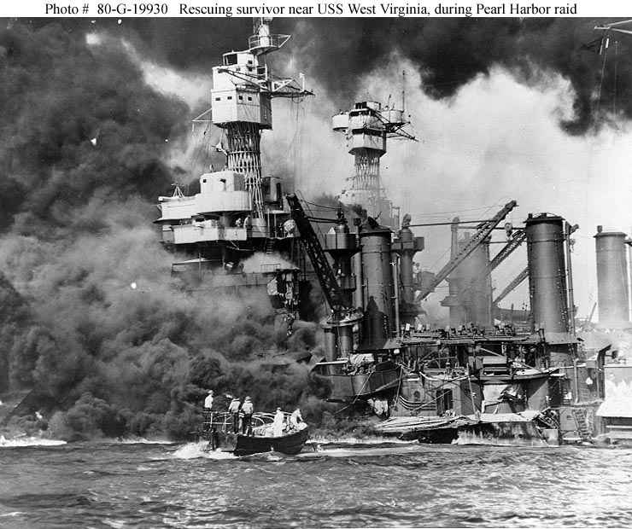
The U.S. Enters War: Pearl Harbor

Slide 27
The U.S. Enters War: Pearl Harbor
Japan had become an imperialist force in Eastern Asia. Its military invaded foreign territories in the region with the goal of gaining resources.
In 1941, when Japan set its sights on conquering more of Eastern and Southeast Asia, the United States imposed an embargo on oil and steel. After the embargo, Japan set its sights on going after the rich natural resources of the Dutch East Indies.

Slide 28
The U.S. Enters War: Pearl Harbor
Japan viewed the U.S. naval fleet anchored at Pearl Harbor, Hawaii as a threat to its ability to conquer the territories it wanted.

Slide 29
The U.S. Enters War: Pearl Harbor
Japanese Admiral Isoroku Yamamoto devised a plan to sail six (6) aircraft carriers across the Pacific undetected. Once in place, these carriers would launch a surprise attack on Pearl Harbor. The Japanese ships maintained radio silence on their way to Hawaii.

Slide 30
The U.S. Enters War: Pearl Harbor
The United States believed the Japanese would attack but did not know where. They believed that the waters of Pearl Harbor would be too shallow for Japanese planes to drop torpedoes.

Slide 31
December 7, 1941
Japanese airplanes began the first wave of bombings on the Pacific Fleet at Pearl Harbor.
United States military personnel detected the incoming planes on radar, but they ignored the warning because they thought it was U.S. planes arriving from the mainland.

Slide 32
December 7, 1941
In less than two hours, the Japanese air attack sank or seriously damaged a dozen (12)naval vessels, destroyed almost two hundred (200) warplanes, and killed or wounded nearly three-thousand (3,000) people.

Slide 33
December 8, 1941
President delivers a speech. He describes December 7, 1941 as:
“a day which will live in infamy!”
WWII in HD — Attack on Pearl Harbor — History.com Videos

Slide 34
December 8, 1941
Both houses of Congress approved a declaration of war against Japan and later against Germany and Italy as well.

Slide 35
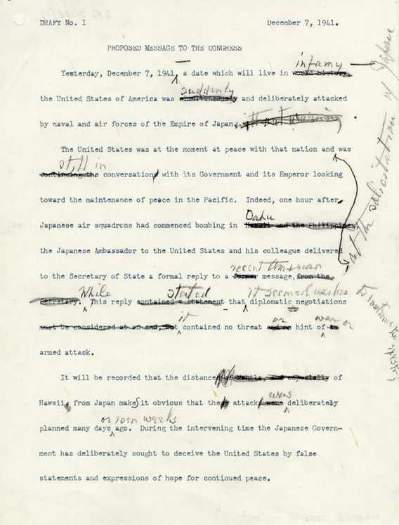
December 8, 1941

