Slide 1
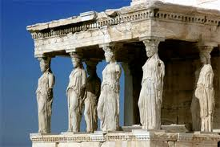
Welcome to Ancient Greece!

Slide 2
GEOGRAPHY
Greece is a peninsula, which means that it is surrounded on three sides by water. Greece has a lot of smaller peninsulas sticking out from it, which means Greece enjoys many natural harbors.

Slide 3
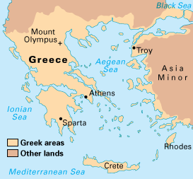
VOCAB WORD
Peninsula: a portion of land that is nearly surrounded by water.

Slide 4
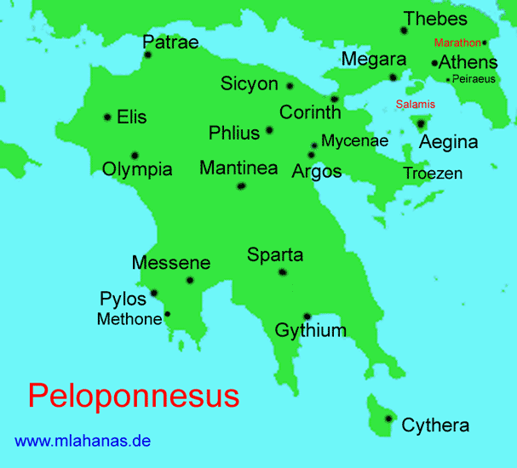
VOCAB WORD
Peloponnesus: The large southern peninsula in Greece.

Slide 5
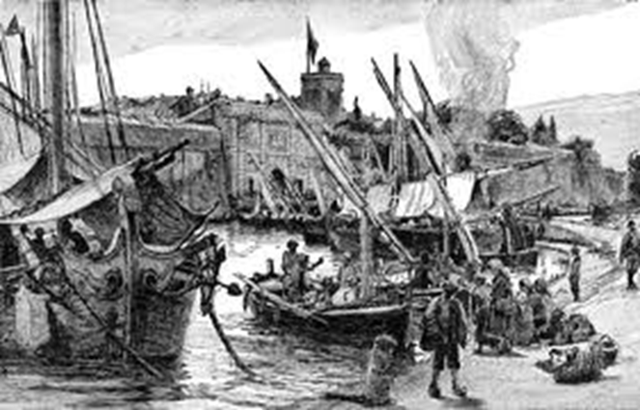
VOCAB WORD
Harbor: a sheltered port where ships can take on or discharge cargo.

Slide 6
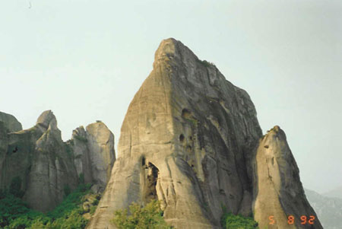
Greece is also covered with mountains, which made it hard to get around by foot, and hard to grow grain in some parts.
Three thousand years ago, it was very difficult to get from place to place in ancient Greece by walking. But it was easy to get from place to place in Greece by boat.

Slide 7
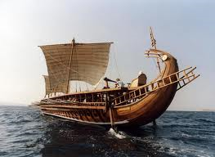
In the ancient world that grew up around the Mediterranean Sea, the Greeks became known as great sailors. They sailed about the Mediterranean, setting up colonies and outposts where they could.

Slide 8
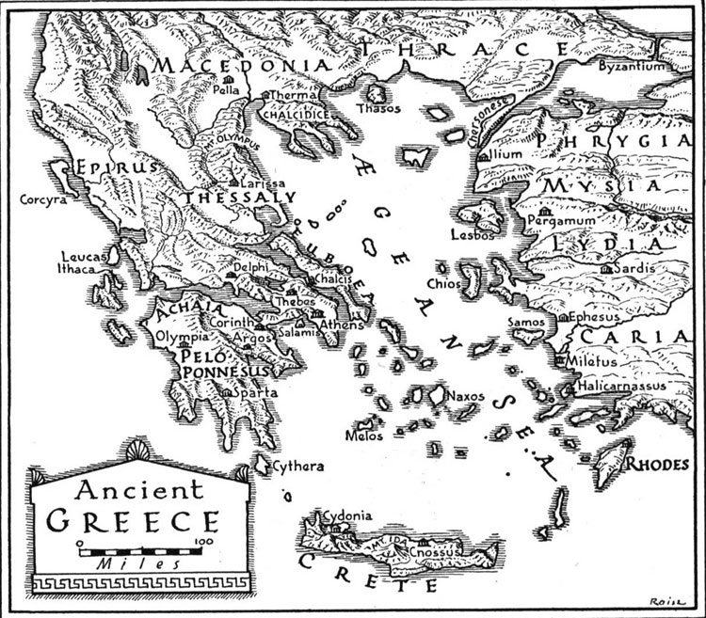

Slide 9
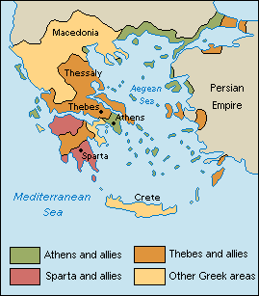
VOCAB WORD
City-State: A city that acts like its own nation.
It’s kind of like if Logan acted
like its own country, with its own
President, laws, and flag.

Slide 10
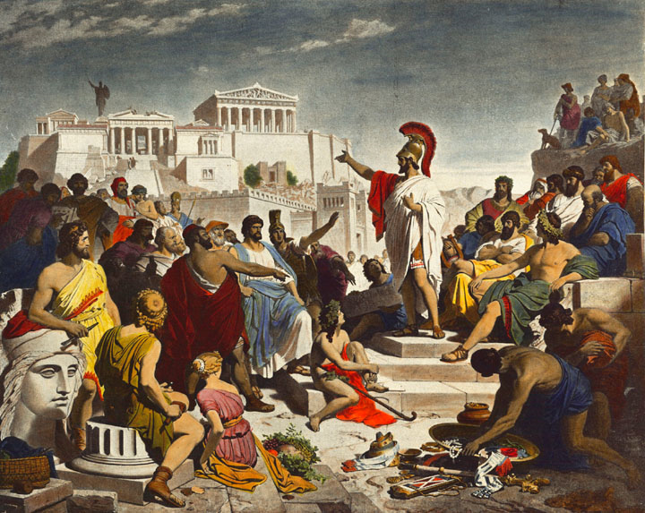
Government
City-States need good leadership to function properly. What is the best way to run things?

Slide 11
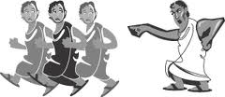
Bad
Tyrant: Someone who takes complete control without following the law or constitution.

Slide 12
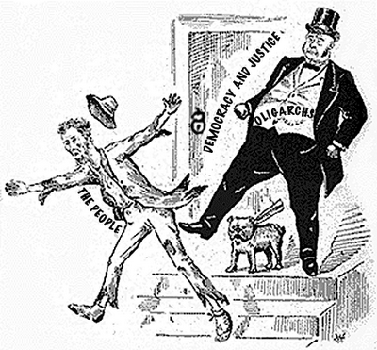
better
Oligarchy: A type of government where only the richest and most powerful citizens controlled decision-making.

Slide 13
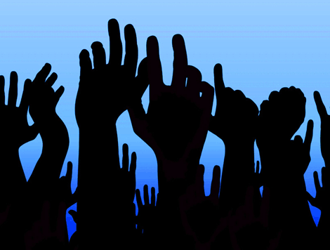
best
Democracy.

Slide 14
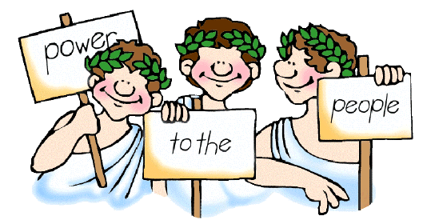
VOCAB WORD
Democracy: A system of government where the citizens vote to make decisions.

Slide 15
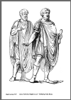
Who were citizens?
A citizen is a person who has rights and responsibilities in their community. Only men could be citizens, and not even all men were granted this right. Women had few rights, and slaves could not be citizens either.

Slide 16
Let’s practice!
We have a few options for our next big class project. They are:
Present a mythological play
Create a research project on a person or event from Ancient Greece.
Let’s take vote on which ones we’ll do, Ancient Democracy style.

Slide 17
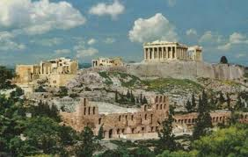
Vocab word
Polis: A City-State in ancient Greece.

Slide 18
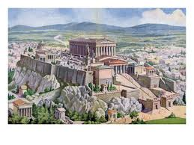
Vocab word
Acropolis: A large hill in ancient Greece where city residents found shelter in times of war.

Slide 19
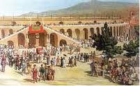
Vocab word
Agora: The marketplace and meeting place in Greece cities.

Slide 20
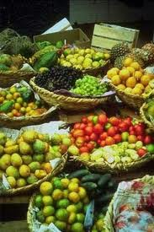
Vocab word
Commodity: Something that can be bought or sold.

Slide 21
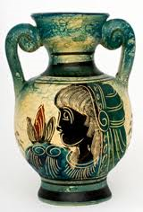
Common commodities
One of the most important commodities of ancient Greece was pottery.
It was used to store goods and wine on long voyages.
It was also collected as a work of art.

Slide 22
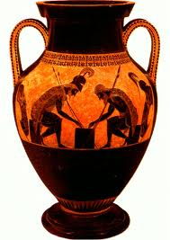

Slide 23
30 second discussion
What kind of commodities come from our community?

Slide 24
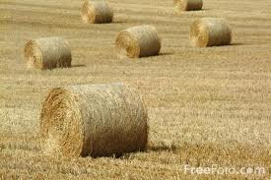
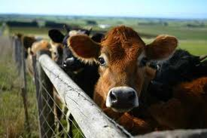
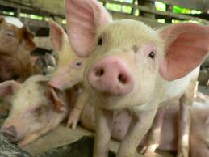
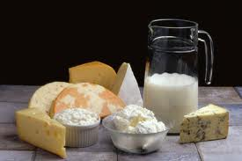

Slide 25
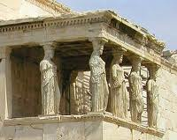
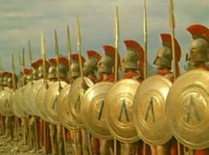
Star city-states
ATHENS and SPARTA were the most famous Greek city-states.
Athens Sparta

Slide 26
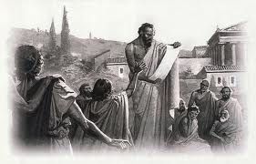
Vocab word
Athens: A city-state known for democracy.

Slide 27
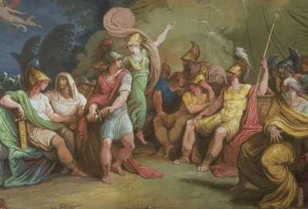
Who makes the law?
Assembly: A law-making part of government made up of citizens.

Slide 28
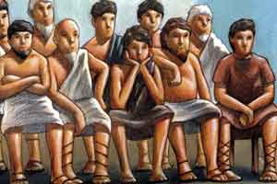
What if you break the law?
Jury: A group of citizens that make a decision in court.

Slide 29
Vocab word
Athens was also the intellectual center for Greece. People were able to sit and ponder the mysteries of life.
Philosophy: The search for truth, wisdom, or the right way to live.

