Slide 1
The Great War Western Front
Germans, Austria-Hungarians vs. French, British and later Americans
Germany develops the Schlieffen Plan
Battle of the Marne (1914- German Defeat)
Trench Warfare on the Western Front

Slide 2
Western Front: Battles
Battle of Verdun
Ten months long
French and German armies.
Estimated 540,000 French and 430,000 German casualties
No strategic advantages were gained for either side.
Battle of Somme
English and French vs Germany
Six months of fighting
Five miles of advancement for Allies
1 million men killed

Slide 3
Eastern Front
Russians and Serbs vs. Germans and Austria-Hungarians
War more mobile but still a stalemate
Russia’s disadvantages
Not Industrialized
Short on Supplies
Russia’s advantage
People

Slide 4
Eastern Front: Battles
Battle of Tannenberg:
August 1914- First major eastern battle.
Russia was badly defeated and pushed back.
Russia lost millions of men against Germany, undersupplied, under gunned

Slide 5
Other Fronts
Japan, Australia, India join Allies
Ottoman Turks, Bulgaria join Central Powers
Gallipoli Campaign in the Ottoman Empire
Battles occur in Africa and Asia for Colonial Possessions

Slide 6
Russia Exits the War
In March 1917, Nicholas II abdicates his throne,
the Russian Duma continues to fight.
In October 1917: Lenin and the Bolsheviks take command: The Soviet Union is created.
March 1918: Soviets and Germans sign the Treaty of Brest-Litovsk, ending the war in the East.

Slide 7
US claims Neutrality
I didn’t raise my boy to be a soldier
I brought him up to be my pride and joy
Who dares to place a musket on his shoulder,
To shoot some other mother’s darling boy?

Slide 8
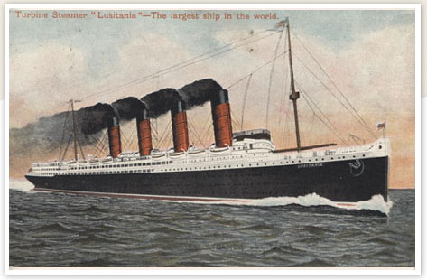
· THE U.S. ENTERS THE WAR Georpedoed the Lusitania, a British passenger ship, killing approximately 1,200 people, including 128 Americans.

Slide 9
US Road to War
British Blockade
did not allow products to leave or enter Germany
German U-Boat Response
counter to blockade, destroy all boats headed for British shores

Slide 10
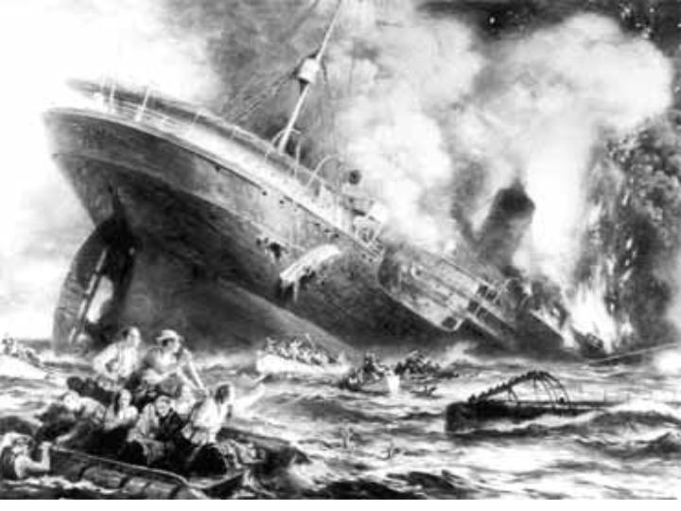
US Road to War
May 7th 1915
Sinking of the Lusitania

Slide 11
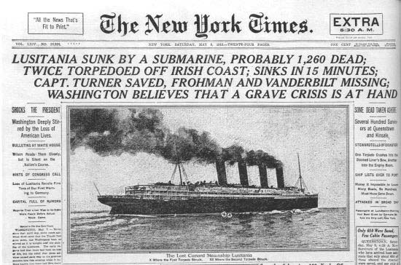
· Americans were infuriated with the destruction of the Lusitania.

Slide 12
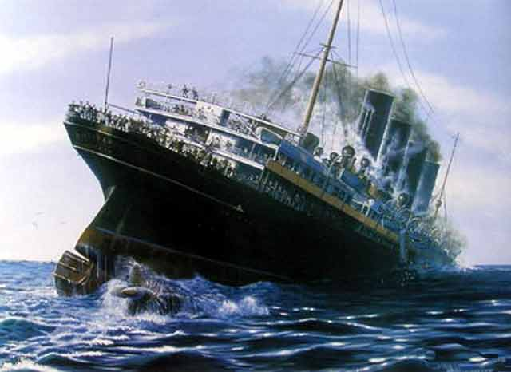

Slide 13
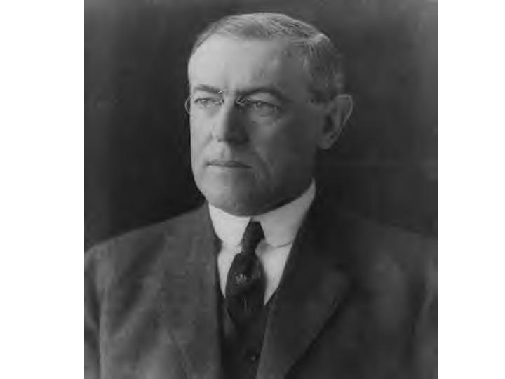
1916 Presidential Election And the Winner is…
Woodrow Wilson
Because
“he kept us out of the war”

Slide 14
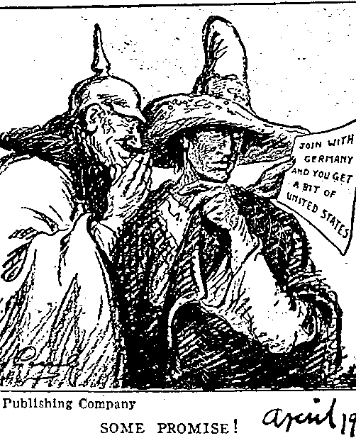
Moving Toward War
Zimmermann telegram:
The Last Straw
– secret message from Germany to Mexico urging Mexico to attack the U.S. if the U.S. declared war on Germany
– Germany promised to help Mexico regain land it lost to the U.S. in the Mexican War.
* The U.S. declared war on the Central Powers in 1917.

Slide 15
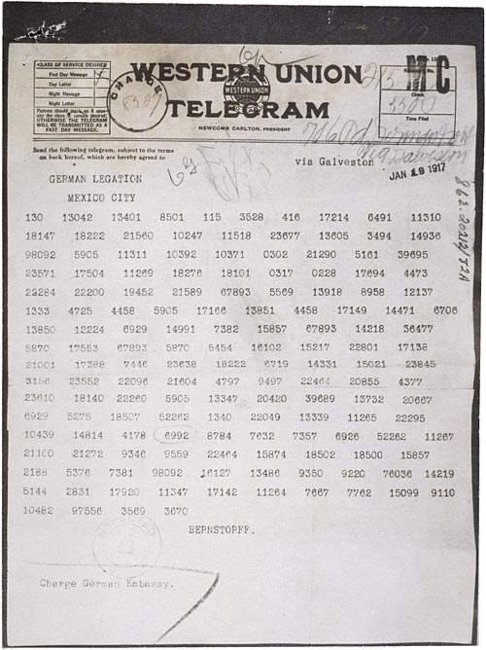
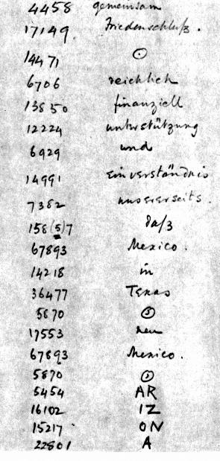
(above) Zimmermann Telegram as Received by the German Ambassador to Mexico, 01/19/1917 (right) decoded words

Slide 16
US Declares War
Senate Declares War April 4th 1917
House of Representatives Declares War April 6th 1917
Wilson’s reasoning for War
make the world “Safe for Democracy”

Slide 17
War on the Homefront
World War I as a Total War
All Resources devoted to homefront
Gov’t took over factories to make Military goods
All had to work (Women took place of men in factories)
Rationing- limit consumption of resources/goods necessary for the war effort
Propaganda- one-sided information to keep support for the war

Slide 18
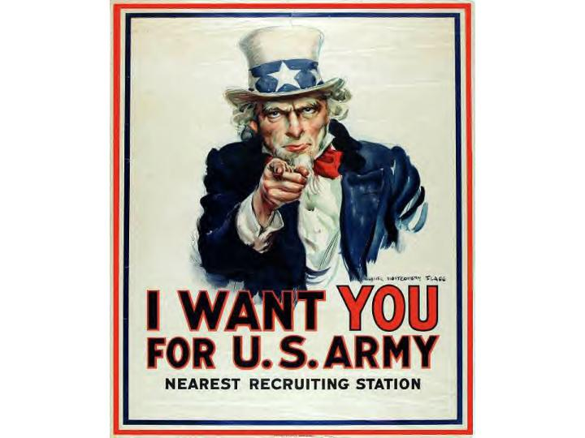
Propaganda US

Slide 19
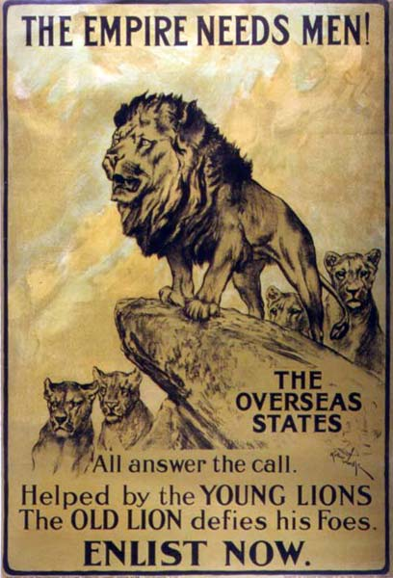
Propaganda Great Britain

Slide 20
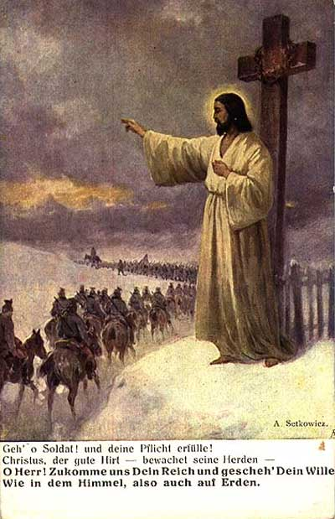
Propaganda Germany

Slide 21
Ending the War 1917-1918
US Enters the War in April of 1917
March 1918 Russia and Germany sign the Treaty of Brest-Litovsk
Germans now use all resources on Western Front
March of 1918 Germany begins a massive attack on France

Slide 22
Ending the War (1918) The Tide Turns
German troops fatigued
US had 140,000 “fresh” troops
2nd Battle of the Marne (June 1918)
Central Powers Crumble
Revolutions in Austria Hungary
Ottoman Empire surrenders
German soldiers mutiny, public turns against Kaiser Wilhelm II

Slide 23
Ending the War (1918)
Kaiser Wilhelm abdicates on November 9th 1918
11th hour of the 11th day of the 11th month in 1918 Germany agrees to a cease-fire
8.5 million soldiers dead
21 million soldiers wounded
Cost of 338 billion dollars

Slide 24
Ending the War The Paris Peace Conference
Meeting of the “Big Four” at the Paris Peace Conference
Wilson Proposes his “14 points”
“Big Four” create Treaty of Versailles
War Guilt Clause
Break up of German, Austrian, Russian and Ottoman Empire
Reparations
Legacy of bitterness and betrayal

Slide 25
Effects of World War I
Before World War I feeling of optimism and progress of Human Kind
After the War feelings of pessimism
New forms of Art, Literature, Philosophy and Science
(ex. Surrealism, “Lost” Generation, Psychoanalysis, Existentialism)

Slide 26
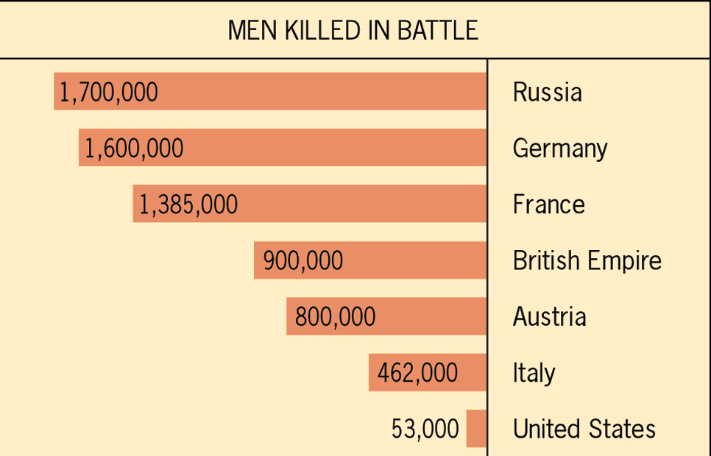
Figure 31.1: Approximate Comparative Losses in World War I

Slide 27
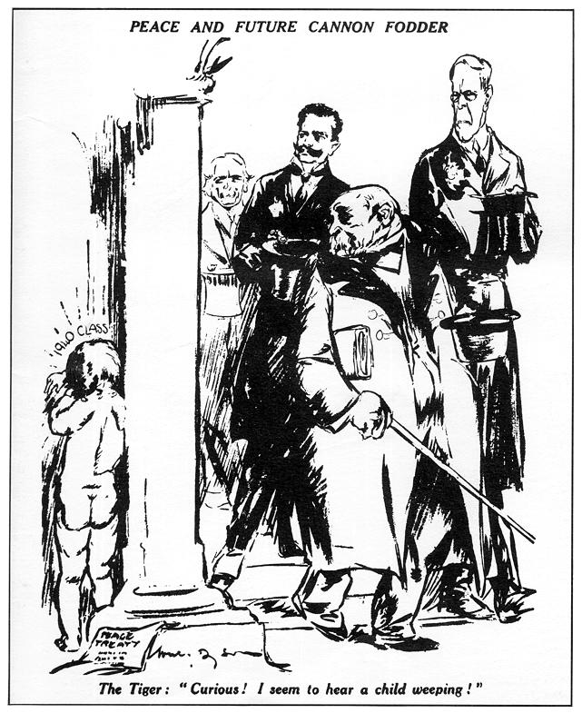
-Versailles Treaty
#19
- Germany was forced to:
· take full blame for the war
· completely disarm
· pay huge reparations to the Allies
· give up it’s colonies to the Allies
* Germany was an angry, humiliated nation, setting the stage for World War II.

